Slide 1
Lectures flop, so flip the classroom
Gunnar Karlsson
School of Electrical Engineering

Slide 2
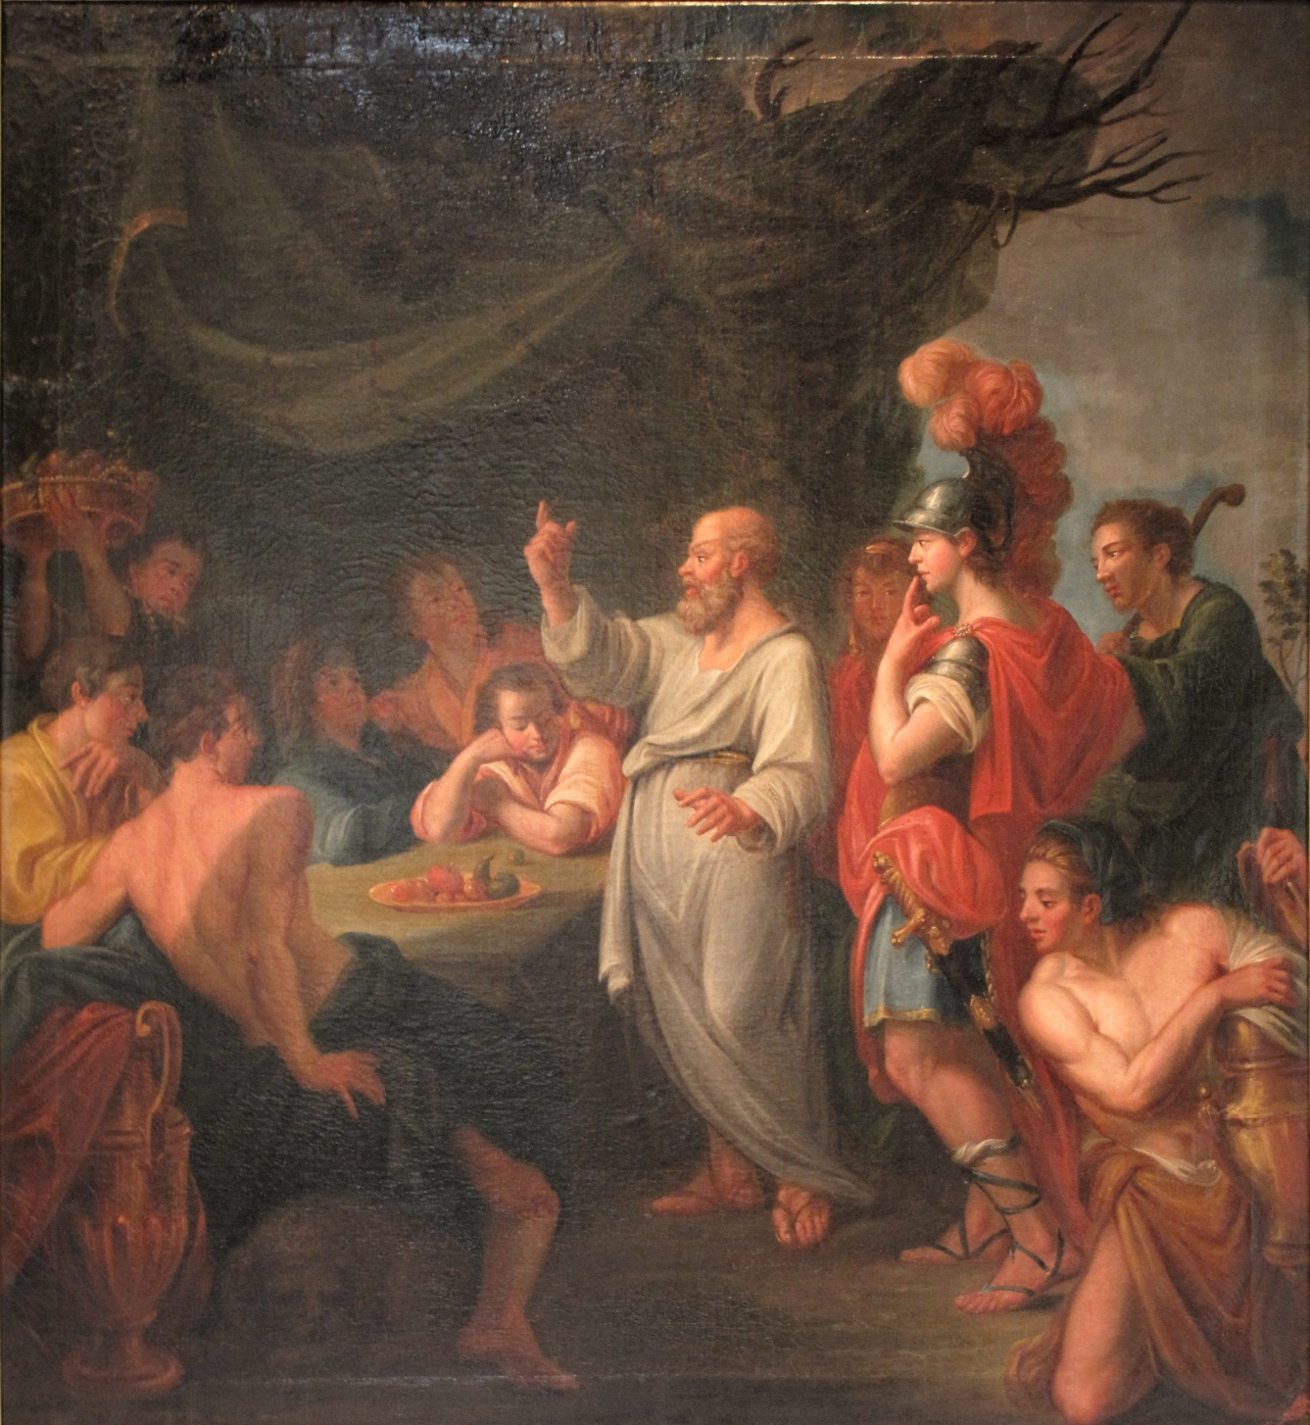
Imaginary view of teaching

Slide 3
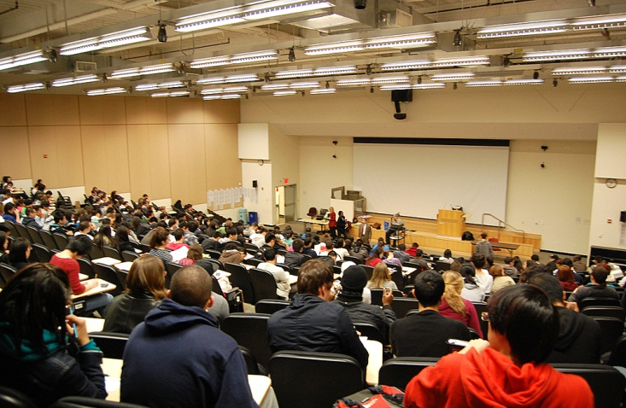
Real view of teaching
Notes:
Distance education via broadcasting. Any communication engineer knows that one transmitter may not adapt to all different receivers. It will be too slow for some whose mind starts other processes; too fast for others who will get buffer overflow and incompatible with yet other ones.

Slide 4


Broadcasting problem – flow control and compatibility
!
Zzzz

Slide 5


Problem: Asynchrony
???

Slide 6






Technology-enhanced learning
Your Own Private Socrates
Any point: Tradeoff of cost vs coaching
YOPS
MOOC

Slide 7
Outline of remainder
The case for active learning
Peer instruction
Flipped classroom
Experiences at KTH
Structure of a flipped course with peer instruction
Learning management tool and learning analytics
Active learning at distance and scale
A proposal for an undergraduate MOOC College
A reason why education must improve
Conclusion

Slide 8

The case for active learning
“active learning leads to increases in examination performance that would raise average grades by a half a letter, and that failure rates under traditional lecturing increase by 55% over the rates observed under active learning.”

Slide 9
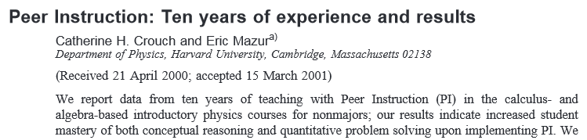
Peer instruction to activate the class
Ask a question, let them think
  Take answers by clickers, hands in the air, colored cards
  Do not give any feedback
Let students work two-by-two
  New answer
Compare the outcomes of the two rounds of answers and discuss the question

Slide 10
Using online material: Flipped classroom and peer instruction
Learning module
Video
Quiz
Clarifi-cation
Indepth
Outlook
• • •
Reading
Time
Preparation
In class

Slide 11
Active learning at KTH
Flipped classroom and peer instruction
Now used in courses in all five-year engineering programs
Positive outcomes; no teacher who has tried wants to return to old practice
Student resistance in the beginning; now they are used to active teaching and might demand it for all courses
Voluntary effort, bottom up
Neither incentives nor pressure for teachers to change
Peer pressure and student expectations might lead to wide-scale adoption
A reward structure would be beneficial
And time to restructure and develop a course

Slide 12
Structure of a course
About the course
Pre-requisites
Learning module
Learning module
Examination
• • •
Video
Video
Prepar-ation
Prepar-ation
Video
Quiz
Quiz
Class
Class
Written
Self-asses-ment

Slide 13
Use of learning management system
Scalable learning, developed by SICS Swedish ICT
Easy to provide videos to students
Add multiple-choice and free-text questions
  Machine graded
Get individual student data on progress and difficulties
Use any video material
  eliminating need to provide own material
  TED talks, OER, recorded television and film

Slide 14
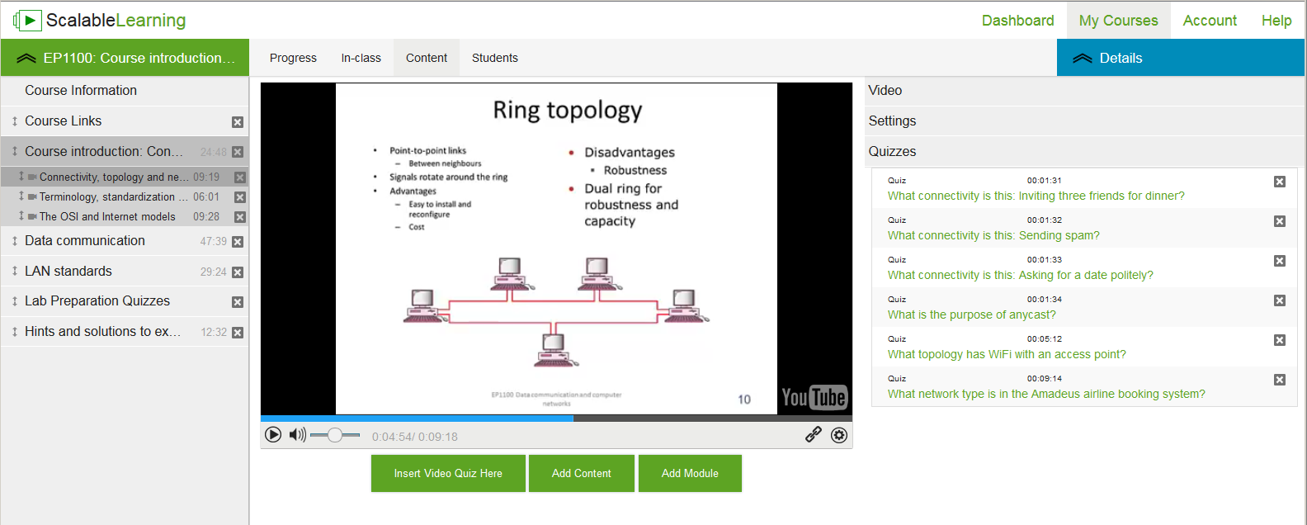

Slide 15
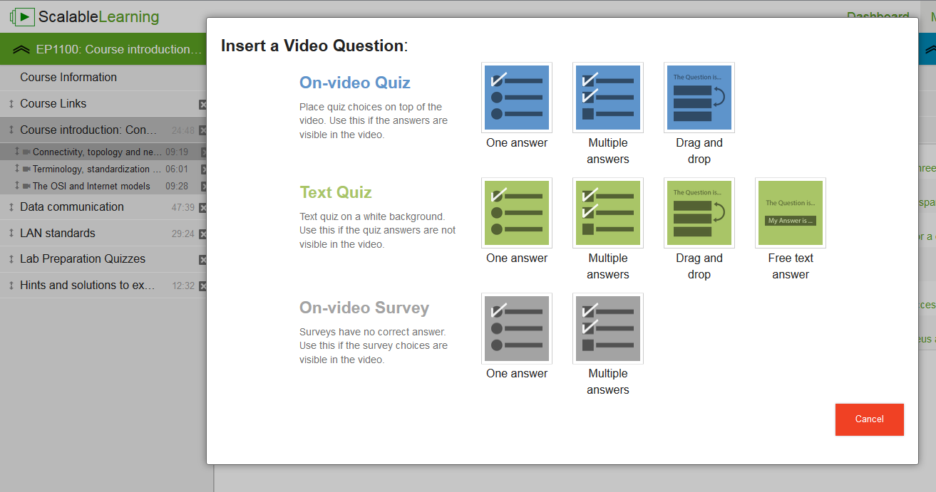

Slide 16
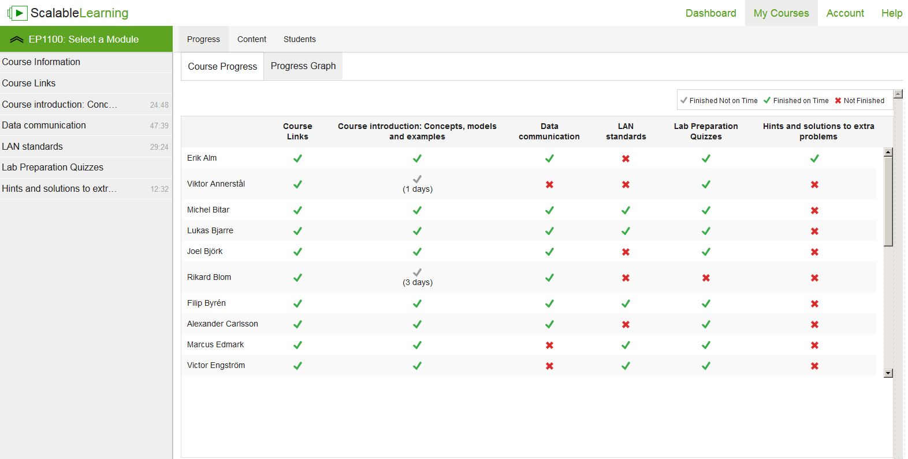
Names of students

Slide 17
Learning analytics
Useful data from learning management system
Learn study habits of those who success and fail
Early warning to those who run risk of failing
Indications of deficient material and inherent difficulty
Adapt in-class meetings to performance on preparatory material
Risks
Sensitive with respect to personal integrity
  Basically IQ tests run on large populations
Mitigation of risk
Identifiable data only needed for student and teacher
Random identifier for linking results across courses

Slide 18
Active learning at distance and scale
KTH Summer Mathematics www.sommarmatte.se
  Online bridging course , nationwide
  Started in 2005; 71 000 students to date
  For credit, students obtain financial aid
  Throughput 50 percent
Current project at SICS Swedish ICT on professional distance education
  Challenges
    Scheduling and priorities
      Work tasks, family, own time
    Academic studies in the past
    Work in progress, no results yet
Peer instruction requires system support
  To group students who are in phase
  Provide protocol to follow; control of process
  Produce material following exercise as feedback on the different alternative answers
Clarity on structure, approach and purpose
  Minimize structural uncertainty
  …

Slide 19
Higher education and MOOCs
MOOC
GeorgiaTech MS in CS
Examination
MOOC
College
Teaching
Learning
Campus
Financing
Admission

Slide 20
Organization for MOOC-based education
Hard to be a student without context
  no peer pressure, no support and no socializing
  where to study, when and how?
My proposal: The MOOC College
  Organize studies
  Activate students and
  Life-long learning
Study coaches
  Individual study plan of MOOCs
  Organize study groups with tutors
  Add extracurricular activities
  Examination and certification by external partners

Slide 21


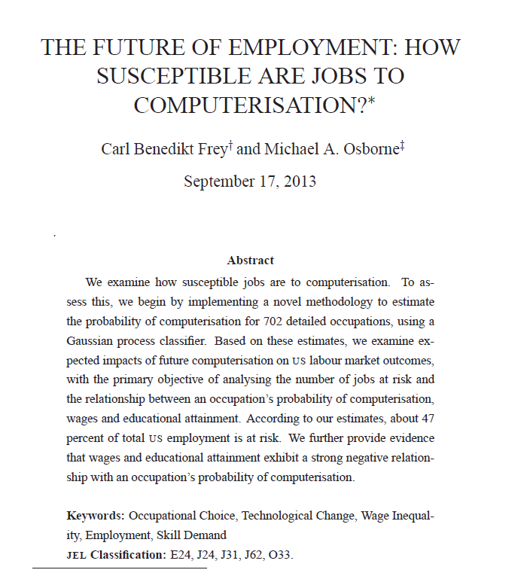
A coming societal challenge

Slide 22
A coming societal challenge
A new need
Retraining, continuous development
Staying ahead of the machines
Suggestions
Less initial full-time study
  too big investment of uncertain usefulness
Blend work and studies throughout life
  Studies adapted to present and future work
  Suited to situation in life
    for increased wellbeing
    applicable skills and knowledge
  Re-certification of
    acquired skills and knowledge
    whenever needed
  Life-long service contract with place of learning

Slide 23
Conclusion
Teaching should be based on scientific knowledge
Active learning provably superior to passive teaching
Substantial improvements cannot be ignored
Flipped classroom with peer instruction works well
Tested at scale at KTH in different subjects
Simple default to get faculty started
Open for experimentation by teachers
Learning management systems are useful
Self-corrected quizzes
Monitoring of individual progress
Learning data for feedback to students and teachers alike
Distributed large-scale teaching require active learning
Important to consider students’ learning situation and environment
Socializing around learning
Peer instruction possible at distance with appropriate system support

Slide 24
Conclusion
The age of automation increases need for effective learning
Skills and knowledge obsoleted by machines
Recurrent retraining might be needed
Large initial investment in studying might not pay off
Continuous learning for
staying competitive vis-à-vis machines
increased life quality and meaning
orderly democratic society and optimism about the future

Slide 25
Thank you for your attention!
Gunnar Karlsson
gk@kth.se

