Slide 1

Scenarios for the Future:
Reshaping the MOOC Landscape
Emerging Models of Learning and Teaching:
From Books to MOOCs?
Stockholm
21-23 May, 2015

Slide 2
Scenarios for the Future:
Reshaping the MOOC Landscape
Professor Mark Brown
National Institute for Digital Learning
Dublin City University, Ireland

Slide 3
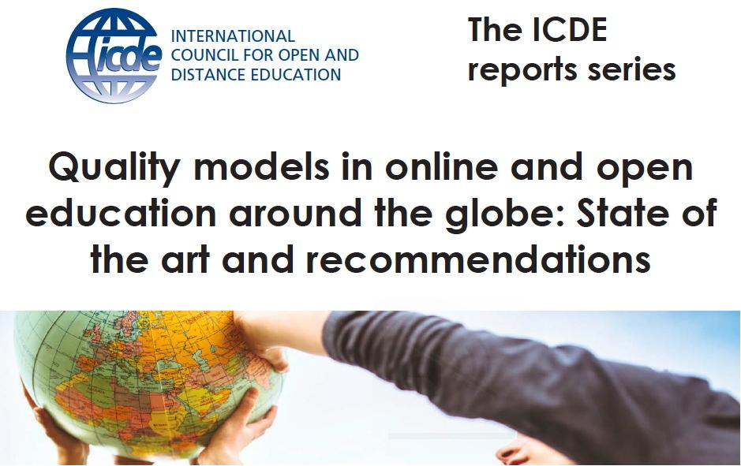
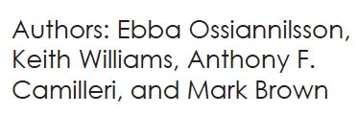

http://www.icde.org

Slide 4
Scenarios for the Future:
Reshaping the MOOC Landscape
Outline…
1. Images of the present
2. Kaleidoscope of competing images
3. Refocusing on preferred images for the future

Slide 5
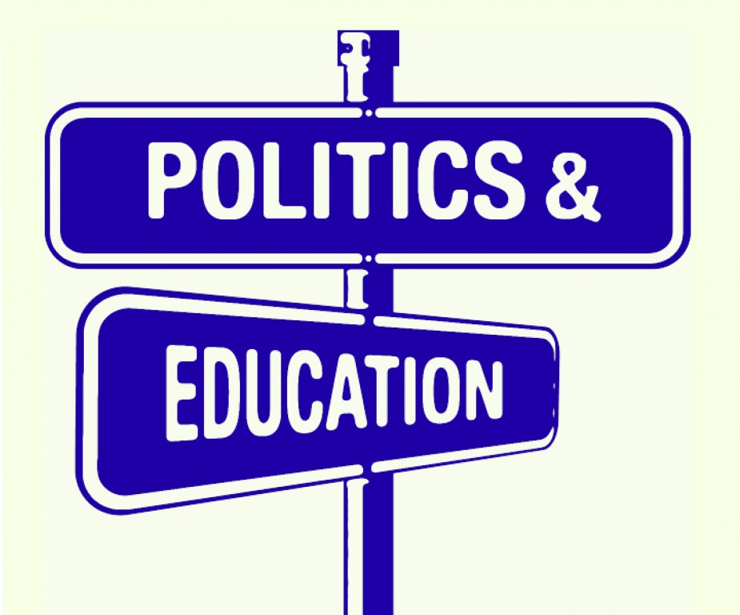
Central thesis…
“All education is political”

Slide 6
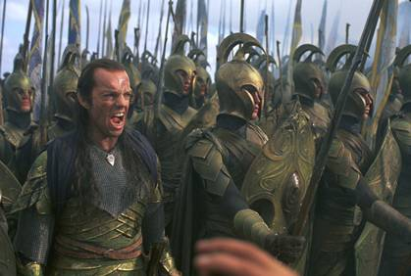
“An educational change is neither natural nor normal, constant nor common as it involves a deeper struggle over who will win control of the curriculum” (Evans, 1996, p.25).

Slide 7
1. Images of the present…

Slide 8
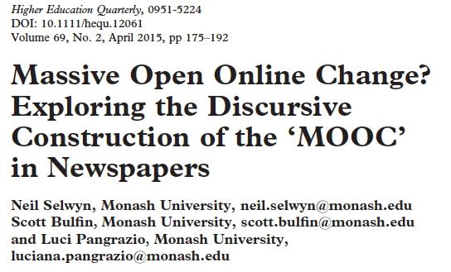
1. Images of the present…

Slide 9
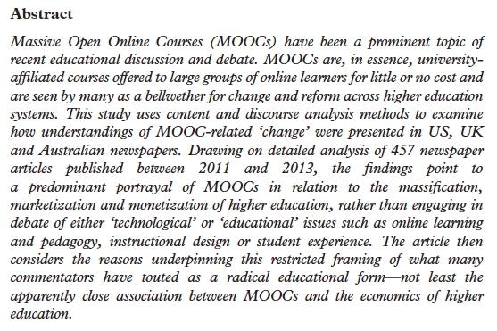
457 newspaper articles published between 2011 and 2013 in Australia, United Kingdom and United States.

Slide 10
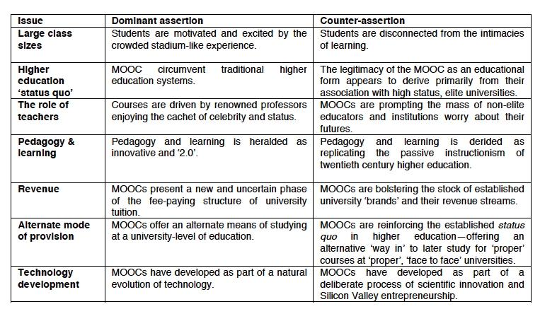
Selwyn, N., & Bulfin, S. (2014). The discursive construction of MOOCs as educational opportunity and educational threat. Monash University.

Slide 11
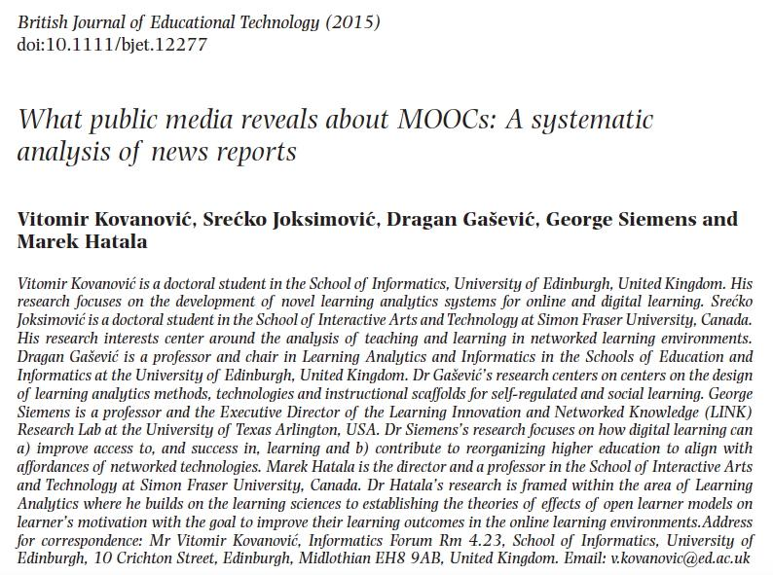
Almost 4000 articles from 591 news sources from around the world, with close to 50% reduction in media stories in 2014 from peak of 2013.

Slide 12
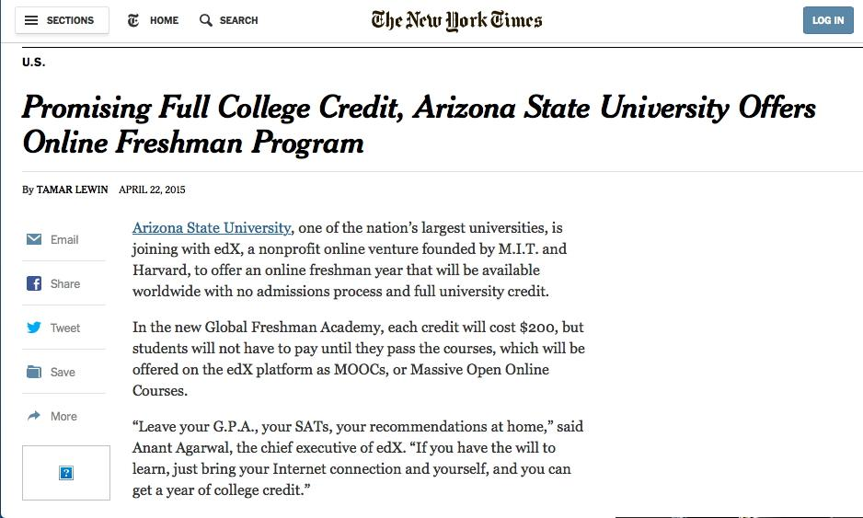



Slide 13
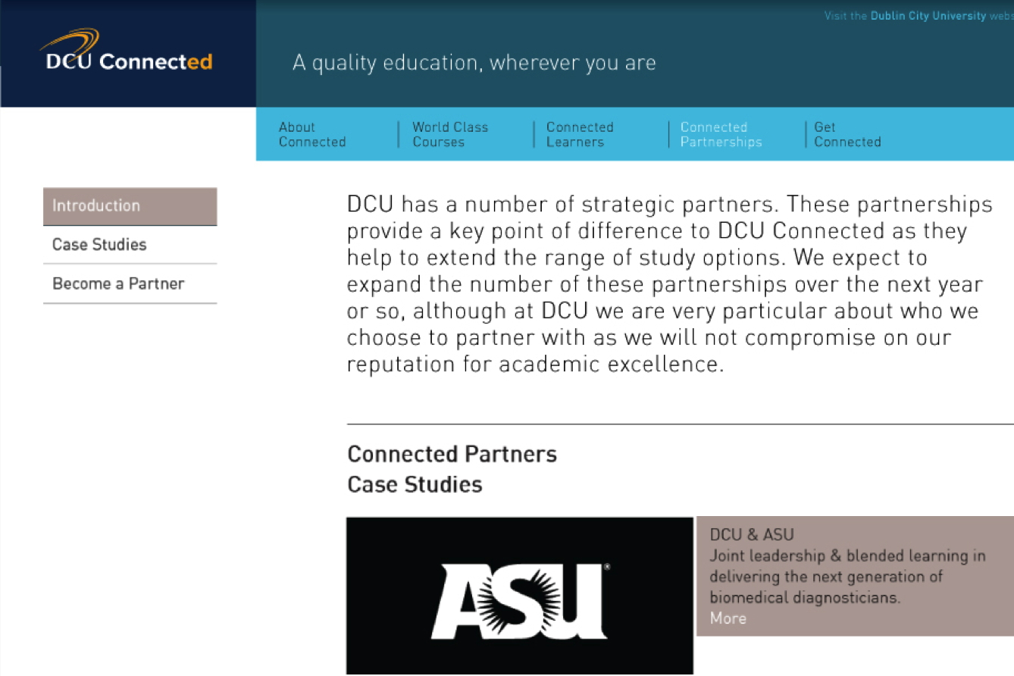

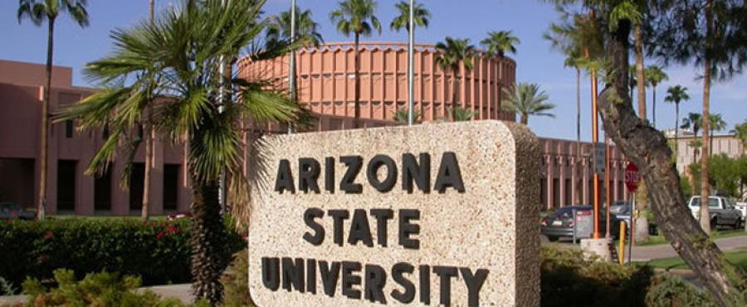

Slide 14
QUESTION…
• When did the first MOOC-related story appear in the Irish media?

Slide 15
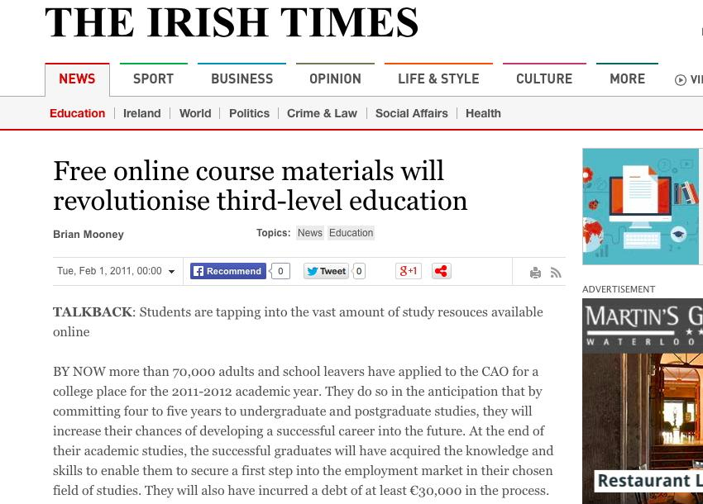
QUESTION…
• When did the first MOOC-related story appear in the Irish media?
Answer… 2011

Slide 16
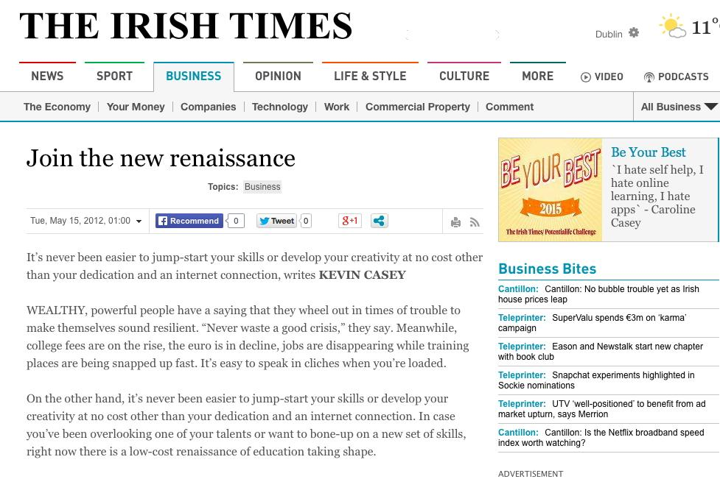
15th May 2012 – 1st mention of MOOC

Slide 17
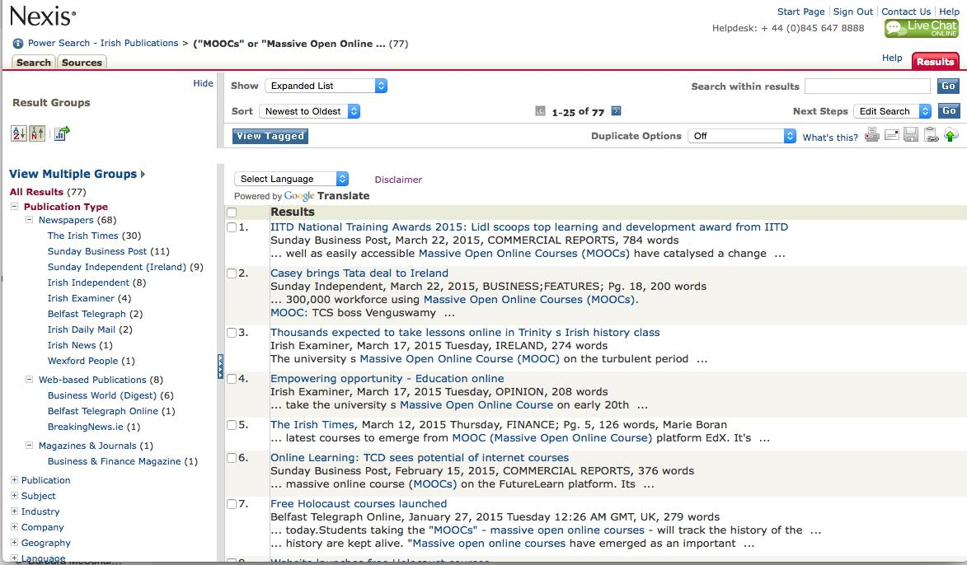
 | 2012 | 2013 | 2014 | 2015 | Total
Number of stories | 1 | 24 | 39 | 11 (33) | 77
Brown, M., Costello, E., Donlon, E., Nic Giollamhichil, M., Kirwan, C. (2015). MOOCs in Irish media: Messages behind the story. Presentation at Opening Up Education: National MOOC Symposium, Dublin City University, Dublin, 1st May.

Slide 18
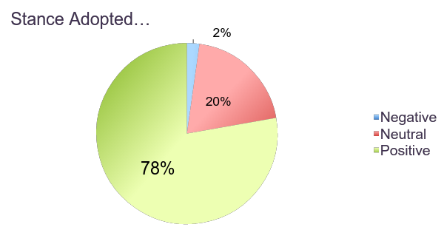
 | 2012 | 2013 | 2014 | 2015 | Total
Number of stories | 1 | 24 | 39 | 11 (33) | 77
Preliminary Findings

Slide 19
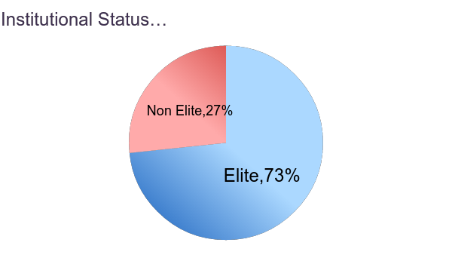
 | 2012 | 2013 | 2014 | 2015 | Total
Number of stories | 1 | 24 | 39 | 11 (33) | 77
Preliminary Findings

Slide 20
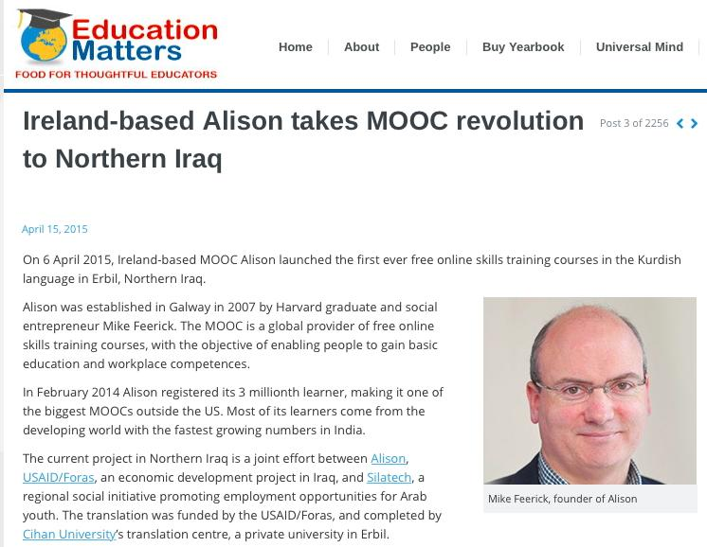


Slide 21
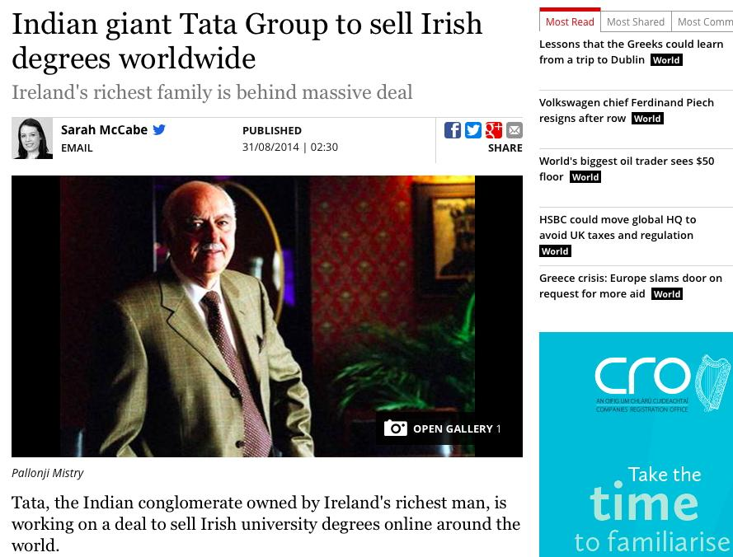

Slide 22
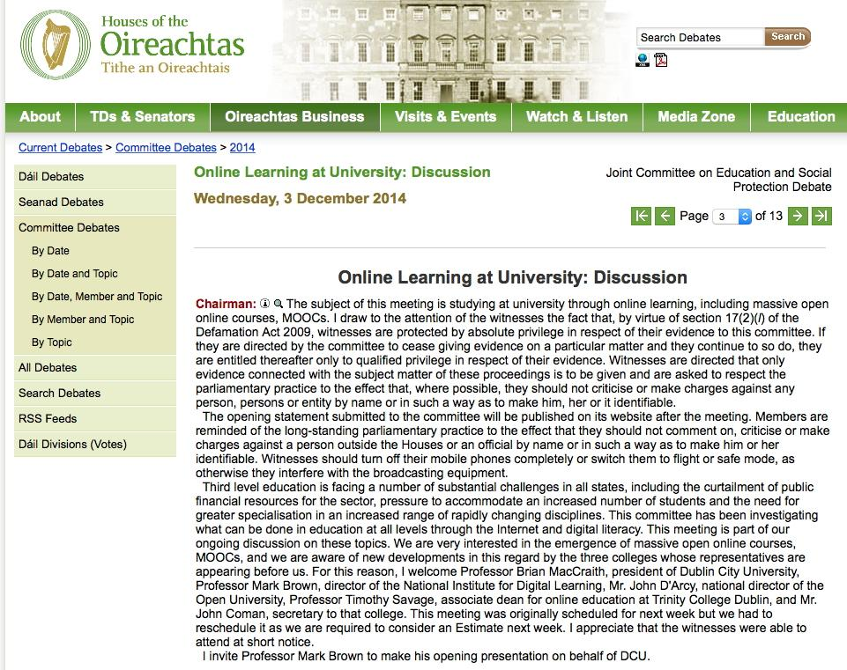
“The subject of this meeting is studying at university through online learning, including massive open online courses, MOOCs”

Slide 23
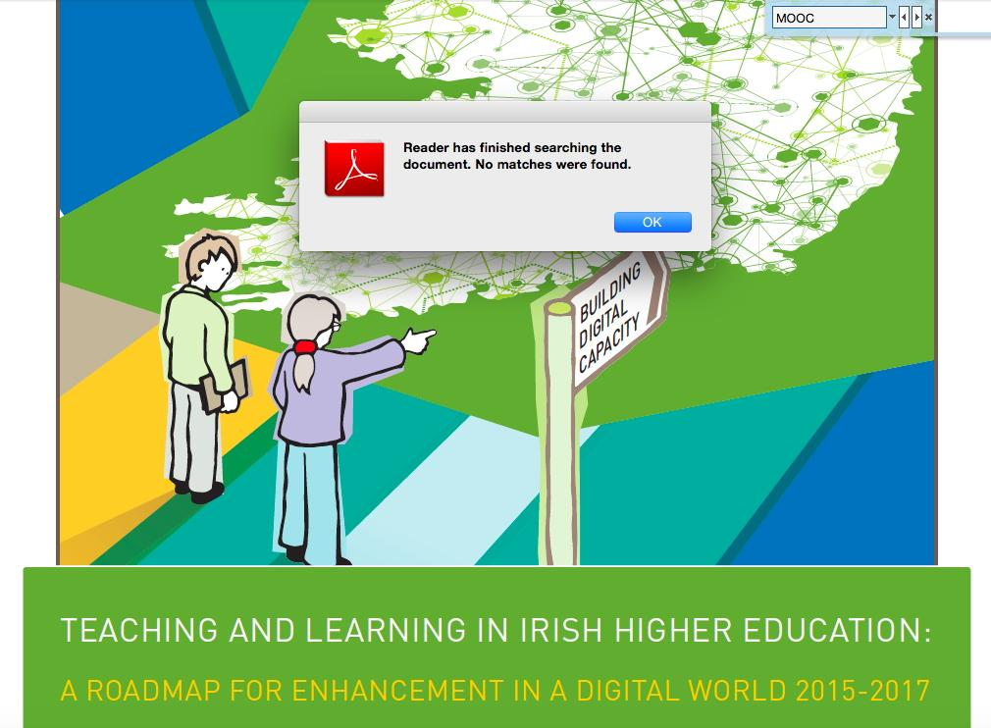
Executive Summary

Slide 24
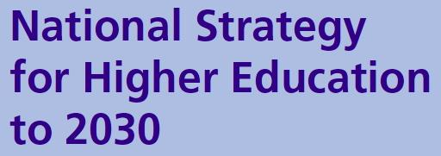

“The National Strategy for Higher Education recommends that if Ireland is to raise levels of lifelong learning and higher education attainment, more is needed in terms of increased flexibility and innovation, broader routes of access and a model of funding that supports all students equally, regardless of mode or duration of study” (HEA, 2012, p.6).

Slide 25


Key paradox…
“There is also almost no understanding of the private and social benefits of distance and online education in comparison with those of face-to-face education” (Rumble, 2014, p.208).

Slide 26
2. Kaleidoscope of competing images

Slide 27

2. Kaleidoscope of competing images
• Who is creating the image and why?
• What are we being told about the image?
• What is missing from the image?
• What images are not being created?

Slide 28

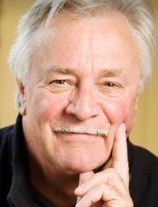
MOOCs are…
• a type of marketing
• an academic labor policy
• a kind of entertainment media
• an expression of Silicon Valley values
• a financial policy for higher education
Peters, M. (2013). Massive Open Online Courses and Beyond: the Revolution to Come. Truthout, August 17

Slide 29
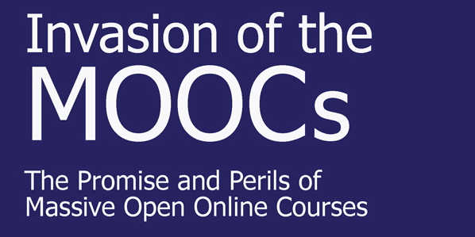

Another colonialist tool?
http://www.parlorpress.com/invasion_of_the_moocs

Slide 30
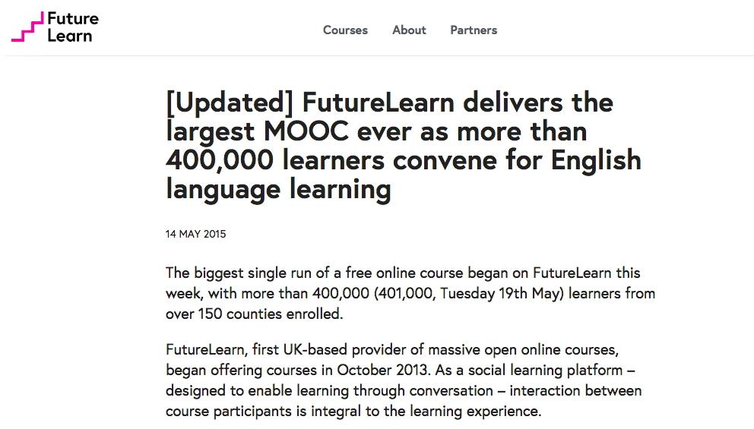
https://about.futurelearn.com/press-releases/futurelearn-delivers-the-largest-mooc-ever-as-nearly-400000-learners-convene-for-english-language-learning/

Slide 31
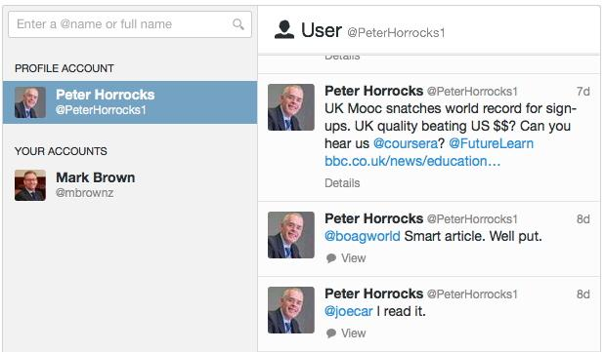

“UK MOOC snatches world record for sign-ups. UK quality beating US $$?”

Slide 32
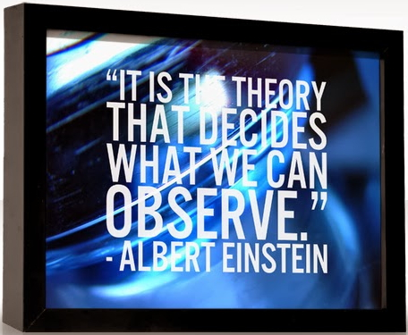
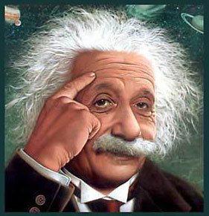

Slide 33
Major Competing Lenses
Commoditization
Knowledge Economy
Globalization
Trans Pacific
Partnership (TTP)
Transatlantic Trade &
Investment Partnership (TTIP)
Learning Society

Slide 34

“…We risk being left behind as other parts of the world act more nimbly in garnering the benefits of technology” (p.6).

Slide 35
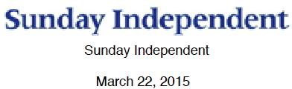
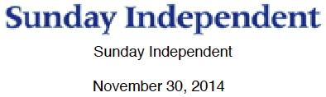
"This is a major opportunity for the Irish economy to become involved with a company that employs 300,000 people worldwide and has a turnover of $15bn.”
“As Chandra told the heads of the Universities and IOTs in Dublin this week, we are talking about building an entire economy based on Irish education. These are wise words from a man whose company's exports are worth more to the Indian economy than their total oil imports.”

Slide 36
Major Competing Lenses
Knowledge Economy
E-learning •
Digital learning •
Technology-enhanced learning •
• Open learning
• Online learning
• Anytime, anywhere learning
Learning Society
Different interest groups and stakeholders borrow the
same ‘language of persuasion’ to legitimize their own hegemonic agenda

Slide 37
Major Competing Lenses
Knowledge Economy
Reproduction
• Mass education
• Quality standards
• Education as commodity
• Increased market competition
E-learning •
Digital learning •
Technology-enhanced learning •
• Open learning
• Online learning
• Anytime, anywhere learning
Learning Society
Different interest groups and stakeholders borrow the
same ‘language of persuasion’ to legitimize their own hegemonic agenda

Slide 38
Major Competing Lenses
Knowledge Economy
Reproduction
Reschooling
• Mass education
• Quality standards
• Education as commodity
• Increased market competition
• Monolingual
• Learning for all
• Global curriculum
• Education in change
E-learning •
Digital learning •
Technology-enhanced learning •
• Open learning
• Online learning
• Anytime, anywhere learning
Learning Society
Different interest groups and stakeholders borrow the
same ‘language of persuasion’ to legitimize their own hegemonic agenda

Slide 39
Major Competing Lenses
Knowledge Economy
Reproduction
Reschooling
Coursera
FutureLearn
E-learning •
Digital learning •
Technology-enhanced learning •
• Open learning
• Online learning
• Anytime, anywhere learning
Learning Society
Different interest groups and stakeholders borrow the
same ‘language of persuasion’ to legitimize their own hegemonic agenda

Slide 40
Major Competing Lenses
Knowledge Economy
Reproduction
Reschooling
• Mass education
• Quality standards
• Education as commodity
• Increased market competition
• Monolingual
• Learning for all
• Global curriculum
• Education in change
E-learning •
Digital learning •
Technology-enhanced learning •
• Open learning
• Online learning
• Anytime, anywhere learning
• Democratic
• Open access
• Learning webs
• Unbundling learning
Deschooling
Learning Society
Different interest groups and stakeholders borrow the
same ‘language of persuasion’ to legitimize their own hegemonic agenda

Slide 41
Major Competing Lenses
Knowledge Economy
Reproduction
Reschooling
• Mass education
• Quality standards
• Education as commodity
• Increased market competition
• Monolingual
• Learning for all
• Global curriculum
• Education in change
E-learning •
Digital learning •
Technology-enhanced learning •
• Open learning
• Online learning
• Anytime, anywhere learning
OERu
Deschooling
Learning Society
Different interest groups and stakeholders borrow the
same ‘language of persuasion’ to legitimize their own hegemonic agenda

Slide 42
Major Competing Lenses
Knowledge Economy
Reproduction
Reschooling
• Mass education
• Quality standards
• Education as commodity
• Increased market competition
• Monolingual
• Learning for all
• Global curriculum
• Education in change
E-learning •
Digital learning •
Technology-enhanced learning •
• Open learning
• Online learning
• Anytime, anywhere learning
• Democratic
• Open access
• Learning webs
• Unbundling learning
• Diversity
• Just society
• Wicked problems
• Education for change
Deschooling
Learning Society
Reconceptualist
Different interest groups and stakeholders borrow the
same ‘language of persuasion’ to legitimize their own hegemonic agenda

Slide 43
Major Competing Lenses
Knowledge Economy
Reproduction
Reschooling
• Mass education
• Quality standards
• Education as commodity
• Increased market competition
• Monolingual
• Learning for all
• Global curriculum
• Education in change
E-learning •
Digital learning •
Technology-enhanced learning •
• Open learning
• Online learning
• Anytime, anywhere learning
• Democratic
• Open access
• Learning webs
• Unbundling learning
OpenupEd
Deschooling
Learning Society
Reconceptualist
Different interest groups and stakeholders borrow the
same ‘language of persuasion’ to legitimize their own hegemonic agenda

Slide 44
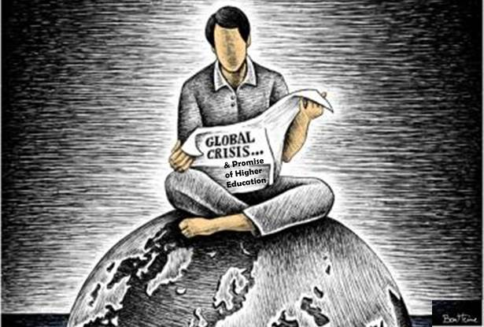
The current emphasis on education in change needs to shift to the language
of education for change.

Slide 45
RECONCEPTUALIST
FRAMEWORK
Digital
Capability
Digital
Inclusion
Digital
Citizenship
LEARNING TO BE
LEARNING TO KNOW
LEARNING TO DO
LEARNING TO LIVE TOGETHER
Fundamental Principles for Reshaping Education

Slide 46

RECONCEPTUALIST
FRAMEWORK
Digital
Capability
Digital
Inclusion
Digital
Citizenship
LEARNING TO
CHANGE
AND TRANSFORM
LEARNING TO BE
LEARNING TO KNOW
LEARNING TO DO
LEARNING TO LIVE TOGETHER
Fundamental Principles for Reshaping Education

Slide 47
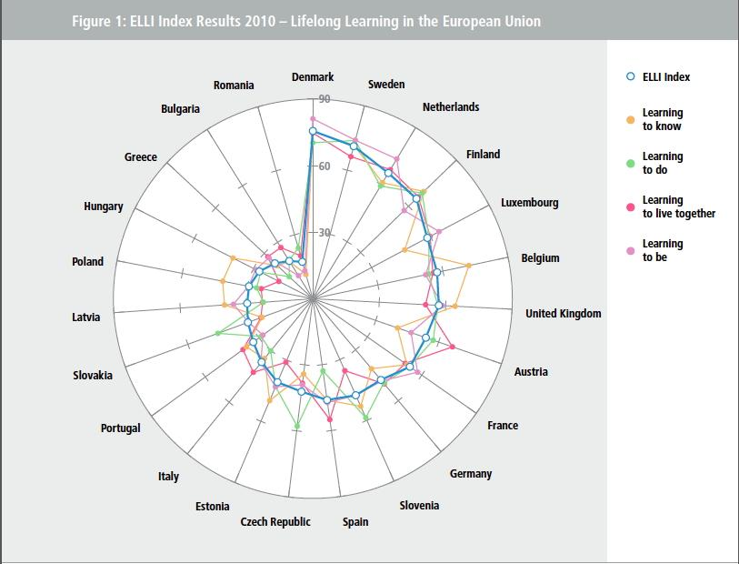
How well is Europe doing?
https://www.bertelsmann-stiftung.de/de/publikationen/publikation/did/making-lifelong-learning-tangible/

Slide 48
3. Refocusing on preferred images
for the future

Slide 49
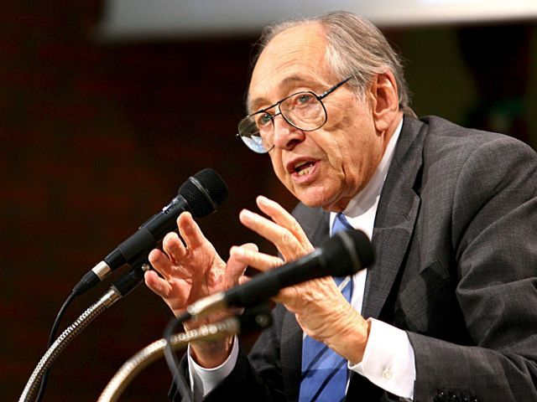
3. Refocusing on preferred images
for the future
“All education springs from images of the future and all education creates images of the future. Thus all education, whether so intended or not, is a preparation for the future. Unless we understand the future for which we are preparing we may do tragic damage to those we teach.”
(Toffler, 1974).

Slide 50
Key question…
What type of higher education system do we
want emerging models of
teaching and learning to
serve in the future?

Slide 51
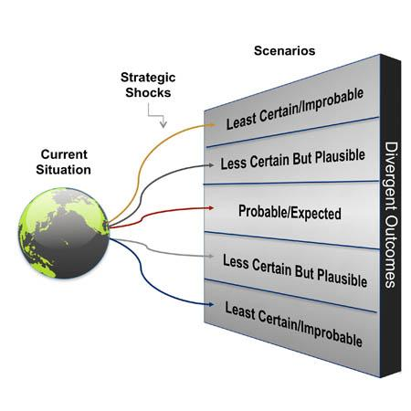
What are our preferred
scenarios for the future?
• Personal
• Knowledge
• Economic
• Social
Aims & Purpose
of Higher Education

Slide 52
Disruptive Business Models
Scenario 3
Scenario 4
Standardised Courses
Customised Courses
Scenario 1
Scenario 2
Conventional Business Models

Slide 53
Disruptive Business Models
Scenario 3
Scenario 4
DCU
Connected
Standardised Courses
Customised Courses
Scenario 1
Scenario 2
Conventional Business Models

Slide 54


Slide 55
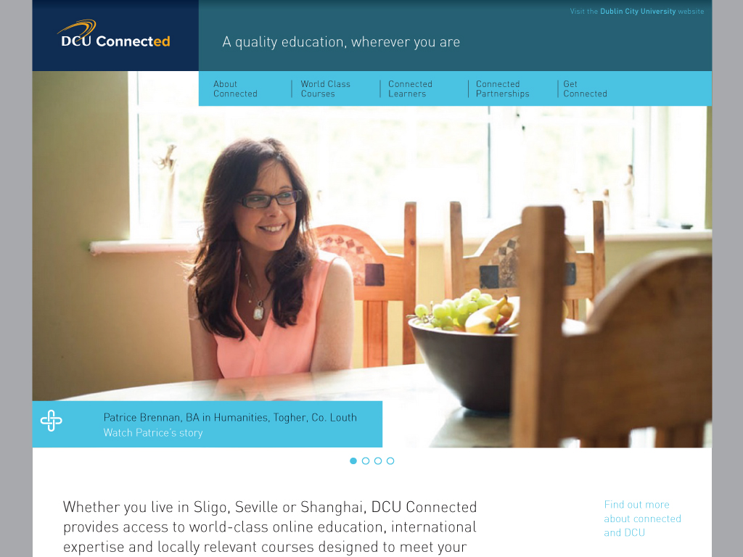

Slide 56
Conclusion…

Slide 57
Conclusion…
• Is political work
• Digital education is a gift
• Where do we want to end up?

Slide 58

Final point…
“MOOCs should
be in the service of
big ideas, not as
a big idea in itself”
(Brown & Costello, 2015;
adapted from Barnett, 2011).

Slide 59

Thank
You!

Slide 60
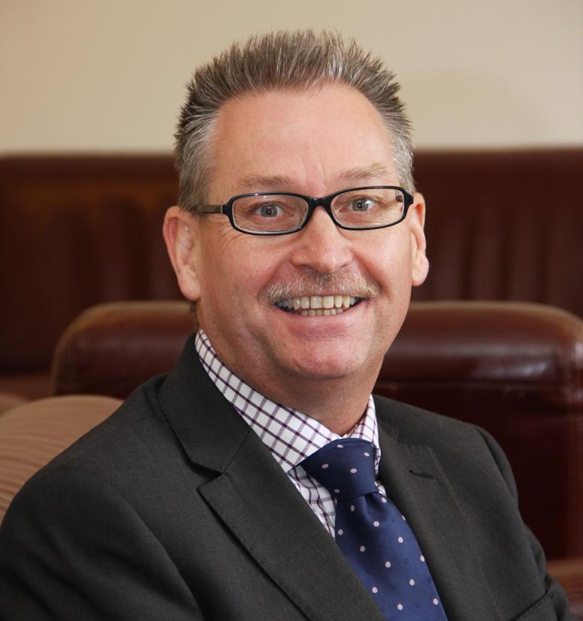
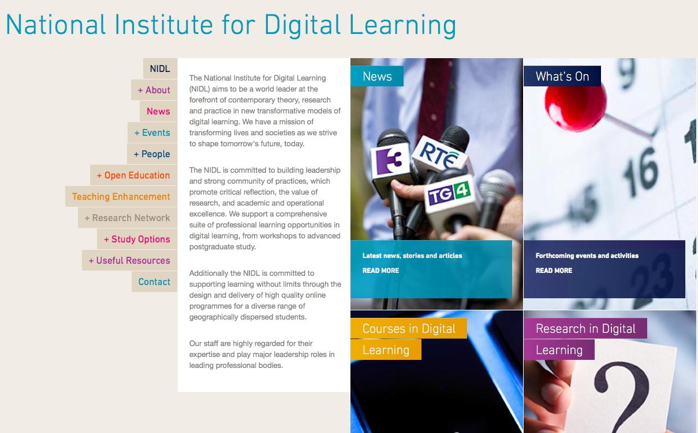

Contact details…
mark.brown@dcu.ie
www.dcu.ie/nidl
www.slideshare.net/mbrownz
@mbrownz

