Slide 1
Beyond MOOCs
Inter-University Use of Tutored Online Courses
Paul Rühl, Managing Director, Bavarian Virtual University
From Books to MOOCs?
Academia Europaea and Wenner-Gren Foundations Conference
Stockholm, 21 – 23 May 2015

Slide 2
Question
Why does the Bavarian Virtual University not engage in MOOCs?
Or do we?
Notes:
introduce
give information about
would like to present
an then maybe discuss the lessons we have learned
finally I would like to show you some course examples
I have learnde from the programme of your summer course that Academic staff from the Chair for Idea and Innovation Mgmt. will give lectures. At BVU we have an online course about “Innovation in Emerging Markets”. So I was pleased to see how topics are interconnected. But we will see in the course examples.

Slide 3
BVU courses and MOOCs
 | BVU courses | MOOCs
Admission | Open to everybody | Open to everybody
Tuition | Individual tuition by tele-tutors | Mostly peer to peer
Tuition fees | Free for students of member universities; other persons pay a fee | Generally no fees, but fees for special offers (e.g. „signature track“)
Credits | Credits given for all courses; acknowledgement regulated by universities | ?
Completion rate | > 50% | Mostly < 10%

Slide 4
Presentation Structure
Aims and tasks of the BVU
Key facts and figures
Principles and success factors
The BVU and MOOCs
Notes:
introduce
give information about
would like to present
an then maybe discuss the lessons we have learned
finally I would like to show you some course examples
I have learnde from the programme of your summer course that Academic staff from the Chair for Idea and Innovation Mgmt. will give lectures. At BVU we have an online course about “Innovation in Emerging Markets”. So I was pleased to see how topics are interconnected. But we will see in the course examples.

Slide 5
Aims and tasks of the BV
Key facts and figures
Principles and success factors
The BVU and MOOCs

Slide 6
Contextual Factors
Face to face education easily available, but
Growing numbers of non-traditional students
Opening of universities to new target groups
Growing need for flexible studies (time and place)
Strained public budgets

Slide 7

The Bavarian Virtual University
(vhb = Virtuelle Hochschule Bayern)
A network formed by all the universities and
the universities of applied sciences in Bavaria
(not an independent university!)
In operation since May 2000
In 2014 identified by European Union DG Education and Culture as one of the most interesting innovative approaches in higher education (cf. http://eprints.lse.ac.uk/55819/)
Notes:
3. According to an EU-survey

Slide 8
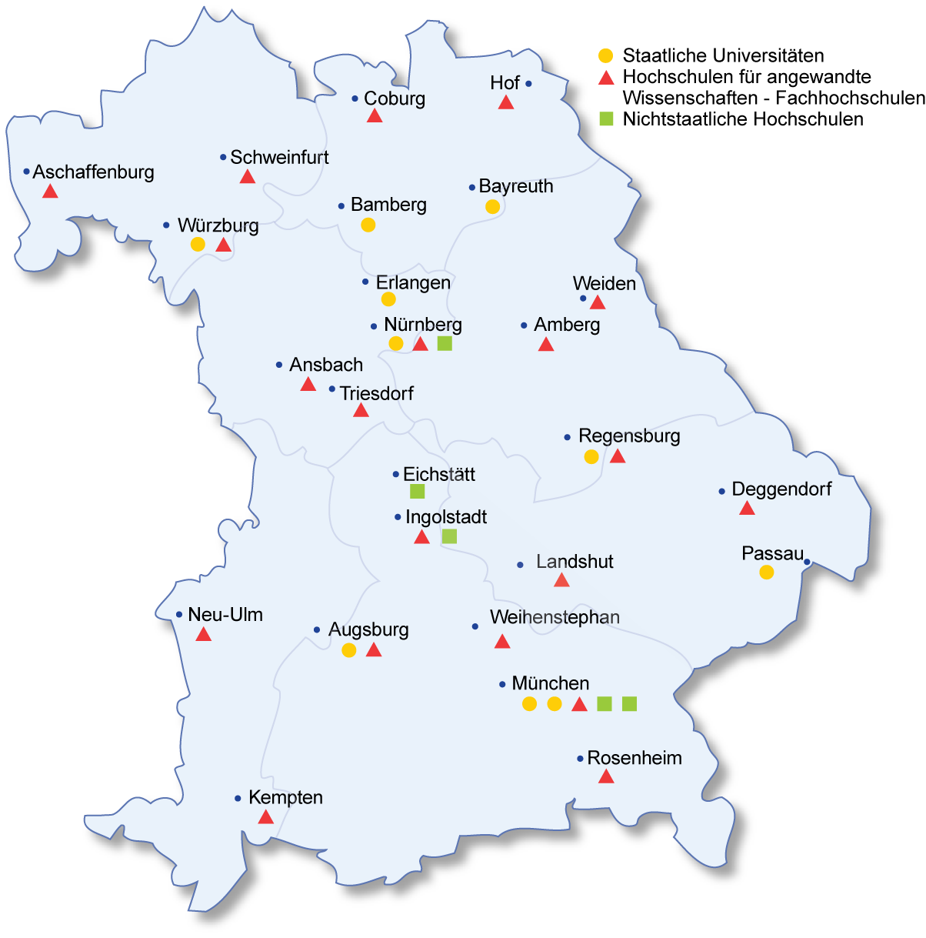
Member Universities
9 state universities
17 state universities of applied sciences
4 further universities
Bavaria:
- population appr. 12.5 mio.
- appr. 360,000 students

Slide 9
The Aims of BVU
To complement the programmes of the traditional universities, not to replace them
No complete degrees / study programmes, but single courses with credit points
Supporting member universities
- in educating growing numbers of students while state funding does not grow proportionally
- in providing better services to non-traditional
students

Slide 10
Aims and tasks of the BVU
Key facts and figures
Principles and success factors
The BVU and MOOCs

Slide 11

Courses
Types of courses:
- lecture + tutorial
- virtual seminar with student collaboration
and tutorial guidance
- exceptionally: self-instruction environment with optional tutoring
Courses offer 3 to 6 credit points (ECTS)

Slide 12
Courses
• Summer term 2015: nearly 400 different courses
Currently about 100 new courses are being developed
• Annual calls for additional proposals
• All courses must be as interactive as possible
• All courses are completely online;
final examination often face-to-face

Slide 13

Figures for the academic year 2014 / 2015
745 courses conducted
approx. 150,000 enrolments
by nearly
50,000 individual students
Notes:
According to the development

Slide 14
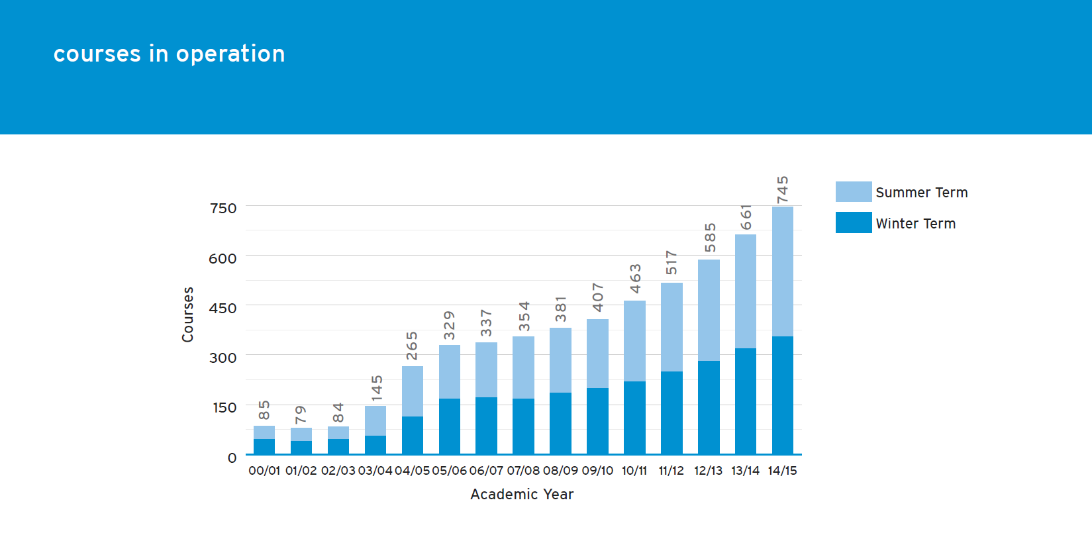
Courses in operation

Slide 15
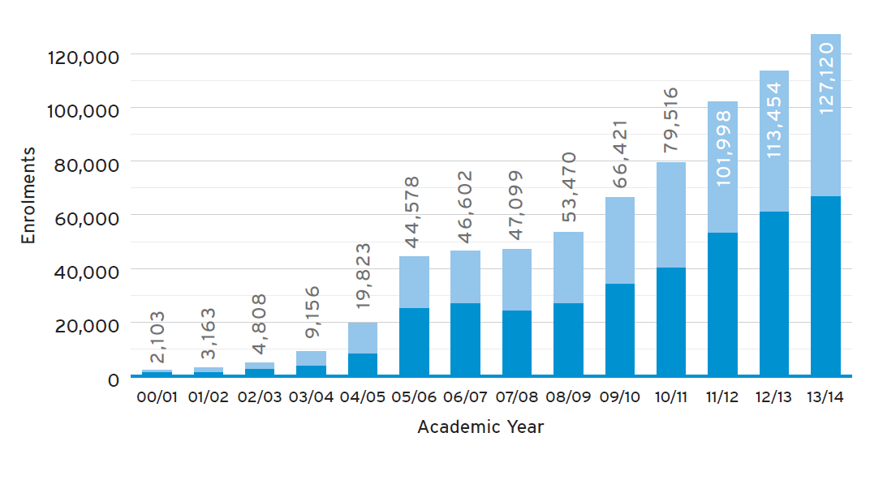
Student enrolment

Slide 16
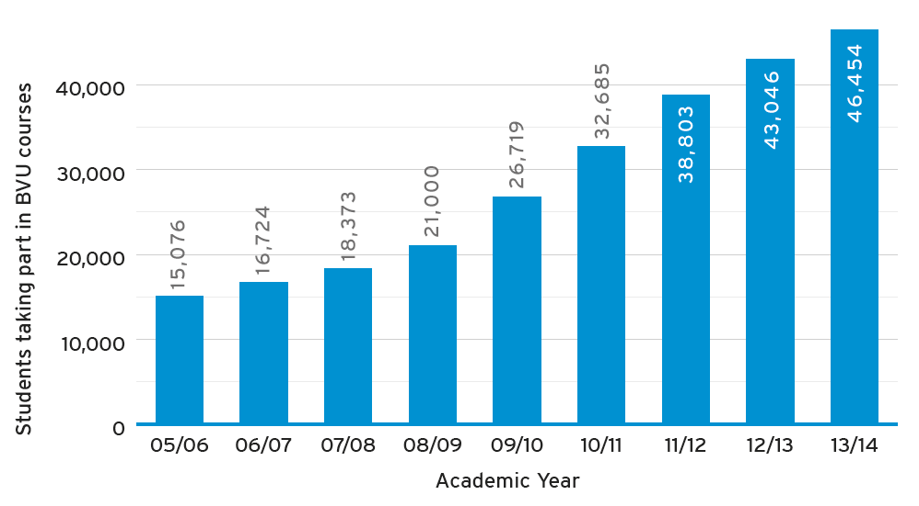
Students taking part
in BVU courses

Slide 17
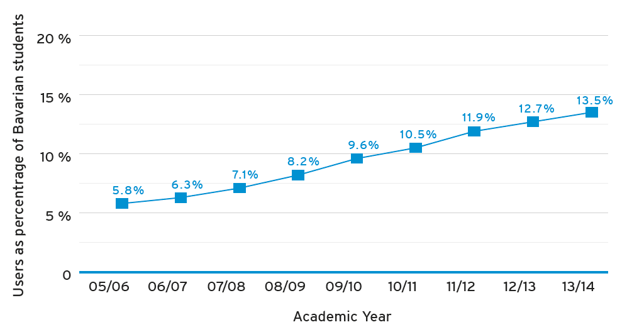
BVU Users as percentage of Bavarian students

Slide 18
Aims and tasks of the BVU
Key facts and figures
Principles and success factors
The BVU and MOOCs

Slide 19

Key Success Factors - Students
Flexibility (therefore priority given to
asynchronous forms of communication)
No extra fees for Bavarian students
Interaction with teachers / tutors and other students
Added value: developing „e-learning literacy“ within the traditional curriculum → enhancing employability

Slide 20
Key Success Factors - Teachers
• Financial support for course development and maintenance (online tutors and necessary improvements)
Larger variety of pedagogical possibilities
Wider range of teaching
Community building

Slide 21
Key Success Factors –
Universities
Enhancing of teaching capacities
Programme development and course funding strictly to the demand of the member universities
Decisions made by elected representatives of member universities
Transparency in all decisions, especially funding
Establishing common quality standards; strict quality management (peer evaluation of teaching)

Slide 22
Investment in Quality
Funding of
e-tutoring for students
training of e-tutors
updates of content and technology
introductory seminars for e-teaching newcomers
evaluation procedures (including p2p)

Slide 23

Key Success Factors –
Society and the State
High quality education
in a cost-effective way
Synergy through statewide cooperation in teaching:
  Drawing upon the expertise and competence of the member universities, using their infrastructure as much as possible
→ Support by government, esp. by Ministry of Education

Slide 24
Aims and tasks of the BVU
Key facts and figures
Principles and success factors
The BVU and MOOCs

Slide 25
Looking back …

Slide 26
The BVU and MOOCs
$ £ $ £ $ £ $ £ $ £ $ £ $ £ $ £ $ £ $ £ $ £ $ £
In the beginning, one of the main drivers to create MOOCs appeared to be
student debt
$ £ $ £ $ £ $ £ $ £ $ £ $ £ $ £ $ £ $ £ $ £ $ £

Slide 27
The BVU and MOOCs
„Average Grad's Loan Jumps To $27,000” (http://www.forbes.com/sites/halahtouryalai/2013/01/29/more-evidence-on-the-student-debt-crisis-average-grads-loan-jumps-to-27000/)
“…graduates must now repay an average of £26,000”
(http://www.guardian.co.uk/commentisfree/2012/jul/03/absurd-student-debt-has-ended-inclusion)

Slide 28
The BVU and MOOCs
A different point of view:
British university and science minister David Willets at Going Global in Dubai, 5 March, 2013:
„…higher education institutions should consider how moocs could be harnessed to boost their physical intake.“
(Times Higher Education, 7-13 March, 2013, p. 8)

Slide 29
The BVU and MOOCs
Main motive for Bavarian / German universities to offer MOOCs:
Boosting international visibility
of the individual university

Slide 30
The BVU and MOOCs
Back to the initial question:
Are BVU courses MOOCs?

Slide 31
BVU courses and MOOCs
 | BVU courses | MOOCs
Admission | Open to everybody | Open to everybody
Tuition | Individual tuition by tele-tutors | Mostly peer to peer
Tuition fees | Free for students of member universities; other persons pay a fee | Generally no fees, but fees for special offers (e.g. „signature track“)
Credits | Credits given for all courses; acknowledgement regulated by universities | ?
Completion rate | > 50% | Mostly < 10%

Slide 32
Conclusion
BVU’s target group: undergraduate students
BVU puts interaction first and accepts the fundamental role of the teacher / tutor for the success of education (cf. John Hattie)
MOOCs best suited for professional development (cf. Diana Laurillard)

Slide 33
Conclusion
Perhaps the most important effect of MOOCs:
Web-beased learning and web-based teaching are back on the agenda
Cooperation among universities in web-based teaching should be put on the agenda – especially in state funded HE systems.
Cooperation makes online teaching much more affordable and much more feasible

Slide 34
Thank you for your attention
Your questions are most welcome
Please take a leaflet
Contact: paul.ruehl@vhb.org

