Slide 1
2024 Class A2 – Social and related sciences Section – Economics, Business & Management Sciences
Overall section members: 179 Overall foreign members: 8 Overall female members: 28

Slide 2
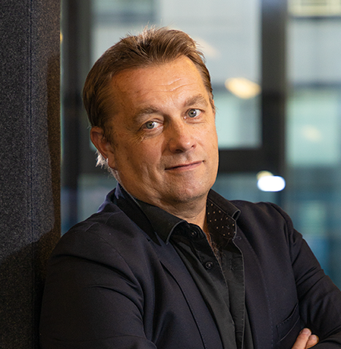
2024 Class A2 – Social and Related Sciences Section – Economics, Business & Management Sciences
Frédéric Docquier Luxembourg Institute of Socio-Economic Research Esch-sur-Alzette Luxembourg | Economics of migration Quantitative development theory Growth theory

Slide 3

2024 Class A2 – Social and Related Sciences Section – Economics, Business & Management Sciences
Dorothea Kübler WZB Berlin Social Science Center Berlin Germany | Game theory Matching markets Behavioral and experimental economics Labor and organization economics Market design Economics of education

Slide 4

2024 Class A2 – Social and Related Sciences Section – Economics, Business & Management Sciences
Brian Lucey Trinity College Dublin Ireland | Scientometrics Machine learning Commodities Biodiversity and climate finance Applied econometrics Behavioural finance Digital finance

Slide 5

2024 Class A2 – Social and Related Sciences Section – Economics, Business & Management Sciences
Shaul Shalvi University of Amsterdam The Netherlands | Judgment and decision making Behavioural ethics Cooperation Trust Normative behaviour

Slide 6
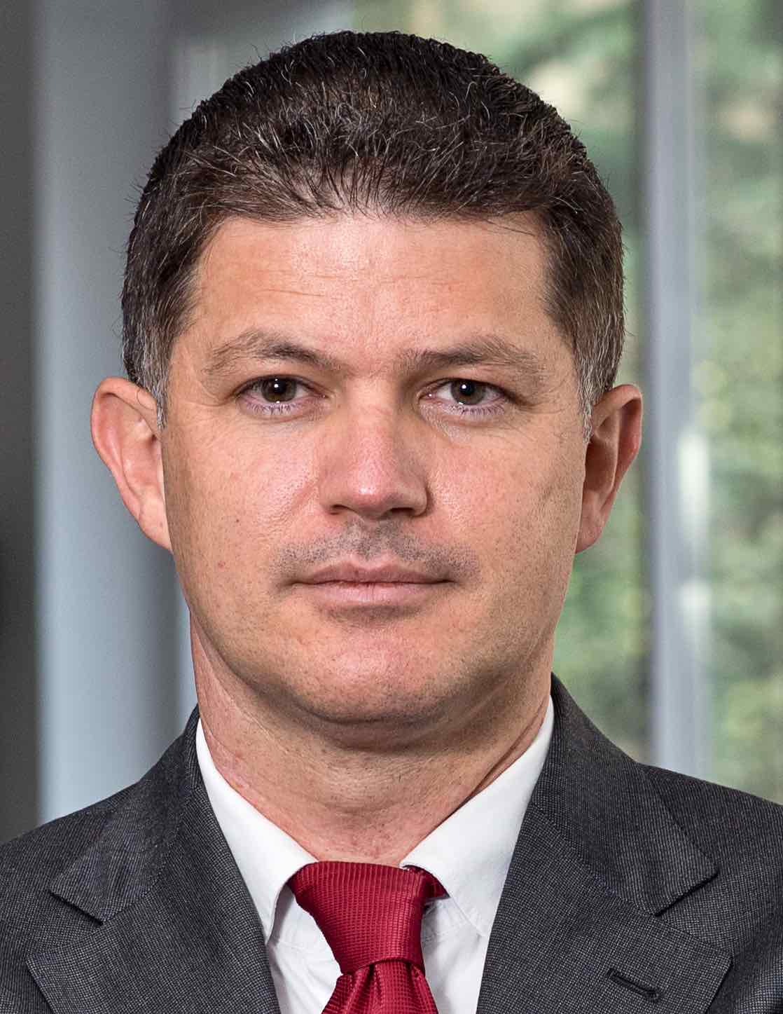
2024 Class A2 – Social and Related Sciences Section – Economics, Business & Management Sciences
Mirco Tonin Free University of Bozen-Bolzano Italy | Labour economics Public service motivation Experimental economics Behavioural economics Social capital Policy evaluation Public finance Social preferences

Slide 7
2024 Class A2 – Social and related sciences Section – Governance, Institutions & Policies
Overall section members: 74 Overall foreign members: 1 Overall female members: 25

Slide 8

2024 Class A2 – Social and Related Sciences Section – Governance, Institutions & Policies
Duncan Bell Cambridge University United Kingdom | History of Political Thought International Relations Political Theory

Slide 9

2024 Class A2 – Social and Related Sciences Section – Governance, Institutions & Policies
Daniele Caramani University of Zurich Switzerland | Parties and party systems Electoral systems and behaviour Democracy and democratization Populism and technocracy Historical analysis Comparative politics and methods Globalization Political representation Nationalism, state formation, and nation-building European integration

Slide 10
2024 Class A2 – Social and Related Sciences Section – Governance, Institutions & Policies
Rosemary Deem Royal Holloway University London United Kingdom | Public policy and its effects on management & leadership in public service organisations Sociology of leisure and lifestyles Qualitative methods Higher education quality and equality Equality and diversity in educational organizations Governance Relationship between teaching and research Higher education leadership Management

Slide 11

2024 Class A2 – Social and Related Sciences Section – Governance, Institutions & Policies
Maurizio Ferrera University of Milan Italy | EU studies Political theory Comparative social policies

Slide 12

2024 Class A2 – Social and Related Sciences Section – Governance, Institutions & Policies
Karin Ingold University Bern Switzerland | Public policy Climate resilience Environmental governance Energy transition Water resources management Social network analysis Policy design and policy instruments Policy studies

Slide 13
2024 Class A2 – Social and Related Sciences Section – Governance, Institutions & Policies
Manja Klemenčič University Ljubljana Slovenia | Sociology and politics of higher education European higher education Comparative higher education

Slide 14
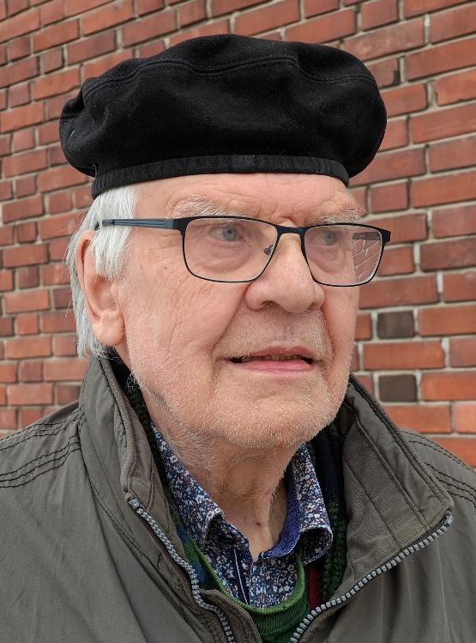
2024 Class A2 – Social and Related Sciences Section – Governance, Institutions & Policies
Kari Palonen University of Jyväskylä Helsinki Finland | Conceptual history Parliamentary procedure and rhetoric Max Weber studies Political theory

Slide 15

2024 Class A2 – Social and Related Sciences Section – Governance, Institutions & Policies
Kirsi Tirri University of Helsinki Finland | Teacher education Talent development and gifted education School pedagogy Cross-cultural studies Moral and religious education

Slide 16
2024 Class A2 – Social and related sciences Section – Human Mobility, Governance, Environment & Space
Overall section members: 154 Overall foreign members: 15 Overall female members: 32

Slide 17

2024 Class A2 – Social and Related Sciences Section – Human Mobility, Governance, Environment & Space
Iñaki Alday Sanz Tulane University Barcelona Spain | Sustainable design Urbanism and urban ecology Architecture Urban public spaces Landscape studies: cities, riverfronts and water parks Environmental studies

Slide 18

2024 Class A2 – Social and Related Sciences Section – Human Mobility, Governance, Environment & Space
Harriet Bulkeley Durham University United Kingdom | Politics and governance of environmental issues Climate change Roles of cities and other non-state actors in responding to this global challenge Social and environmental justice Urban sustainability focusing energy, smart grids, infrastructure, housing, mobility & wastees

Slide 19

2024 Class A2 – Social and Related Sciences Section – Human Mobility, Governance, Environment & Space
Johannes Glückler Ludwig-Maximillians-Universität München Germany | Innovation and organizational networks Regional economic development Spatial economy Relational research Social network analysis Network governance and natural resources Social institutions and institutional change Knowledge and space Economic geography

Slide 20
2024 Class A2 – Social and related sciences Section – Law
Overall section members: 140 Overall foreign members: 7 Overall female members: 36

Slide 21
2024 Class A2 – Social and Related Sciences Section – Law
Susanne Baer Humboldt University Berlin Germany | Feminist legal theory Public law Legal culture Gender studies Equality law Comparative constitutional law Socio-legal studies Political theory

Slide 22
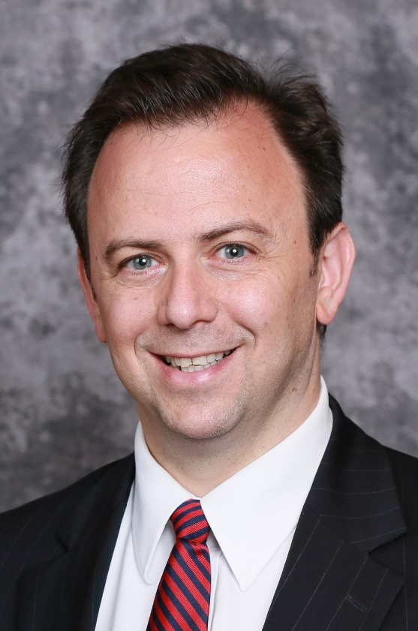
2024 Class A2 – Social and Related Sciences Section – Law
F. Scott Kieff George Washington University Washington DC USA | Operations Intellectual property Ethics International trade Finance Strategy Dispute resolution Governance Antitrust Interfaces among technology law, business, national security

Slide 23

2024 Class A2 – Social and Related Sciences Section – Law
Randall Lesaffer KU Leuven Belgium | History of international law Diplomatic history Laws of war Legal history Constitutional history

Slide 24

2024 Class A2 – Social and Related Sciences Section – Law
Antonello Miranda University of Palermo Italy | Comparative law Legal systems English law European private law Legal history Family law

Slide 25
2024 Class A2 – Social and Related Sciences Section – Law
Niamh Moloney London School of Economics and Political Science United Kingdom | Consumer financial protection regulation EU financial market regulation Institutional dynamics of financial market regulation Investor protection regulation

Slide 26

2024 Class A2 – Social and Related Sciences Section – Law
Jiří Přibáň Cardiff University United Kingdom | Law and culture Law and constitutional transitions Comparative law European law Sociology of law

Slide 27
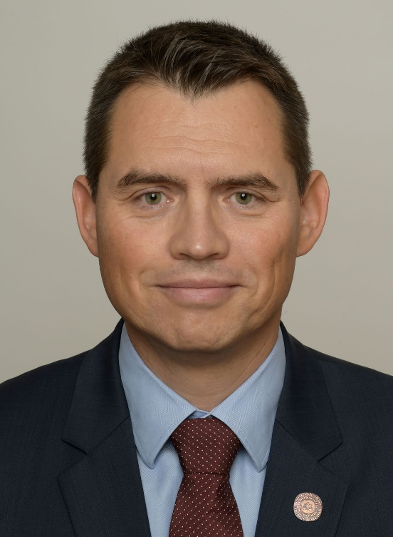
2024 Class A2 – Social and Related Sciences Section – Law
Grega Strban University of Ljubljana Slovenia | Labour law Comparative legal studies International social law Law European Union law Social law Legal terminology

Slide 28

2024 Class A2 – Social and Related Sciences Section – Law
Frederik Swennen University of Antwerp Belgium | Kinship studies Socio-legal studies Family law Critical legal studies (Queer Legal Theory)

Slide 29
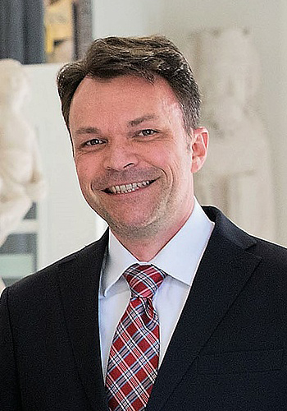
2024 Class A2 – Social and Related Sciences Section – Law
Matthias Weller University of Bonn Germany | Civil procedural law Reconciliation studies Art and cultural property protection Transnational commercial law International dispute resolution Private International law International civil procedural law

Slide 30

2024 Class A2 – Social and Related Sciences Section – Law
Lucia Zedner University of Oxford United Kingdom | Security & counterterrorism Punishment theory Citizenship Immigration & border control Criminal justice Criminal law Risk

Slide 31
2024 Class A2 – Social and related sciences Section – Social Change & Social Thought
Overall section members: 91 Overall foreign members: 6 Overall female members: 26

Slide 32

2024 Class A2 – Social and Related Sciences Section – Social Change & Social Thought
Richard Bellamy University College London United Kingdom | Democratic theory Comparative politics - especially UK and Italy EU studies Public ethics Legal and constitutional theory Italian studies Global ethics History of political thought Social and political theory

Slide 33

2024 Class A2 – Social and Related Sciences Section – Social Change & Social Thought
Sharon Macdonald Humboldt-Universität zu Berlin Germany | Museums Social and cultural anthropology Heritage Memory politics Europe

Slide 34

2024 Class A2 – Social and Related Sciences Section – Social Change & Social Thought
Attila Melegh Corvinus University of Budapest Hungary | Sociology of culture Population history Global social change International migration Economic sociology Historical demography

Slide 35

2024 Class A2 – Social and Related Sciences Section – Social Change & Social Thought
Hui Wang Tsinghua University Beijing China | Rise of modern Chinese thought Chinese and global social theory Twentieth-century China in world history Chinese intellectual history Chinese literature

Slide 36

2024 Class A2 – Social and Related Sciences Section – Social Change & Social Thought
Ayşe Zarakol University of Cambridge United Kingdom | International relations theory Historical international relations Sovereignty International orders International relations Historical sociology Turkish politics in a comparative perspective East-West relations

Slide 37
2024 Class A2 – Social and related sciences Section – The Human Mind and its Complexity
Overall section members: 177 Overall foreign members: 5 Overall female members: 54

Slide 38
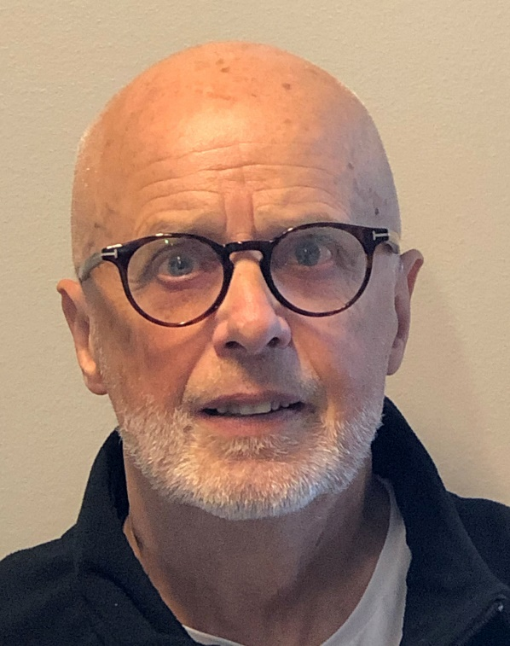
2024 Class A2 – Social and Related Sciences Section – The Human Mind and its Complexity
Kenneth Hugdahl University of Bergen Norway | Cognitive neuroscience Neuroimaging, functional magnetic resonance imaging (fMRI) Hemispheric asymmetry and auditory processing Neuroscience of mental disorders, schizophrenia and auditory hallucinations Experimental psychology, attention and language

Slide 39

2024 Class A2 – Social and Related Sciences Section – The Human Mind and its Complexity
Sonja Kotz Maastricht University The Netherlands | Integration of neuroimaging methods Cognitive, affective, comparative, & translational neuroscience

Slide 40

2024 Class A2 – Social and Related Sciences Section – The Human Mind and its Complexity
Carlo Alberto Marzi University of Verona Italy | Neurophysiology of visual functions Neuropsychology of vision Functional magnetic resonance imaging Visual event-related potentials Hemispheric asymmetries and Interhemispheric transfer Cognitive neuroscience Neuropsychology of selective attention

Slide 41

2024 Class A2 – Social and Related Sciences Section – The Human Mind and its Complexity
Uta Noppeney Radboud University Nijmegen The Netherlands | Human neuroimaging (Multisensory) Perceptual inference, Learning & Attention Semantics & concept learning Cognitive neuroscience

