Slide 1
2024 Class B – Exact Sciences Section – Mathematics
Overall section members: 239 Overall foreign members: 33 Overall female members: 28

Slide 2

2024 Class B – Exact Sciences Section – Mathematics
Ana Caraiani Imperial College London United Kingdom | Algebraic number theory Arithmetic geometry Representation theory Langlands program

Slide 3

2024 Class B – Exact Sciences Section – Mathematics
Gary Froyland UNSW Sydney Australia | Algebraic number theory Arithmetic geometry Representation theory Langlands program

Slide 4

2024 Class B – Exact Sciences Section – Mathematics
Gergely Harcos Alfréd Rényi Institute of Mathematics Budapest Hungary | Analytic number theory Automorphic forms L-functions

Slide 5
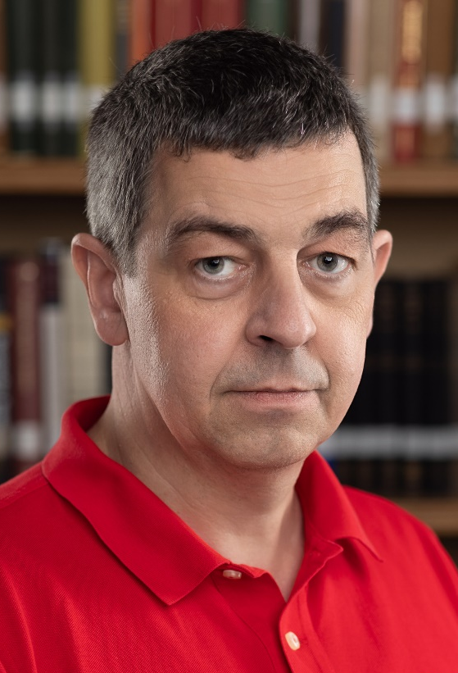
2024 Class B – Exact Sciences Section – Mathematics
Lars Hesselholt University of Copenhagen Denmark | Homotopy theory Arithmetic geometry

Slide 6
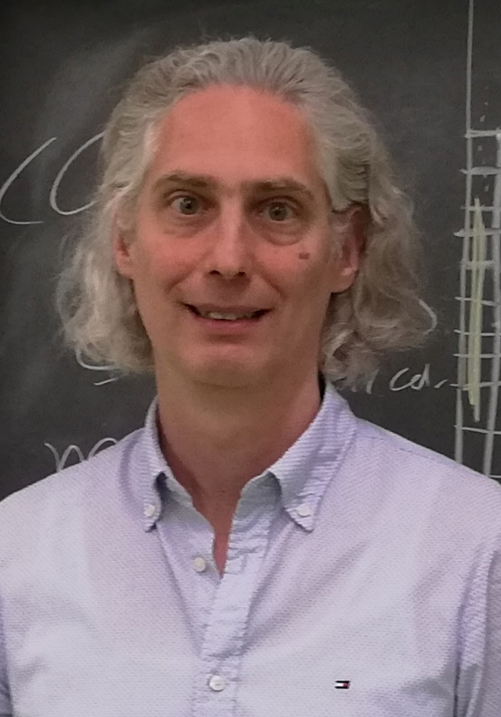
2024 Class B – Exact Sciences Section – Mathematics
Andrew Kresch University of Zurich Switzerland | Rationality problems Algebraic geometry Brauer groups

Slide 7
2024 Class B – Exact Sciences Section – Mathematics
Rafał Latała University of Warsaw Poland | Convex geometry Functional analysis Asymptotic geometric analysis Probability theory

Slide 8

2024 Class B – Exact Sciences Section – Mathematics
Leonid Polterovich Tel Aviv University Israel | Symplectic and contact topology Dynamical systems Classical and quantum mechanics

Slide 9
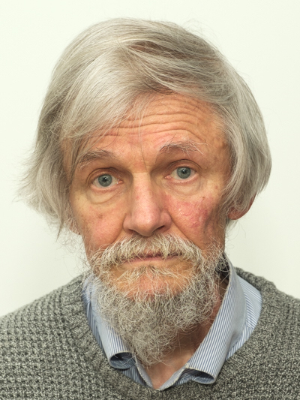
2024 Class B – Exact Sciences Section – Mathematics
Miles Reid University of Warwick Coventry United Kingdom | Algebraic geometry

Slide 10

2024 Class B – Exact Sciences Section – Mathematics
Marta Sanz-Solé Universitat de Barcelona Spain | Stochastic differential Partial differential equations Malliavin calculus Random fields Analysis on the Wiener space

Slide 11
2024 Class B – Exact Sciences Section – Mathematics
Nizar Touzi New York University USA | Stochastic processes Mathematical Finance Stochastic control Mean field games Monte Carlo methods Probability theory

Slide 12

2024 Class B – Exact Sciences Section – Mathematics
Emmanuel Trélat Sorbonne Université Paris France | Optimal control Applications of optimal control to aerospace problems Sub-Riemannian geometry Controllability, observability, stabilization of PDEs Best actuator and sensor shape and location

Slide 13
2024 Class B – Exact Sciences Section – Informatics
Overall section members: 383 Overall foreign members: 86 Overall female members: 33

Slide 14

2024 Class B – Exact Sciences Section – Informatics
Barbara Hammer University of Bielefeld Germany | Artificial intelligence applications for social good Human-centered machine learning Learning for data streams Neural networks for structured data Neuro-symbolic systems Explainable artificial intelligence Machine learning Nonlinear dimensionality reduction and self-organization

Slide 15

2024 Class B – Exact Sciences Section – Informatics
Mira Mezini TU Darmstadt Germany | AI programming systems Automated software engineering Software security Programming languages design and implementation

Slide 16
2024 Class B – Exact Sciences Section – Informatics
Stefanie Rinderle-Ma Technical University of Munich Germany | Workflow automation Information systems Collaborative and distributed processes Business process management AI-driven compliance management Process intelligence Flexible process technologies

Slide 17
2024 Class B – Exact Sciences Section – Informatics
Louis Wehenkel University of Liège Belgium | Electric power systems reliability management and optimal decision making under uncertainties Bioinformatics and computational systems biology Machine learning

Slide 18

2024 Class B – Exact Sciences Section – Informatics
F. Richard Yu Carleton University Ottawa Canada | Machine learning and artificial intelligence Connected and autonomous vehicles Blockchain and distributed ledger technology Security and privacy in networks Mobile wireless networks

Slide 19

2024 Class B – Exact Sciences Section – Informatics
Andreas Zeller CISPA Helmholtz Center for Information Security Saarbrucken Germany | Software security Automated software debugging Software testing and analysis Mining software archives Mining software specifications Generating software tests

Slide 20
2024 Class B – Exact Sciences Section – Physics & Engineering Sciences
Overall section members: 511 Overall foreign members: 80 Overall female members: 45

Slide 21
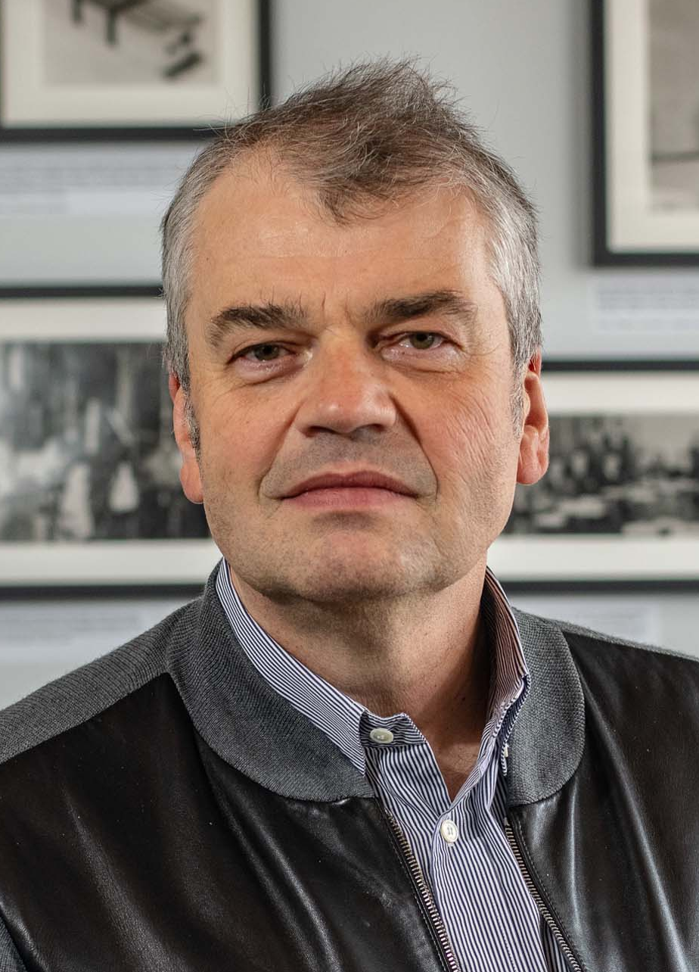
2024 Class B – Exact Sciences Section – Physics & Engineering Sciences
Dmitri Basov Columbia University New York USA | Optical spectroscopy Unconventional superconductors Nano-imaging Correlated electron systems Quantum materials Ultra-fast spatio-temporal nano-imaging

Slide 22
2024 Class B – Exact Sciences Section – Physics & Engineering Sciences
Darwin Caldwell Italian Institute of Technology Genoa Italy | Industrial robotics Actuation and actuators Humanoid and quadrupedal robotics Robotics Exoskeletons Medical robotics Haptics Telepresence

Slide 23

2024 Class B – Exact Sciences Section – Physics & Engineering Sciences
Eric Collet University Rennes France | Functional materials Electronic properties and materials Symmetry breaking Time-resolved X-ray diffraction and absorption Spin cross-over, charge transfer, photoswitchability Phase transitions and critical phenomena Out-of-equilibrium dynamics Synchrotron radiation, X-Ray free electron laser (X-FEL) Ultra-fast photoinduced phase transitions Coupled electronic instability and symmetry breaking

Slide 24

2024 Class B – Exact Sciences Section – Physics & Engineering Sciences
Paolo Colombo Università di Padova Italy | Architected materials Additive manufacturing Geopolymers Preceramic polymers Porous ceramics

Slide 25
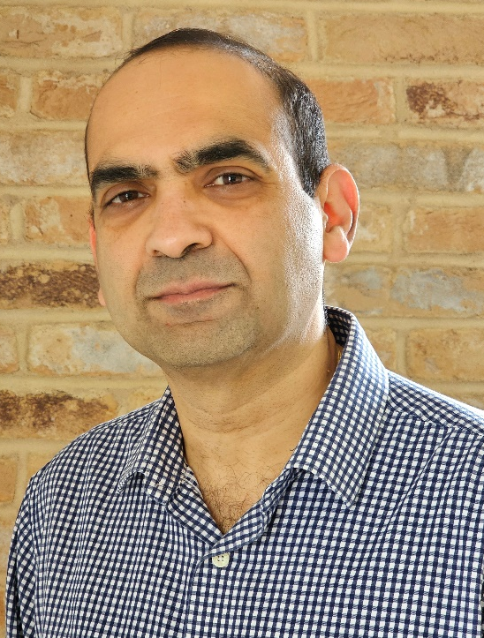
2024 Class B – Exact Sciences Section – Physics & Engineering Sciences
Vikram Deshpande University of Cambridge United Kingdom | Mechanobiology Solid mechanics Data-driven mechanics Microarchitectured solids Fluid-structure interaction in impact Chemo-mechanics Dislocation mechanics

Slide 26

2024 Class B – Exact Sciences Section – Physics & Engineering Sciences
Tiziana Di Matteo King’s College London United Kingdom | Granular materials Numerical simulations of diffusive processes for the analysis of the magnetic properties in new materials Magnetic properties of high-Tc superconductors Econophysics Network science Josephson Junction networks Data science Strongly correlated electronic systems and high-Tc superconductivity Complex systems Superconducting technological devices

Slide 27
2024 Class B – Exact Sciences Section – Physics & Engineering Sciences
Marcella Diemoz Istituto Nazionale di Fisica Nucleare (INFN) Rome Italy | Dark matter Neutrino physics Electroweak interactions High energy physics Collider physics

Slide 28
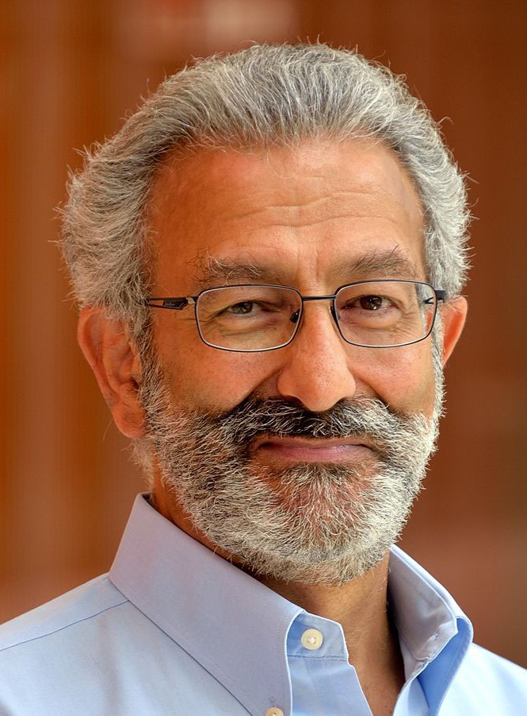
2024 Class B – Exact Sciences Section – Physics & Engineering Sciences
Nader Engheta University of Pennsylvania Philadelphia USA | Electromagnetics/Optics/nanophotonics/plasmonics Optical metatronics and modularized photonics Fractional paradigm in electrodynamics Metamaterials Bio-inspired polarization imaging Omega and chiral media Plasmonic cloaking Near-zero-index photonics Graphene photonics Photonic doping

Slide 29

2024 Class B – Exact Sciences Section – Physics & Engineering Sciences
Fengzhou Fang University College Dublin Ireland | Bio-medical manufacturing Precision manufacturing Optical design and manufacturing

Slide 30

2024 Class B – Exact Sciences Section – Physics & Engineering Sciences
Ambrogio Fasoli Swiss Federal Institute of Technology- Lausanne (EPFL) Lausanne Switzerland | Plasma magnetic confinement Magnetic reconnection Physics of burning plasmas Suprathermal particle physics Plasma physics Fusion energy Plasma waves Turbulence

Slide 31

2024 Class B – Exact Sciences Section – Physics & Engineering Sciences
Despo Fatta-Kassinos University of Cyprus Aglantzia Cyprus | Contaminants of emerging concern in the environment and technical systems Reclaimed water reuse Advanced processes for wastewater treatment Antimicrobial resistance determinants in natural and engineered systems

Slide 32
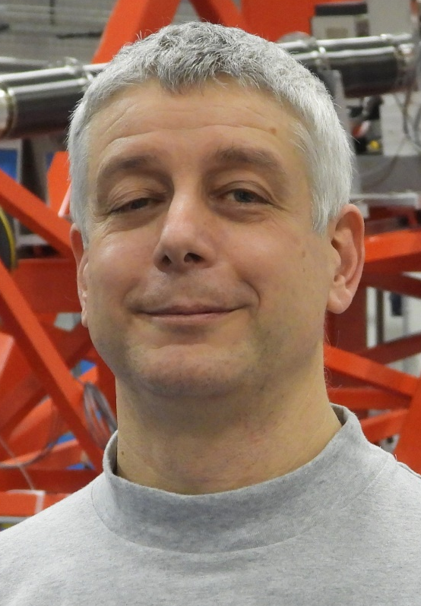
2024 Class B – Exact Sciences Section – Physics & Engineering Sciences
Giacomo Claudio Ghiringhelli Politecnico di Milano Italy | High Tc Superconductors Strongly Correlated Electron Systems Synchrotron Research X-Ray Science

Slide 33

2024 Class B – Exact Sciences Section – Physics & Engineering Sciences
Soteris Kalogirou Cyprus University of Technology Limassol Cyprus | Designed innovative renewable energy systems Renewable energy engineering Artificial Intelligence in renewable energy modelling, prediction and fault-finding Advanced thermodynamic analysis and modelling of solar thermal and photovoltaic applications

Slide 34
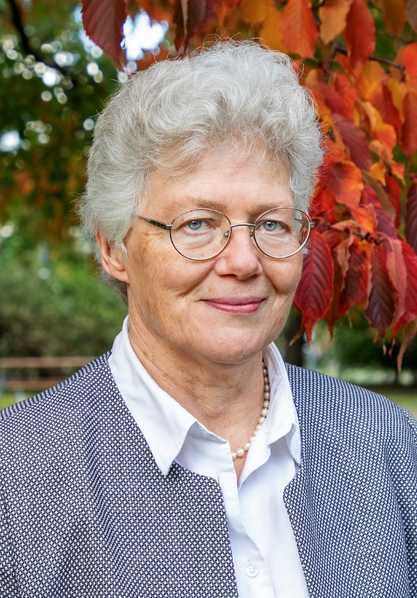
2024 Class B – Exact Sciences Section – Physics & Engineering Sciences
Anne L'Huillier Lund University Sweden | Electron dynamics of atomic systems Attosecond physics Atomic and molecular physics Attosecond light sources designed for different goals

Slide 35

2024 Class B – Exact Sciences Section – Physics & Engineering Sciences
James Lam University of Hong Kong China | Control theory Networked control systems Dynamic systems Positive systems Multidimensional systems Estimation theory Multi-agent systems Vibration control Neural networks Complex networks

Slide 36
2024 Class B – Exact Sciences Section – Physics & Engineering Sciences
Rodrigo Martins New University of Lisbon Portugal | Advanced functional materials Design and architecture of solar cells Tandem solar cells Biosensors Thin film solar cells Oxide semiconductor Energy storage: super-capacitors, batteries, hydrogen Co-pioneer in transparent electronics Responsible electronics Co-pioneer and co-inventor of the paper transistor and paper memory

Slide 37

2024 Class B – Exact Sciences Section – Physics & Engineering Sciences
Urbashi Mitra University of Southern California Los Angeles USA | Sensor networks Wireless communication systems (4G,5G,6G) Machine learning Molecular communications Statistical learning and inference Underwater networking Information theory Communication theory Signal processing

Slide 38

2024 Class B – Exact Sciences Section – Physics & Engineering Sciences
Martin Ostoja-Starzewski University of Illinois at Urbana-Champaign USA | Sensor networks Wireless communication systems (4G,5G,6G) Machine learning Molecular communications Statistical learning and inference Underwater networking Information theory Communication theory Signal processing

Slide 39

2024 Class B – Exact Sciences Section – Physics & Engineering Sciences
S. Ravi P. Silva University of Surrey Guildford United Kingdom | Engineering science Nanoelectronics Solar cells Nanotechnology Electronic engineering Engineering science Thin film coatings Carbon materials Applied physics Materials science Energy materials

Slide 40

2024 Class B – Exact Sciences Section – Physics & Engineering Sciences
Tamás Tél Eötvös Loránd University Budapest Hungary | Numerical investigations of particle advection, spreading of pollutants Environmental fluid dynamics and related laboratory experiments Statistical physics, stochastic processes, non-equilibrium potentials Physics of systems subjected to parameter drift Transport and irreversibility from a chaotic point of view Climate dynamics Nonlinear phenomena, chaos and transient chaos, fractals Dynamics of inertial particles, reactions in flows

Slide 41

2024 Class B – Exact Sciences Section – Physics & Engineering Sciences
Alice Valkárová Czech Science Foundation Prague Czech Republic | Diffraction Ep interactions Antip-p interactions Particle physics Photoproduction

Slide 42

2024 Class B – Exact Sciences Section – Physics & Engineering Sciences
Massimo Vergassola CNRS/Ecole Normale Supérieure Paris/Paris Sciences et Lettres Paris France | Physics of living systems Fluid dynamics Continuum mechanics Statistical physics

Slide 43

2024 Class B – Exact Sciences Section – Physics & Engineering Sciences
Xiao-Cong Yuan Shenzhen University China | Optical communication Photoacoustic microscopy Optical trapping Plasmonics Structured light Nanophotonics Optical vortices

Slide 44

2024 Class B – Exact Sciences Section – Physics & Engineering Sciences
Jun Zhang New York University USA | Physics of fluid Biological Physics (animal swimming and flying) Nonlinear dynamics and complex systems Experimental fluid dynamics Instabilities and symmetry-breaking bifurcations Soft matter physics

Slide 45
2024 Class B – Exact Sciences Section – Chemical Sciences
Overall section members: 328 Overall foreign members: 41 Overall female members: 54

Slide 46
2024 Class B – Exact Sciences Section – Chemical Sciences
De Chen Norwegian University of Science and Technology Trondheim Norway | Multiscale study of catalysis Mechanistic and kinetic study of heterogenous catalysis Biomass conversion techniques Process scaling up Rational design of catalysts

Slide 47

2024 Class B – Exact Sciences Section – Chemical Sciences
Jonathan Coleman University of Dublin Ireland | Printing and solution deposition of nanomaterials Nanotubes, nanowires and other 1D materials Materials chemistry, nanosciences and nanotechnology Liquid exfoliation and solution processing of nanomaterials Processing and characterization of nanocomposites Graphene and other 2D materials Nanomaterials for printed electronic devices and sensors Nanomaterials for energy storage

Slide 48

2024 Class B – Exact Sciences Section – Chemical Sciences
Patricia Dankers Eindhoven University of Technology The Netherlands | Supramolecular chemistry Hydrogels Biomedical materials Regenerative medicine Polymer chemistry Cell cultures Biomaterials Drug delivery

Slide 49
2024 Class B – Exact Sciences Section – Chemical Sciences
Jürgen Gauss Johannes Gutenberg-Universität Mainz Germany | Theoretical chemistry Quantum chemistry Theoretical support for the interplay of theory and experiment in rovibrational spectroscopy Quantum-chemical calculation of molecular properties Treatment of electron correlation via coupled-cluster theory Quantum-chemical treatment of relativistic effects Prediction and identification of new molecules Quantum-chemical calculation of NMR chemical shifts

Slide 50

2024 Class B – Exact Sciences Section – Chemical Sciences
Yury Gogotsi Drexel University Philadelphia USA | MXenes Materials chemistry Nanotechnology Materials science Energy storage Electrochemistry

Slide 51

2024 Class B – Exact Sciences Section – Chemical Sciences
Wolfgang A. Herrmann Technische Universität München Germany | Molecularly-defined catalysts Inorganic chemistry High-Oxidation-State transition-metal complexes Homogenous catalysis N-Heterocyclic carbene Organometallic chemistry C–C Coupling reactions

Slide 52
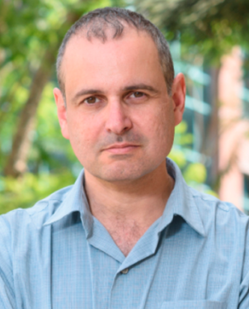
2024 Class B – Exact Sciences Section – Chemical Sciences
Leeor Kronik Weizmann Institute of Science Rehovoth Israel | Molecular crystals Halide perovskites Electronic structure theory Density functional theory 2d materials

Slide 53

2024 Class B – Exact Sciences Section – Chemical Sciences
Todd B. Marder Julius-Maximilians-Universität Würzburg Germany | Fluoroarene-arene interactions in crystal engineering and liquid crystal phase behavior Organometallic Chemistry (Metal boron complexes, synthesis of model catalytic intermediates, luminescent organometallics) Homogeneous Catalysis (Borylations including C-H and C-X bond functionalization and addition reactions,coupling reactions) Conjugated organic, organoboron and organometallic materials for applications in linear and nonlinear optics, organic electronics, bioimaging, photodynamic therapy, and sensing of biomolecules

Slide 54

2024 Class B – Exact Sciences Section – Chemical Sciences
Thanh Thi Kim Nguyen University College London United Kingdom | Chemical synthesis of nanomaterials Physical characterisation of nanomaterials Biofunctionalisation of nanomaterials for biomedical applications

Slide 55

2024 Class B – Exact Sciences Section – Chemical Sciences
Javier Pérez-Ramirez ETH Zurich Switzerland | Nanostructured materials Renewable energy conversion Halogen chemistry Catalysis Sustainable chemistry Single atom catalysis Chemical engineering CO2 valorisation Chemical plastic recycling Halogen chemistry Sustainable chemistry

Slide 56

2024 Class B – Exact Sciences Section – Chemical Sciences
Thalappil Pradeep Indian Institute of Technology Madras Chennai India | Instrumentation Molecular surfaces Low energy ion scattering Molecular and nanoscale materials Nanoscience and nanotechnology Water purification

Slide 57
2024 Class B – Exact Sciences Section – Chemical Sciences
Ruth Signorell ETH Zurich Switzerland | Single droplet/particle studies Aerosol and molecular cluster science Chemical reaction kinetics in confined systems Single droplet spectroscopy and scattering Phase transitions in particulate matter Gas phase nucleation Optical trapping Photoelectron imaging of confined systems

Slide 58
2024 Class B – Exact Sciences Section – Chemical Sciences
Xinchen Wang Fuzhou University Fuzhou China | Materials chemistry Heterogeneous photocatalysis Physical chemistry Water splitting chemistry Artificial photosynthesis Metal/conjugated organic frameworks for solar energy utilization Chemistry Energy materials

Slide 59
2024 Class B – Exact Sciences Section – Earth & Cosmic Sciences
Overall section members: 455 Overall foreign members: 48 Overall female members: 57

Slide 60

2024 Class B – Exact Sciences Section – Earth & Cosmic Sciences
Susanne Buiter Helmholtz Centre Potsdam Germany | Quantitative investigation of deformation processes in crust and lithosphere Subduction zone dynamics, terrane accretion, and continental collision Development of 2D/3D numerical modelling software Numerical modelling of the Wilson Cycle of subduction, collision and rifting Numerical and analogue (laboratory) model benchmarks of brittle thrust wedges Formation and evolution of rifted continental margins

Slide 61
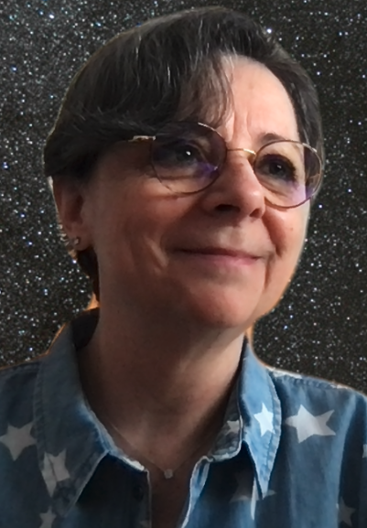
2024 Class B – Exact Sciences Section – Earth & Cosmic Sciences
Cecilia Ceccarelli Université Grenoble Alpes Grenoble France | Interstellar medium Solar system history Astrophysics Molecular physics Star formation Astrochemistry

Slide 62

2024 Class B – Exact Sciences Section – Earth & Cosmic Sciences
Francisco Doblas-Reyes Barcelona Supercomputing Center Spain | Climate adaptation Climate prediction Climate modelling Climate services

Slide 63

2024 Class B – Exact Sciences Section – Earth & Cosmic Sciences
Kevin Heng Ludwig Maximilian University Munich Germany | Planetary science Atmospheric radiative transfer Astronomy Atmospheric dynamics Atmospheric chemistry Theoretical astrophysics Exoplanet science

Slide 64

2024 Class B – Exact Sciences Section – Earth & Cosmic Sciences
Hartmut Herrmann Leibniz-Institute for Tropospheric Research (TROPOS) Leipzig Germany | Photochemistry Multiphase modelling Atmospheric chemistry Multiphase chemistry Aerosol and cloud chemistry Air pollution Kinetics

Slide 65
2024 Class B – Exact Sciences Section – Earth & Cosmic Sciences
Emilia Kilpua University of Helsinki Finland | Solar wind - magnetosphere interactions Space weather Solar-terrestrial physics Coronal mass ejections Radiation belts Geomagnetic storms

Slide 66

2024 Class B – Exact Sciences Section – Earth & Cosmic Sciences
Lyesse Laloui EPFL – Swiss Federal Institute of Technology Lausanne Switzerland | Energy geostructures Biomediated soils and grouting Smart urban design Geotechnical engineering Soil mechanics Geothermal energy Climate change mitigation and adaptation

Slide 67
2024 Class B – Exact Sciences Section – Earth & Cosmic Sciences
Barbara Maher Lancaster University United Kingdom | Sediment provenancing Particulate air pollution, health impacts, mitigation Environmental magnetism Palaeomagnetism Quaternary palaeoclimate

Slide 68

2024 Class B – Exact Sciences Section – Earth & Cosmic Sciences
Abdelwahid Mellouki University Mohammed VI Polytechnic (UM6P) Ben Guerir Marocco | Gas phase atmospheric physicochemical processes Air quality Atmospheric kinetics and oxidation mechanisms Atmospheric chemistry

Slide 69

2024 Class B – Exact Sciences Section – Earth & Cosmic Sciences
Stephen Mojzsis MTA Hungarian Academy of Sciences Hungary | Biogeodynamics Planetary geochemistry Geoastronomy Nuclear cosmochemistry Solid-state physics Radiogenic isotope geochemistry Stable isotope geochemistry Geochronology Metamorphic field petrology Origins of life

Slide 70
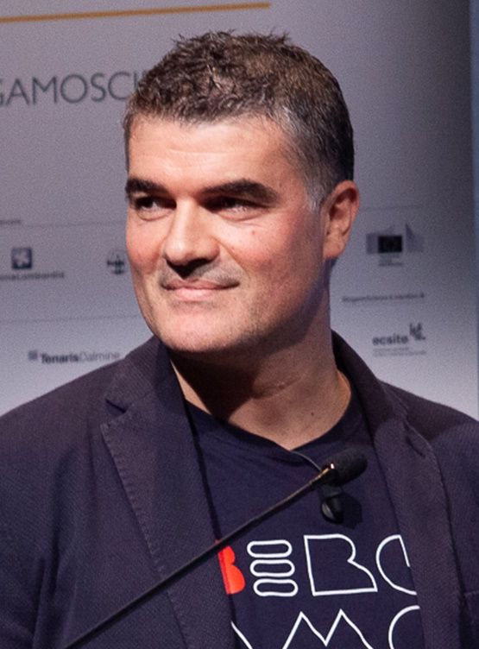
2024 Class B – Exact Sciences Section – Earth & Cosmic Sciences
Fabrizio Nestola University of Padova Italy | Natural diamonds High-pressure and high-temperature mineralogy Meteorites Deep-earth geological processes

Slide 71

2024 Class B – Exact Sciences Section – Earth & Cosmic Sciences
Daniel Rosenfeld The Hebrew University of Jerusalem Israel | Aerosol-cloud interactions Cloud electrification Tropical cyclones Climate change Severe convective storms Geoengineering Cloud physics

Slide 72

2024 Class B – Exact Sciences Section – Earth & Cosmic Sciences
Karline Soetaert Netherlands Institute for Sea Research (NIOZ) Utrecht The Netherlands | Food-web studies Benthic-pelagic coupling Applied mathematics Biogeochemical modelling Marine biodiversity Computer science Coastal ecosystem sciences Sediment-animal interactions

Slide 73

2024 Class B – Exact Sciences Section – Earth & Cosmic Sciences
Gerard van der Steenhoven University of Twente Oosthuizen The Netherlands | Climate science Meteorology Earth observation Nuclear physics Astroparticle physics Satellite instrumentation High-energy physics

Slide 74
2024 Class B – Exact Sciences Section – Earth & Cosmic Sciences
Stephanie Werner University of Oslo Norway | Formation and evolution of planets Remote sensing of the Earth and planets Potential field data interpretation Cratering chronology, cratering processes, planetary dynamics Formation and evolution of (exo-)planetary systems

Slide 75

2024 Class B – Exact Sciences Section – Earth & Cosmic Sciences
Xiaoxiang Zhu Technical University of Munich Germany | Synthetic aperture radar Remote sensing Global urban mapping Data science Machine learning Earth observation Signal processing

