Slide 1



Science for policy: the European perspective
This project has received funding from the European Union’s Horizon 2020 research and innovation programme under grant agreement No 737432.

Slide 2

European Commission’s Scientific Advice Mechanism
Established in 2015 by the European Commission
Designed to be transparent and as free of bias as possible
Composed by the Group of Chief Scientific Advisors, the SAPEA consortium (Science Advice for Policy by European Academies) and a dedicated Unit within the European Commission
SAPEA provides evidence review and analysis
Group of Chief Scientific Advisors provides scientific advice
Better policymaking & legislation outcome for citizens

Slide 3
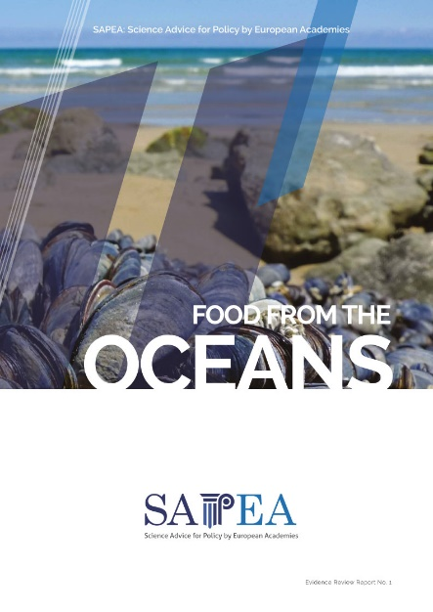
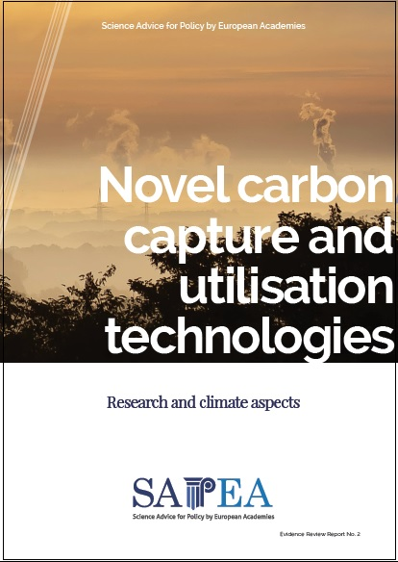
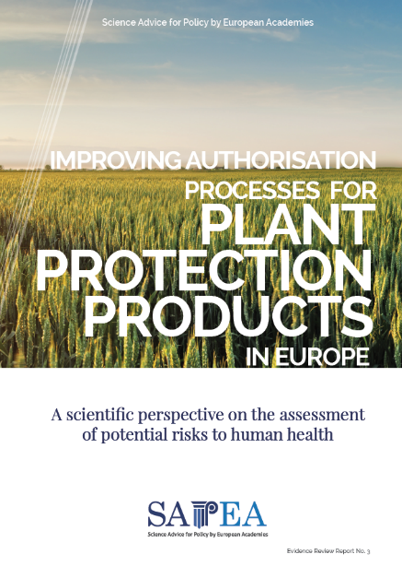
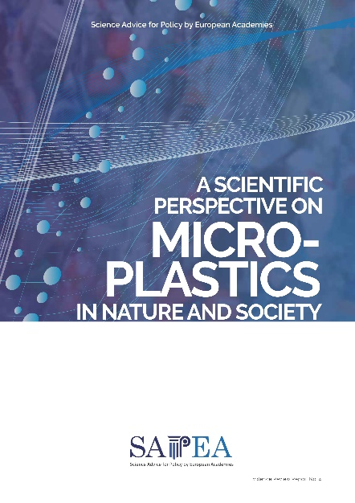
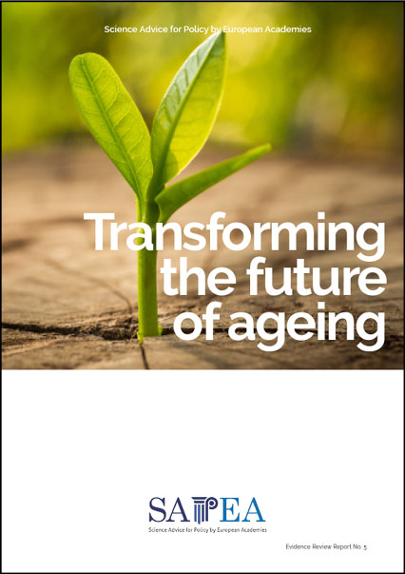
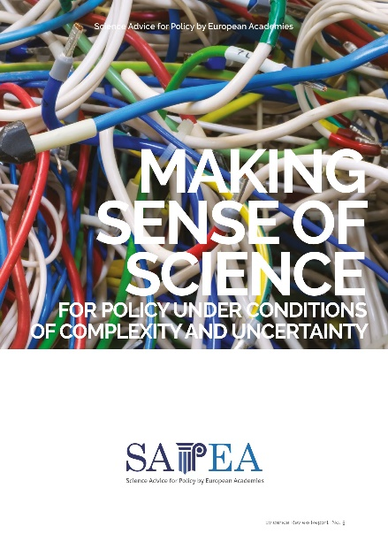
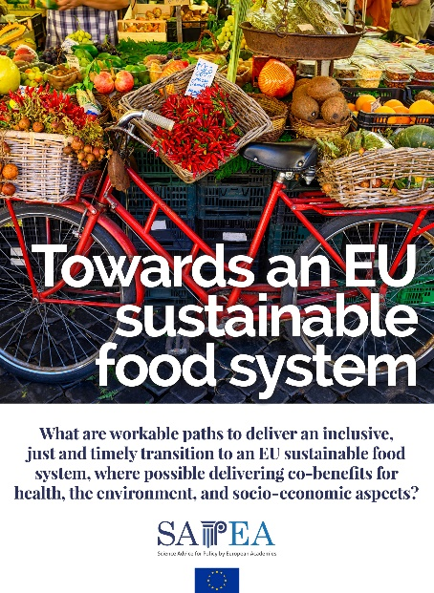
SAPEA Evidence Reviews published to date
All reports are available at www.sapea.info
Forthcoming topic:

Slide 4


SAPEA Evidence Reviews: a transparent and independent process
  SAPEA Working Groups
    Scientific excellence
    Interdisciplinary
    Gender balanced
    Geographically diverse
    Young academicians
  Quality assurance process for SAPEA publications
    Declaration of interests is mandatory for working group members
    Extensive peer review
    Endorsed by the European Academy Networks
  Open access: All SAPEA reports are published under open licences

Slide 5

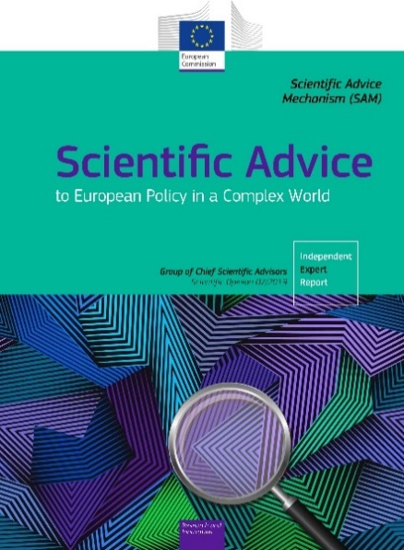
Making Sense of Science for Policy Evidence Review
SAPEA was asked to conduct an evidence review to inform the GCSA’s scientific opinion. The overarching question was:
The SAPEA Evidence Review Making Sense of Science for policy was launched in July 2019
The GCSA’s Scientific Opinion Scientific Advice to European Policy in a Complex World was launched in September 2019
How to provide good science advice to European Commission policymakers, based on available evidence, under conditions of scientific complexity and uncertainty?
Online versions of the reports are available at: www.sapea.info/topics/making-sense-of-science

Slide 6
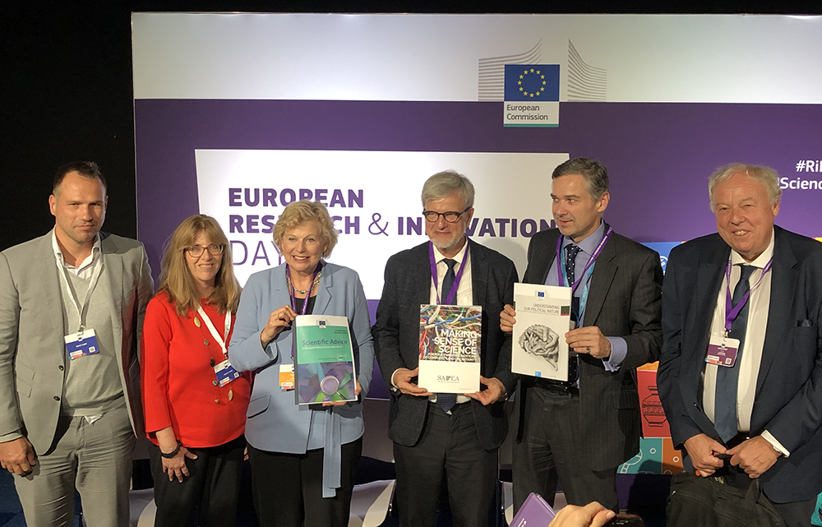
Handover of the reports and panel debate

Slide 7
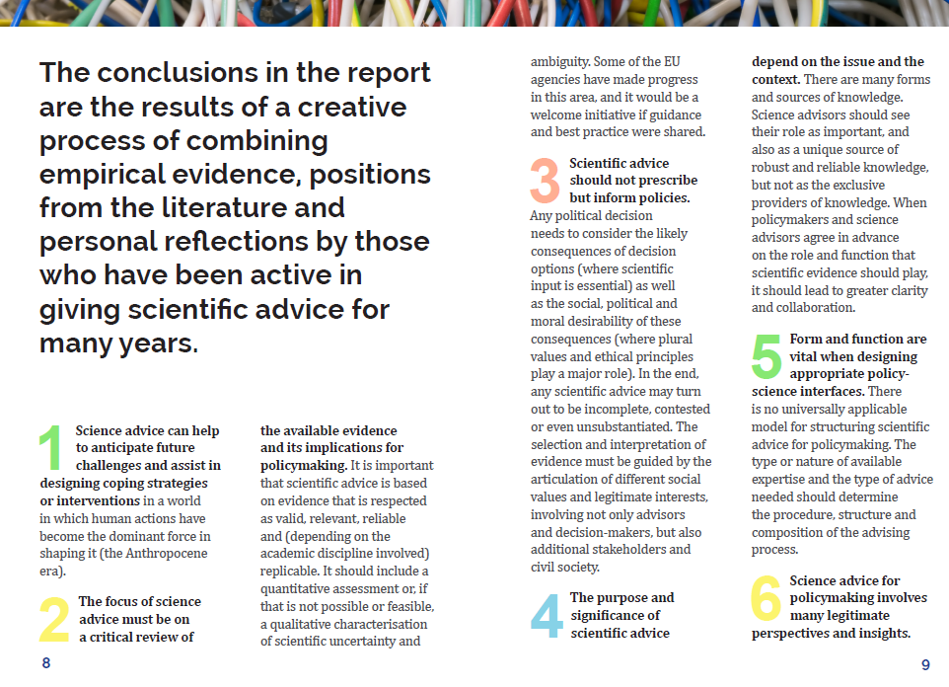
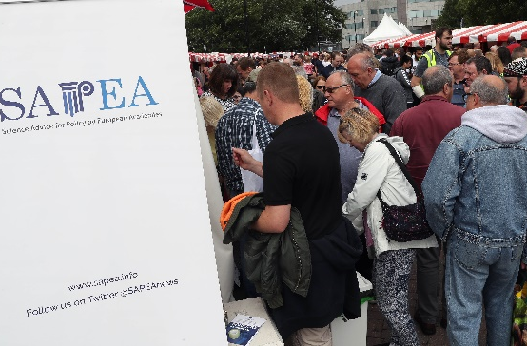
SAPEA outreach
To researchers
To policymakers
To general public
Academic conferences on the policy topic
Events and panel discussions organised by national academies
Summary leaflets
European Commission events
European Parliament hearings
SAPEA annual symposium
Briefings organised by national academies
Communication to EU think tanks, NGOs and other stakeholders
Science festivals
Infographics and videos
Social media activity
Online discussions

Slide 8
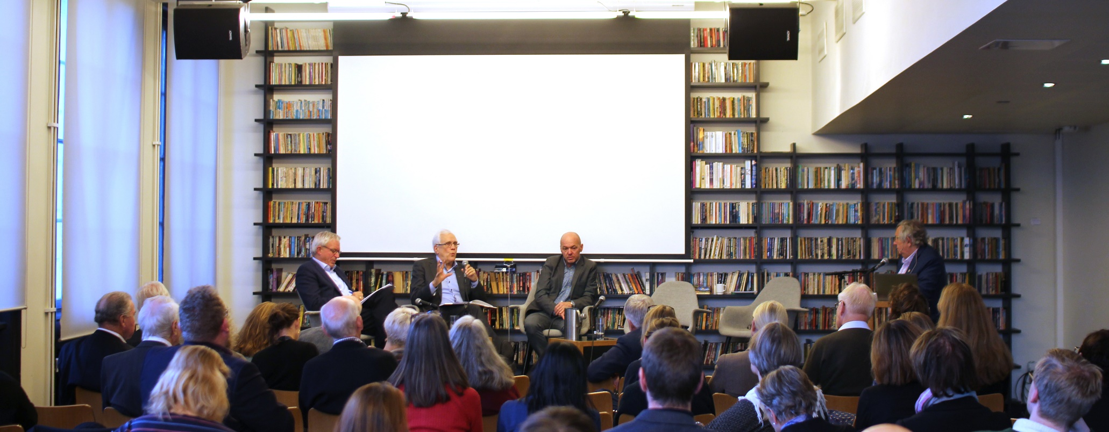
SAPEA outreach to researchers
Making sense of science for policy example
Evidence-informed policy: a Norwegian perspective
Seminar organised by the Academia Europaea Bergen Hub and the Norwegian Academy of Science and Letters on 4 November 2019 in Oslo
Session 1: The European dimension: Panel discussion with SAPEA experts
Session 2: The national dimension: Panel discussion with national experts

Slide 9
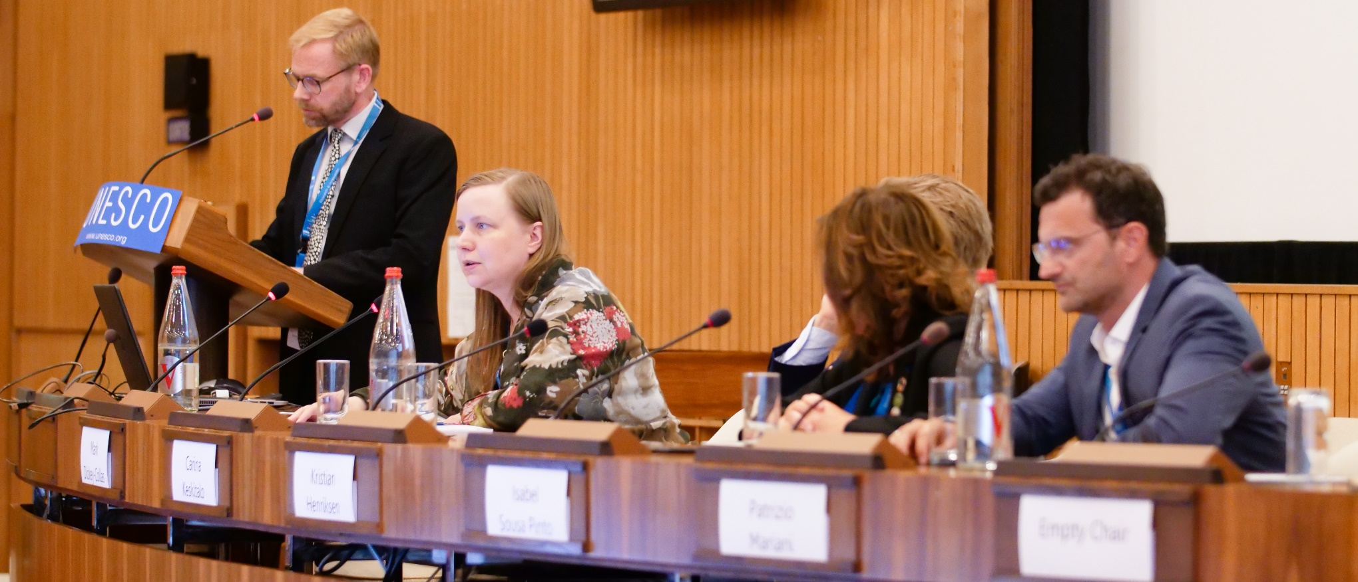
SAPEA outreach to policymakers
Food from the Oceans example
EurOCEAN 2019
High-level science-policy conference co-organised by European Marine Board, the European Commission and the Intergovernmental Oceanographic Commission of UNESCO on 11-12 June 2019. Carina Keskitalo, GCSA, presents the report during Sustainable Marine Resources session

Slide 10
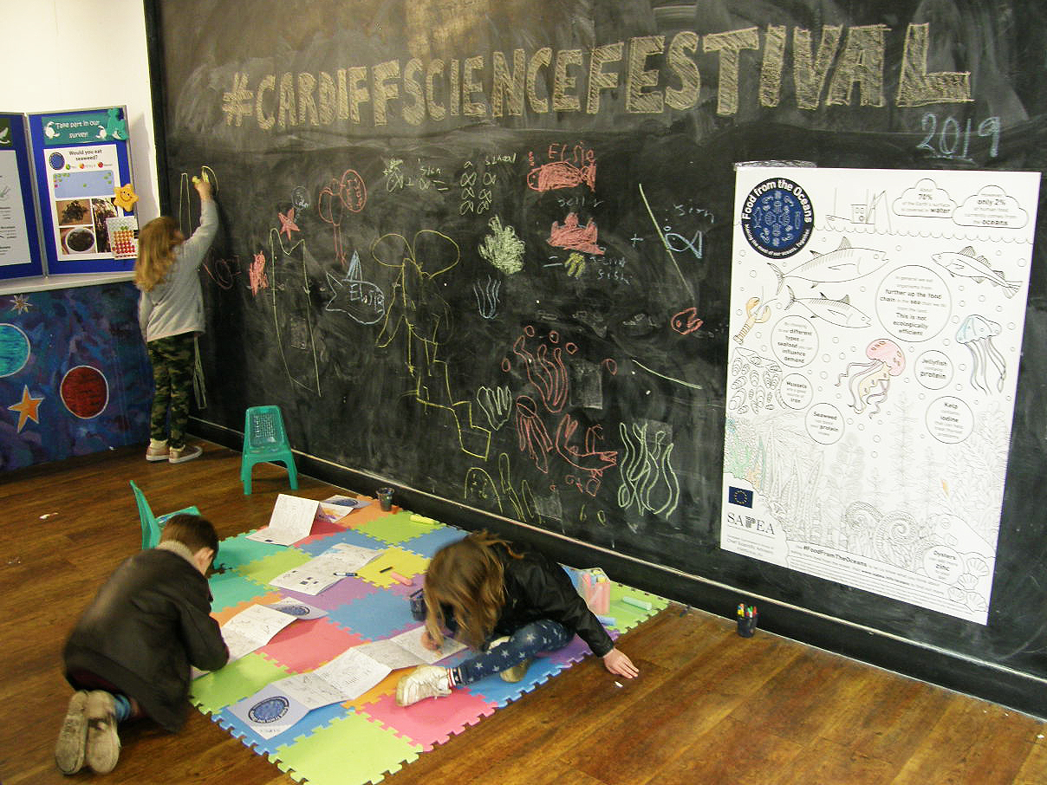
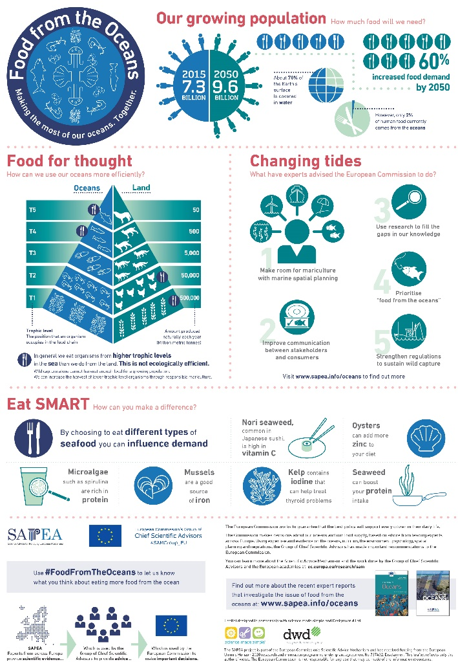
SAPEA outreach to the general public
Food from the Oceans example
Cardiff Science Festival 2019
The Academia Europaea Cardiff Hub organise the activity “Eat SMART. Eat Food from the Oceans!”, with large-scale infographics, a survey and a colouring activity

