Slide 1
Inexact Computing
Jordi Cortadella
Universitat Politècnica de Catalunya
Barcelona
Academia Europaea Annual Conferece
July 18th, 2014

Slide 2
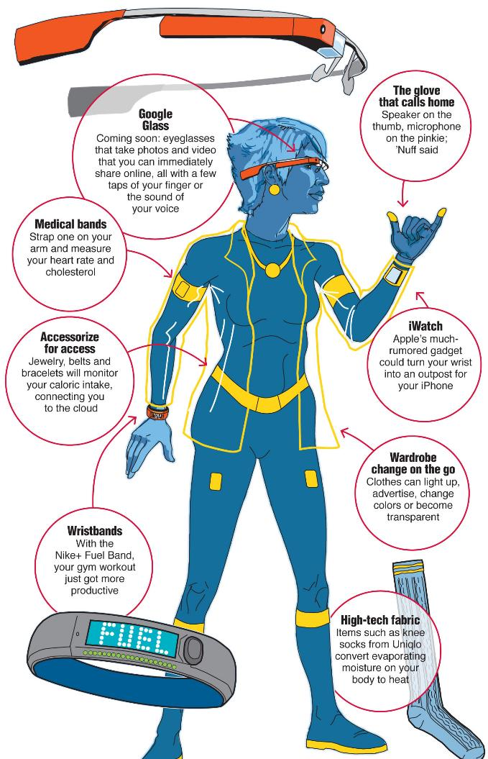
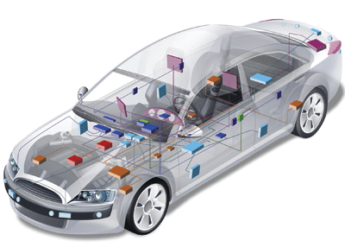
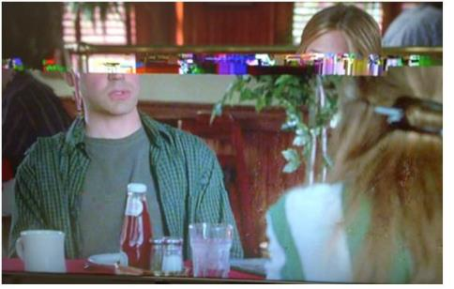

Slide 3
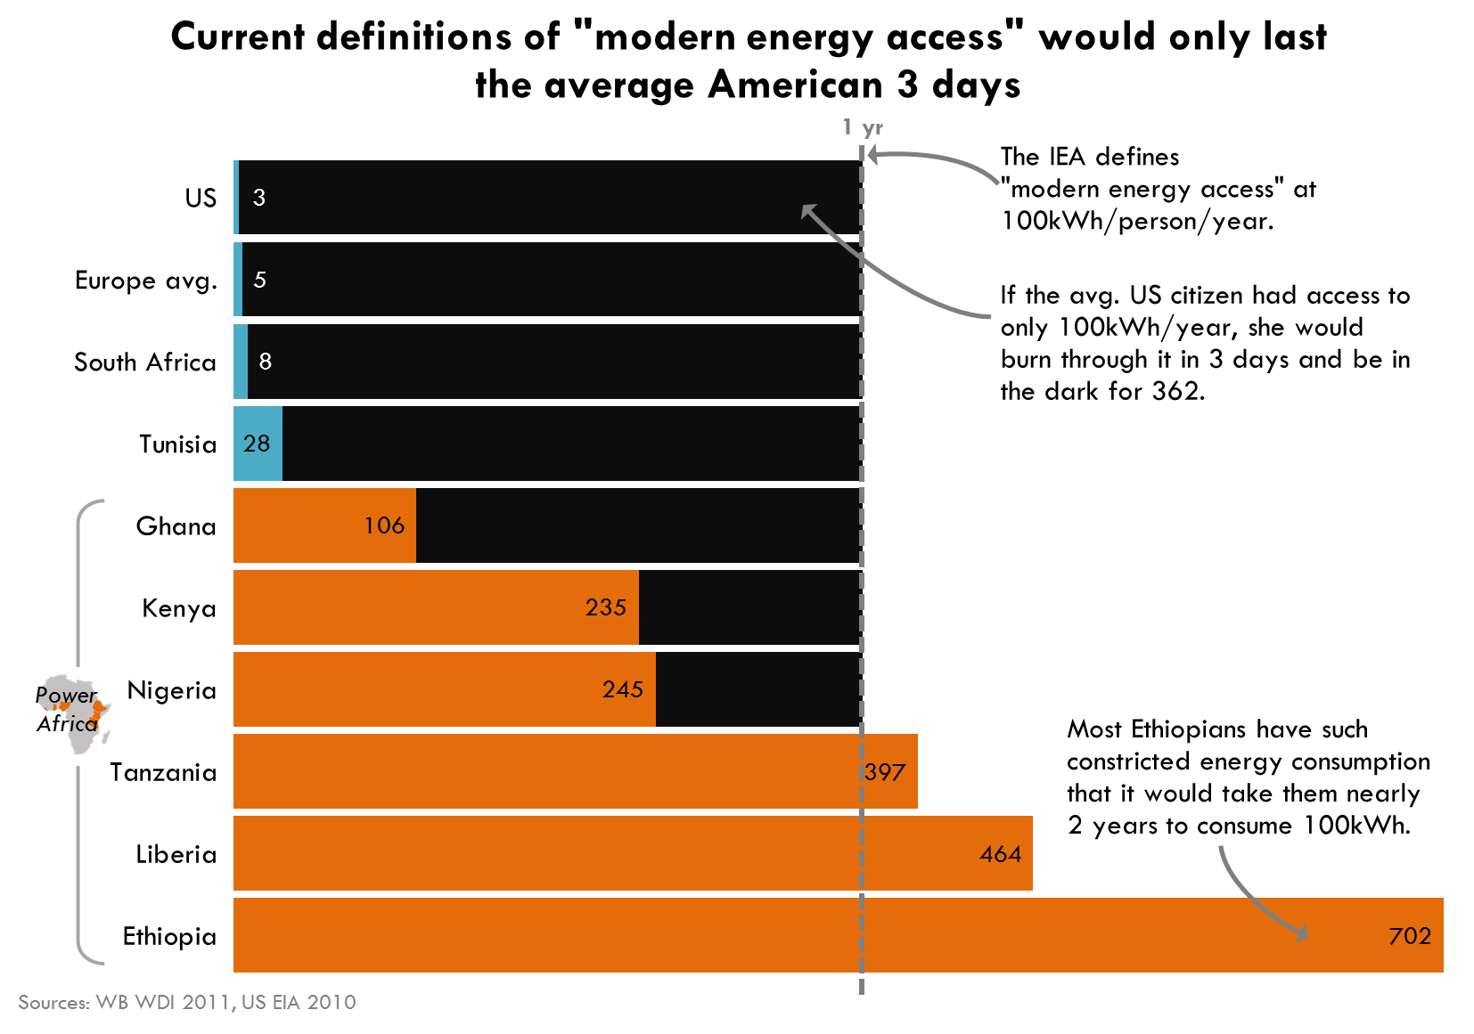

Slide 4

Power consumption: 150W
Energy:
2 weeks desktop ≈ 1 year Ethiopian person

Slide 5
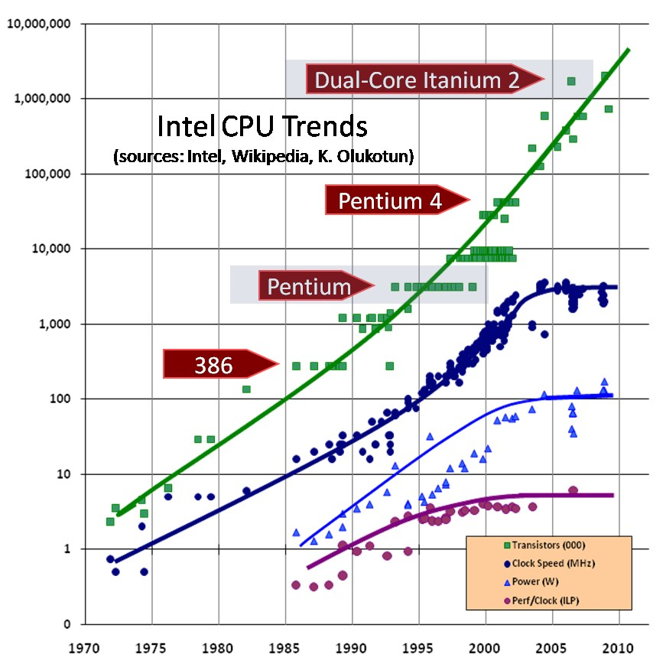
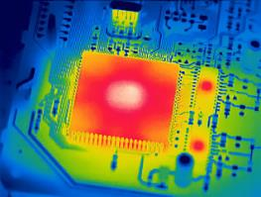
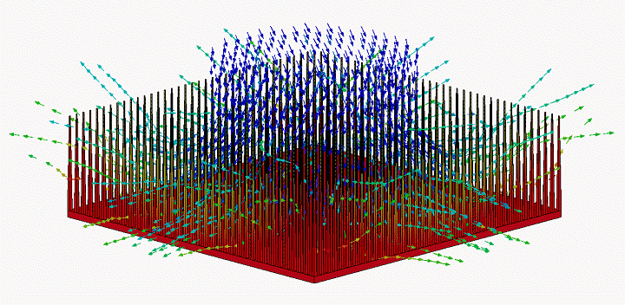
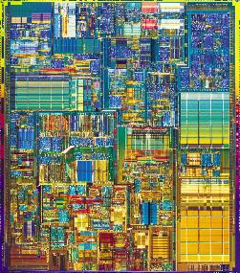
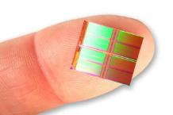
T_{chip} = T_{ambient} + Power • R_{thermal}
Power ∝ V² ƒ
ƒ ∝ V
Transistors
Thermal limit
Speed
Power

Slide 6
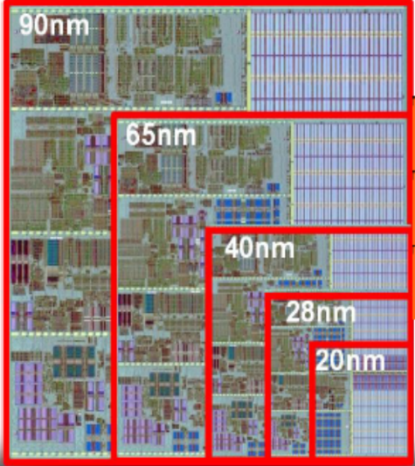
Technology and voltage scaling
Transistor size

Slide 7
Energy for computing
Energy
0
1

Slide 8
Energy for computing
0
1
Voltage

Slide 9
Energy for computing
0
1
Voltage

Slide 10
Energy and errors
Voltage →
1.0
0.9
0.8
Inexact
Computing
0.7
0.6
0.5
Energy
0.4
0.3
Exact
Computing
0.2
0.1
0.0
Source: Kumar, Rabaey, Ramchandran, Dept. EECS, UC Berkeley
SRAM Supply Voltage Scaling: a Reliability Perspective, ISQED 2009.

Slide 11
What does error mean?
1 | 1 | 0 | 0 | 1 | 0 | 0 | 0 | 1 | 0 | 1 | 1 | 0 | 0 | 1 | 0 | 0 | 0 | 1 | 0
0 | 0 | 0 | 1 | 1 | 1 | 0 | 1 | 1 | 1 | 1 | 0 | 0 | 1 | 1 | 0 | 1 | 0 | 1 | 1
0 | 1 | 1 | 1 | 0 | 0 | 0 | 0 | 1 | 0 | 0 | 0 | 1 | 1 | 0 | 0 | 1 | 1 | 0 | 0
1 | 0 | 1 | 0 | 1 | 0 | 0 | 1 | 1 | 0 | 1 | 1 | 0 | 0 | 1 | 0 | 0 | 0 | 1 | 0
0 | 0 | 1 | 1 | 1 | 0 | 0 | 0 | 0 | 1 | 0 | 0 | 0 | 0 | 1 | 0 | 1 | 1 | 0 | 1
1 | 1 | 1 | 0 | 0 | 1 | 0 | 0 | 0 | 1 | 1 | 1 | 0 | 1 | 1 | 1 | 0 | 0 | 1 | 0
0 | 0 | 1 | 1 | 1 | 0 | 0 | 1 | 0 | 0 | 1 | 1 | 0 | 0 | 0 | 0 | 1 | 0 | 0 | 0
1 | 1 | 0 | 0 | 0 | 1 | 1 | 1 | 0 | 1 | 1 | 1 | 1 | 1 | 0 | 1 | 1 | 1 | 0 | 1
0 | 0 | 1 | 1 | 0 | 0 | 1 | 0 | 1 | 0 | 1 | 1 | 0 | 0 | 1 | 0 | 0 | 0 | 1 | 0
1 | 1 | 0 | 0 | 0 | 1 | 1 | 1 | 0 | 1 | 1 | 1 | 1 | 0 | 0 | 0 | 1 | 1 | 0 | 1
0 | 1 | 0 | 0 | 0 | 0 | 1 | 0 | 1 | 1 | 0 | 1 | 0 | 0 | 0 | 0 | 1 | 0 | 1 | 1
1 | 0 | 1 | 1 | 1 | 0 | 0 | 0 | 1 | 1 | 1 | 0 | 0 | 0 | 0 | 1 | 0 | 1 | 0 | 0

Slide 12
What does error mean?
1 | 1 | 0 | 0 | 1 | 0 | 0 | 0 | 1 | 0 | 1 | 1 | 0 | 0 | 1 | 0 | 0 | 0 | 1 | 0
0 | 0 | 0 | 1 | 1 | 1 | 0 | 1 | 1 | 1 | 1 | 0 | 0 | 1 | 1 | 0 | 1 | 0 | 1 | 1
0 | 1 | 1 | 1 | 0 | 0 | 0 | 0 | 1 | 0 | 0 | 0 | 1 | 1 | 0 | 0 | 1 | 1 | 0 | 0
1 | 0 | 1 | 0 | 1 | 0 | 0 | 1 | 1 | 0 | 1 | 1 | 0 | 0 | 1 | 0 | 0 | 0 | 1 | 0
0 | 0 | 1 | 1 | 1 | 0 | 0 | 0 | 0 | 1 | 0 | 0 | 0 | 0 | 0 | 0 | 1 | 1 | 0 | 1
1 | 1 | 1 | 0 | 0 | 1 | 0 | 0 | 0 | 1 | 1 | 1 | 0 | 1 | 1 | 1 | 0 | 0 | 1 | 0
0 | 0 | 1 | 1 | 1 | 0 | 0 | 1 | 0 | 0 | 1 | 1 | 0 | 0 | 0 | 0 | 1 | 0 | 0 | 0
1 | 1 | 0 | 0 | 0 | 1 | 1 | 1 | 0 | 1 | 1 | 1 | 1 | 1 | 0 | 1 | 1 | 1 | 0 | 1
0 | 0 | 1 | 1 | 0 | 0 | 1 | 0 | 1 | 0 | 1 | 1 | 0 | 0 | 1 | 0 | 0 | 0 | 1 | 0
1 | 1 | 0 | 0 | 0 | 1 | 1 | 1 | 0 | 1 | 1 | 1 | 1 | 0 | 0 | 0 | 1 | 1 | 0 | 1
0 | 1 | 0 | 0 | 0 | 0 | 1 | 0 | 1 | 1 | 0 | 1 | 0 | 0 | 0 | 0 | 1 | 0 | 1 | 1
1 | 0 | 1 | 1 | 1 | 0 | 0 | 0 | 1 | 1 | 1 | 0 | 0 | 0 | 0 | 1 | 0 | 1 | 0 | 0

Slide 13
What does error mean?
1 | 1 | 0 | 0 | 1 | 0 | 0 | 0 | 1 | 0 | 1 | 1 | 0 | 0 | 1 | 0 | 0 | 0 | 1 | 0
0 | 0 | 0 | 1 | 1 | 1 | 0 | 1 | 1 | 1 | 1 | 0 | 0 | 1 | 1 | 0 | 1 | 0 | 1 | 1
0 | 1 | 1 | 1 | 0 | 0 | 0 | 0 | 1 | 0 | 0 | 0 | 1 | 1 | 0 | 0 | 1 | 1 | 0 | 0
1 | 0 | 1 | 0 | 1 | 0 | 0 | 1 | 1 | 0 | 1 | 1 | 0 | 0 | 1 | 0 | 0 | 0 | 1 | 0
0 | 0 | 1 | 1 | 1 | 0 | 0 | 0 | 0 | 1 | 0 | 0 | 0 | 0 | 0 | 0 | 1 | 1 | 0 | 1
1 | 1 | 1 | 0 | 0 | 1 | 0 | 0 | 0 | 1 | 1 | 1 | 0 | 1 | 1 | 1 | 0 | 0 | 1 | 0
0 | 0 | 1 | 1 | 1 | 0 | 0 | 1 | 0 | 0 | 1 | 1 | 0 | 0 | 0 | 0 | 1 | 0 | 0 | 0
1 | 1 | 0 | 0 | 1 | 1 | 1 | 1 | 0 | 1 | 1 | 1 | 1 | 1 | 0 | 1 | 1 | 1 | 0 | 1
0 | 0 | 1 | 1 | 0 | 0 | 1 | 0 | 1 | 0 | 1 | 1 | 0 | 0 | 1 | 0 | 0 | 0 | 1 | 0
1 | 1 | 0 | 0 | 0 | 1 | 1 | 1 | 0 | 1 | 1 | 1 | 1 | 0 | 0 | 0 | 1 | 1 | 0 | 1
0 | 1 | 0 | 0 | 0 | 0 | 1 | 0 | 1 | 1 | 0 | 1 | 0 | 0 | 0 | 0 | 1 | 0 | 1 | 1
1 | 0 | 1 | 1 | 1 | 0 | 0 | 0 | 1 | 1 | 1 | 0 | 0 | 0 | 0 | 1 | 0 | 1 | 0 | 0

Slide 14
What does error mean?
1 | 1 | 0 | 0 | 1 | 0 | 0 | 0 | 1 | 0 | 1 | 1 | 0 | 0 | 1 | 0 | 0 | 0 | 1 | 0
0 | 0 | 0 | 1 | 1 | 1 | 0 | 1 | 1 | 1 | 1 | 0 | 0 | 1 | 1 | 0 | 1 | 0 | 1 | 1
0 | 1 | 1 | 1 | 0 | 0 | 0 | 0 | 1 | 0 | 0 | 0 | 1 | 1 | 0 | 0 | 1 | 1 | 0 | 0
1 | 0 | 1 | 0 | 1 | 0 | 0 | 1 | 1 | 0 | 1 | 1 | 0 | 0 | 1 | 0 | 0 | 0 | 1 | 0
0 | 0 | 1 | 1 | 1 | 0 | 0 | 0 | 0 | 1 | 0 | 0 | 0 | 0 | 0 | 0 | 1 | 1 | 0 | 1
1 | 1 | 1 | 0 | 0 | 1 | 0 | 0 | 0 | 1 | 1 | 1 | 0 | 1 | 1 | 1 | 0 | 0 | 1 | 0
0 | 0 | 1 | 1 | 1 | 0 | 0 | 1 | 0 | 0 | 1 | 1 | 0 | 0 | 0 | 0 | 1 | 0 | 0 | 0
1 | 1 | 0 | 0 | 1 | 1 | 1 | 1 | 0 | 1 | 1 | 1 | 1 | 1 | 0 | 1 | 1 | 1 | 0 | 1
0 | 0 | 1 | 1 | 0 | 0 | 1 | 0 | 1 | 0 | 1 | 1 | 0 | 0 | 1 | 0 | 0 | 0 | 1 | 0
1 | 1 | 0 | 0 | 0 | 1 | 1 | 1 | 0 | 1 | 1 | 1 | 1 | 0 | 0 | 0 | 1 | 1 | 0 | 1
0 | 1 | 0 | 0 | 0 | 0 | 1 | 0 | 1 | 1 | 0 | 1 | 0 | 0 | 0 | 1 | 1 | 0 | 1 | 1
1 | 0 | 1 | 1 | 1 | 0 | 0 | 0 | 1 | 1 | 1 | 0 | 0 | 0 | 0 | 1 | 0 | 1 | 0 | 0

Slide 15
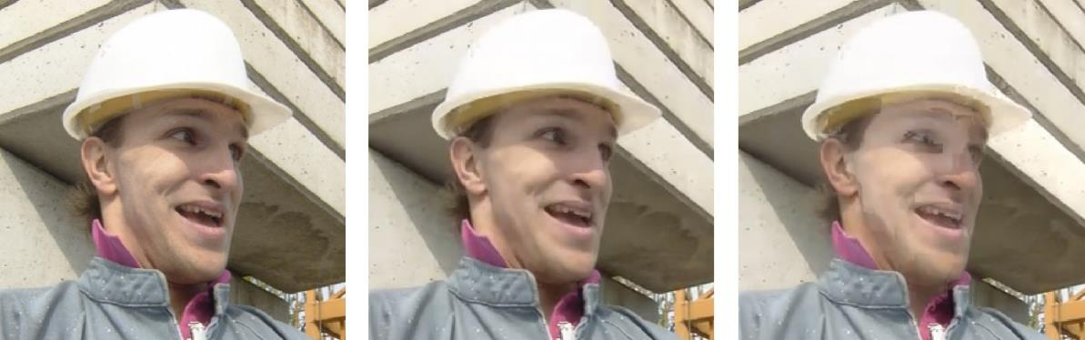
Inexact computing
4.00000013
3.14159265
2
+
2

Slide 16
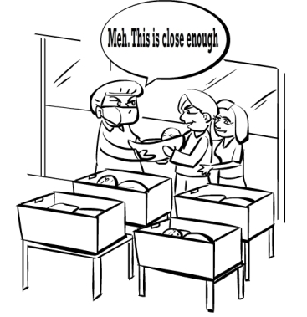
Is inexact computing acceptable?

Slide 17
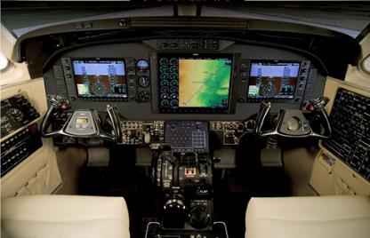
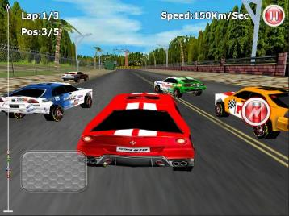
What is good enough?
It depends on
  the type of computation
  the application domain
  subjective perceptions

Slide 18
Energy vs. error rate
Energy (Voltage)
Computation
time
Errors

Slide 19
Computing with errors
checkpoint
check
CP
Comput. 1
C
CP
Comput. 2
C
R
Comput. 2
C
CP
Comput. 3
good enough
(go ahead)
wrong
(go back)
correct
(go ahead)
weak memory
(low energy)
Recover
Checkpoint
strong memory
(mostly sleeping)

Slide 20
How to check: Certifying algorithms
Source: R.M. McConnell, K. Mehlhorn, S. Näher, P. Schweitzer,
Certifying Algorithms. Computer Science Review 5(2): 119-161 (2011)

Slide 21
Example: sorting
V:
43 | 3 | 14 | 36 | 52 | 23 | 13 | 4 | 22 | 9 | 29 | 7 | 38 | 1 | 47 | 8
Sorting: O(n log n)
V’:
1 | 3 | 4 | 7 | 8 | 9 | 13 | 14 | 22 | 23 | 29 | 36 | 38 | 43 | 47 | 52
  Check:
    V’ is sorted: O(n)
    V’ is a permutation of V: O(n),
    using hashing

Slide 22
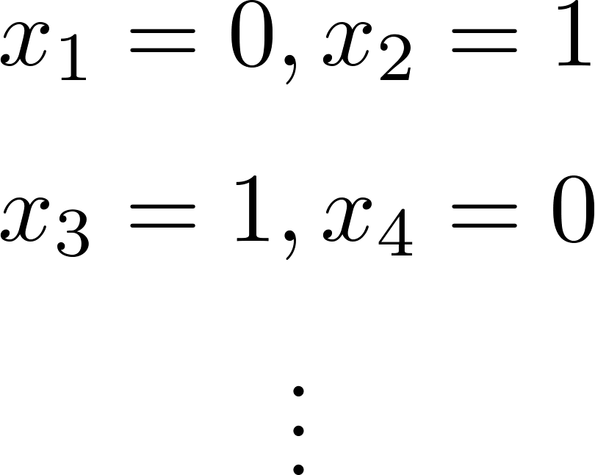
Example: SAT
Is it satisfiable? (NP)
Is is unsatisfiable? (co-NP)
UNSAT
How to check?
Run reliable SAT (high energy), or
Re-run unreliable SAT
(increase probability of correct answer)
Check: O(n)

Slide 23
Conclusions
Energy should be a first-class citizen in algorithm design and analysis
Modern computing should be energy-aware:
Accuracy vs. Sustainability
New programming paradigms are required
to live with inexact computations:
<Algorithm, Certificate, Check>

Slide 24
Some bibliography
Krishna V. Palem, Lingamneni Avinash. Ten Years of Building Broken Chips: The Physics and Engineering of Inexact Computing. ACM Trans. Embedded Comput. Syst. 12(2s): 87 (2013)
Gary Anthes. Inexact design: beyond fault-tolerance. Commun. ACM 56, 4 (April 2013), 18-20.
Jaeyoon Kim and Sandip Tiwari. Inexact computing using probabilistic circuits: Ultra low-power digital processing. J. Emerg. Technol. Comput. Syst. 10, 2, Article 16 (March 2014).
R.M. McConnell, K. Mehlhorn, S. Näher, P. Schweitzer, Certifying Algorithms. Computer Science Review 5(2): 119-161 (2011).
Computing device using inexact computing architecture processor,
Patent US 20110321067 A1

Slide 25
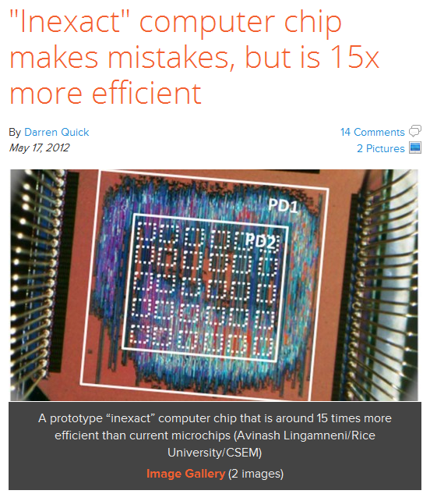

Slide 26
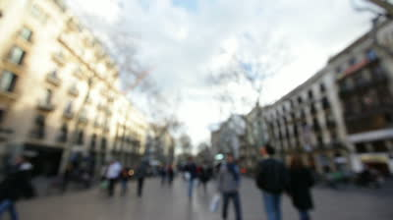
Thank you

