Slide 1

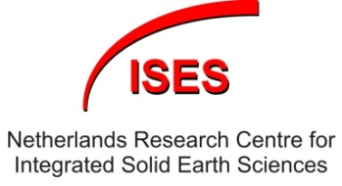

Geothermal Energy: the underlying geosciences base
The Future of Science and the Science of Future
March 4 2015
Sierd Cloetingh¹
Jan Diederik van Wees^{1,2}
Fred Beekman¹
¹ Tectonics Group
Dept. of Earth Sciences
Utrecht University
² TNO
Utrecht, The Netherlands
Notes:
Today we are in an energy transition. The earth itself has much to offer here, especially in view of rapid advances made in the last decades in better process understanding in how the earth works. Apart from hosting geo-resources such as hydrocarbons and fresh water, the system Earth provides us also with a formidable heat engine.

Slide 2
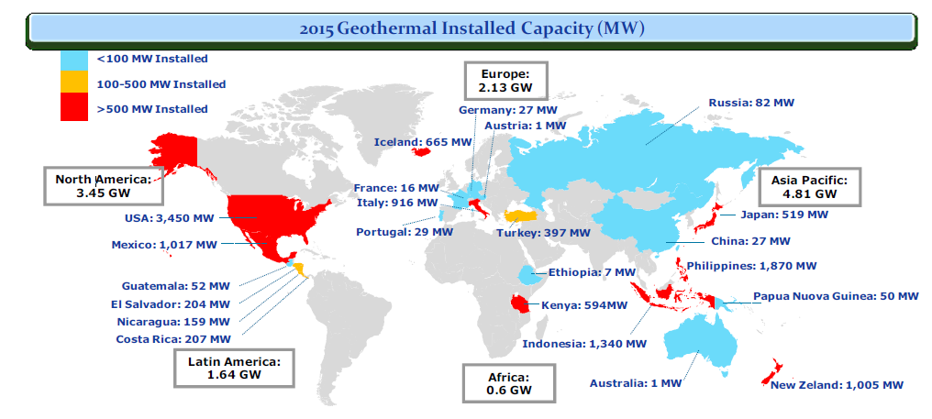
Geothermal resources and their growth
Bertani, World Geothermal Congress 2015
Notes:
Like everything in the Earth subsurface, the geothermal resources are unevenly spread. Some countries like Iceland and Indonesia -places where abundant volcanic activity already points to ascend of hot material from the deep earth to the earth’s surface- possess large resources and many potential for future growth. Other areas, in particular geologically older interiors and no longer tectonically active parts of the continents have less to offer.

Slide 3
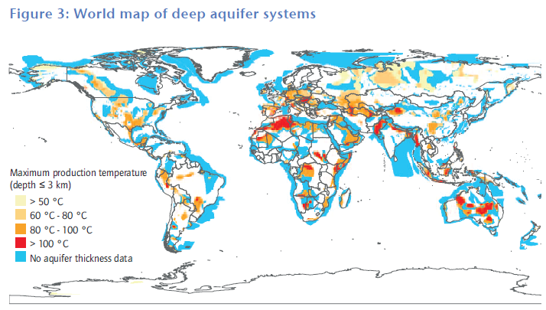
IEA roadmap of geothermal Energy
Notes:
Who speaks about geothermal energy also speaks about water. This map shows the world’s deep aquifer systems, revealing the existence, in some areas, of very high temperatures in aquifer systems. Reaching more than 100˚ C at less than 3 km depth.

Slide 4
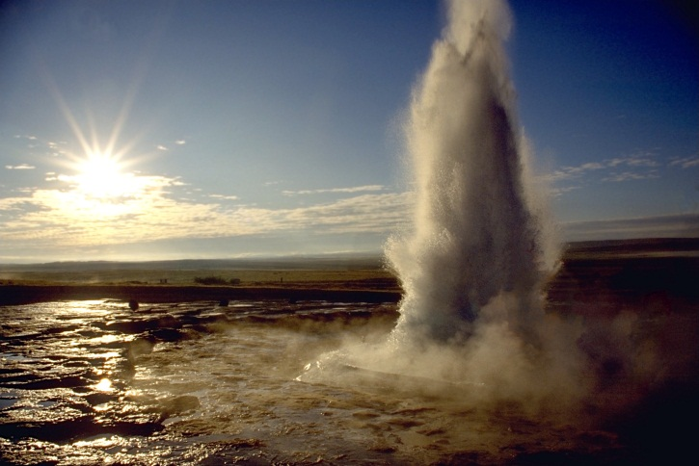
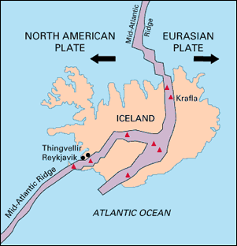
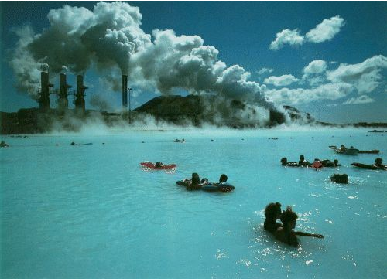
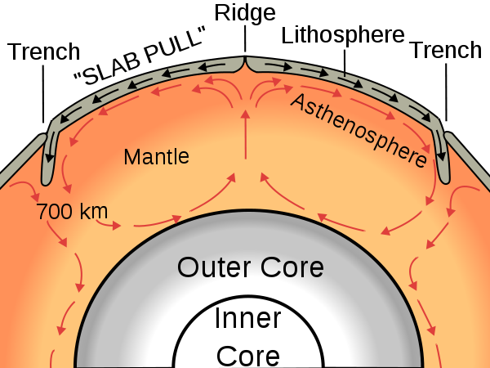
Ridge -
Iceland
Blue Lagoon (Iceland)
Notes:
Iceland, located on top of the north-Atlantic ridge, is the site where hot mantle is ascending up to the surface with spectacular expressions, sometimes also with less positive impact on for example air traffic.

Slide 5
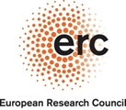
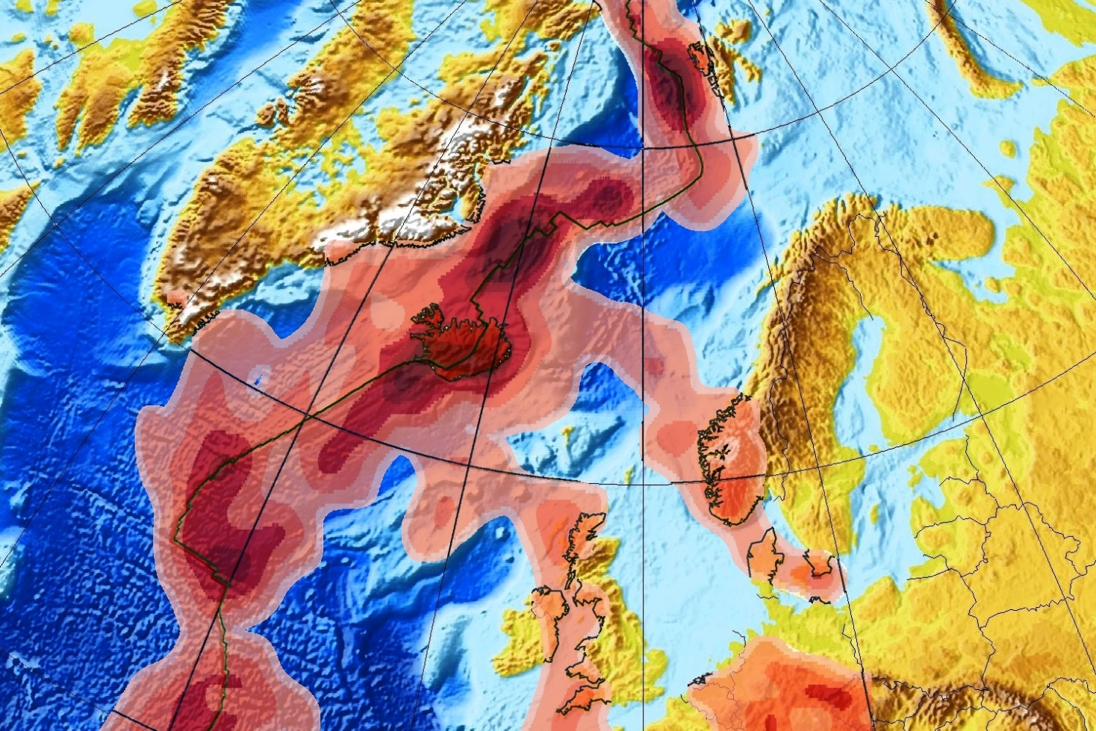
Intraplate deformation: plumes
Plumes in the upper mantle resolved from seismic tomography (in the Northern Atlantic, depth slice between 100 – 200 km)
Rickers et al., 2013.
EPSL.
Notes:
Recent advances in seismic tomography have revealed that these plume systems have side lobes extending from Iceland all the way into the uplifting area of southern Norway, the areas of recent volcanic activity in western Scotland and into the mainland of Central Europe, explaining the recent volcanic activity in the Eifel region of Germany.
This research conducted by prof. Trampert and this ERC funded team has mapped the upper mantle structure in great resolution, detecting seismic velocities a few percent lower (in red) than predicted by a standard model, interpreted as areas of elevated temperatures.

Slide 6
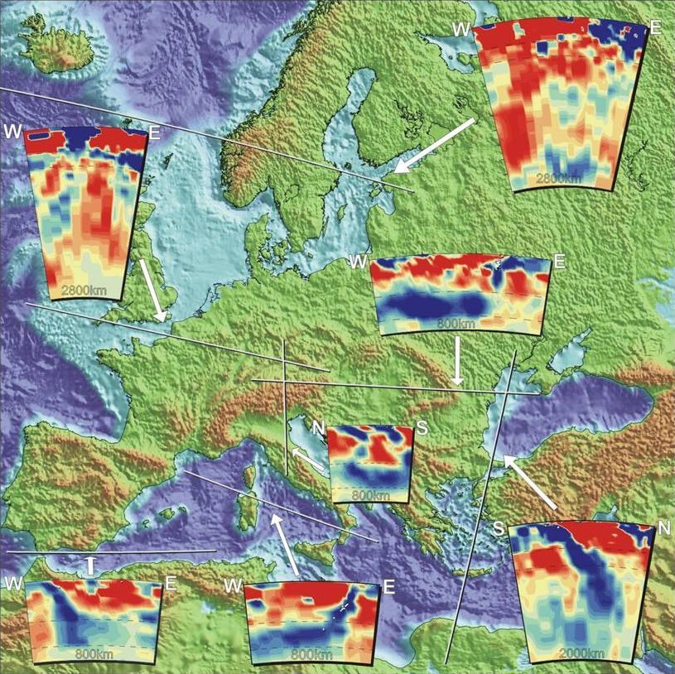
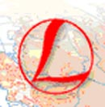
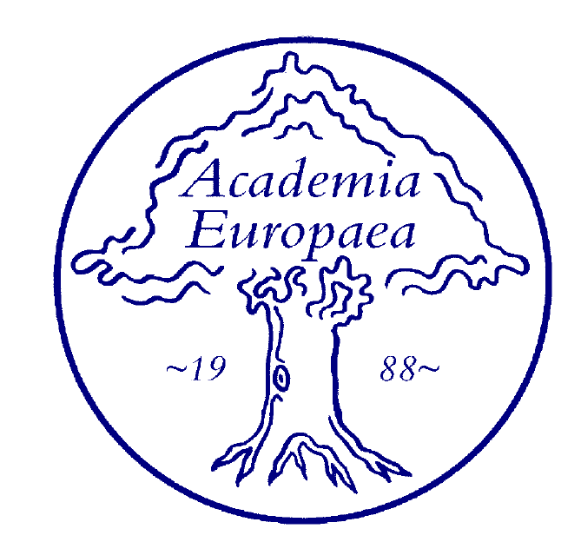

Sierd Cloetingh, Sean Willett
& TOPO-EUROPE team
TOPO-EUROPE
Fundamental Premise
Continental topography is the product of the interaction between processes operating deep in the Earth, on its surface and in the atmosphere
It’s understanding requires a multidisciplinary approach
23 participating countries
14.5 M Euro funding
60 new positions for young researchers
INTERNATIONAL LITHOSPHERE PROGRAM
Notes:
This is another set of tomographic images, to a depth of 600km, this time from prof. Wim Spakman, also from Utrecht University. Showing slabs going down (in blue) at the subduction zones in the Mediterranean region and under the Carpathian Mountains of Romania, overlain by hot areas (in red) like the Hungarian great plain, with great potential for geothermal energy.
Better understanding of the coupling between deep earth processes and the processes operating at the earth surface represent a great challenge for modern Earth-sciences, tackled by the TOPO-EUROPE program.

Slide 7
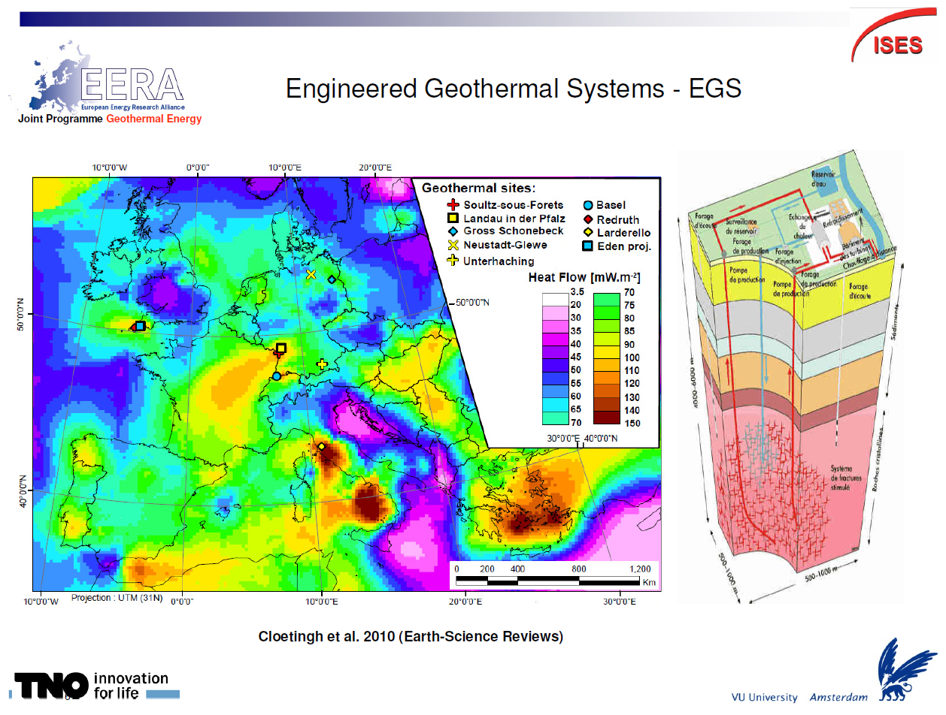
Cross border nature of geothermal energy
Notes:
Fundamental studies carried out in the framework of projects such as TOPO-EUROPE have generated insights into the presence or absence of geothermal energy potential. Key, for Enhanced Geothermal Systems (EGS) where water is injected in deep wells to be heated in fractured reservoirs.

Slide 8
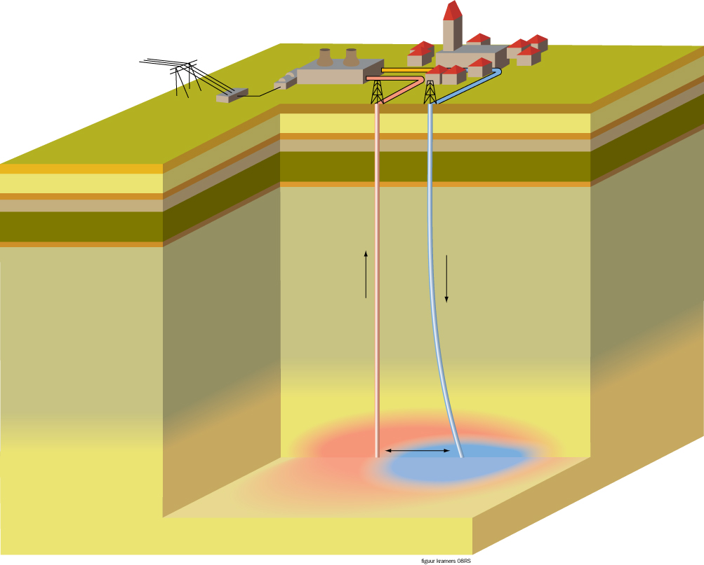
Geothermal power:
MIT report , 2007: Future of geothermal energy
Notes:
The energy efficiency is directly coupled to production temperatures implying the need for deep drilling.

Slide 9
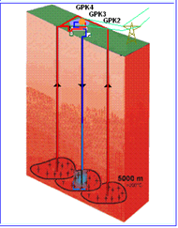
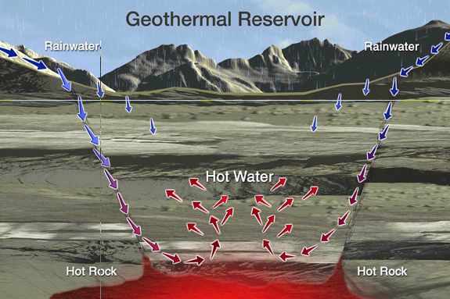
_{Geothermal energy:}
_{Natural flow}
_{Conventional}
_{power}
_{conventional heat}
_{Greenhouses NL}
_{EGS 2020}
_{Depth [ km ]}
supercritical
_{EGS}
_{EGS 2050}
_{Temperature [°C]}
Notes:
For enhanced geothermal energy systems this means that with increased ability to drill deeper, its impact as a main contributor to energy supply will substantially increase in the coming decades.

Slide 10
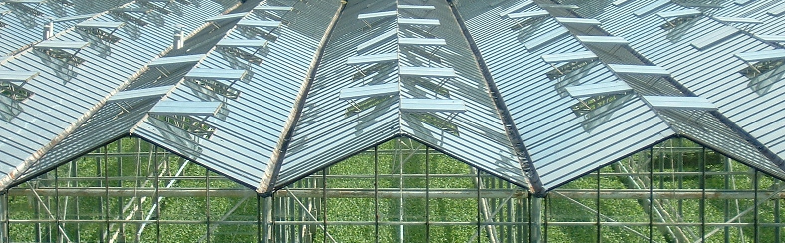
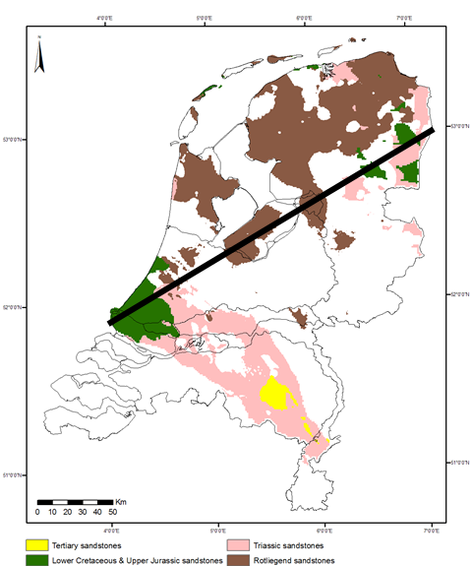
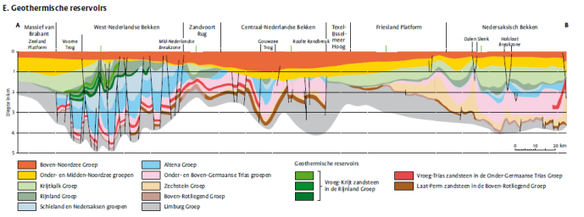
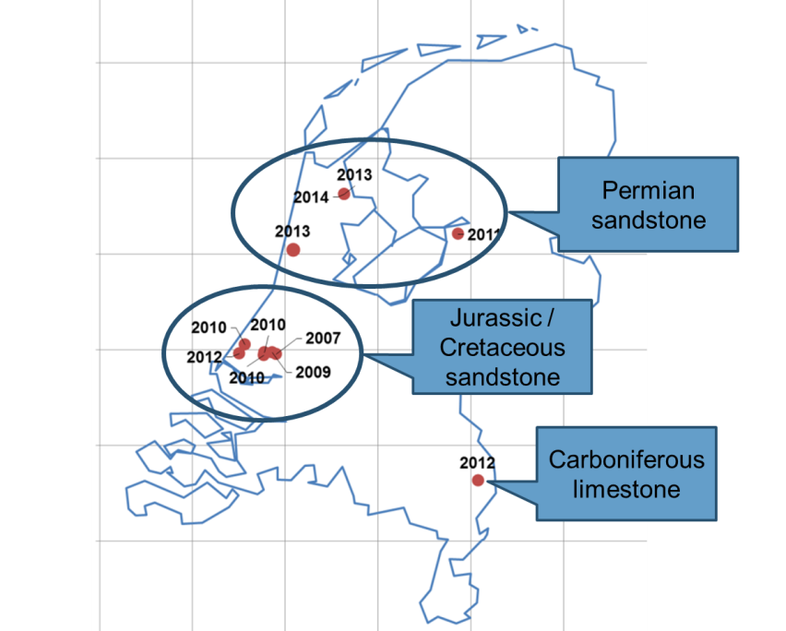

Geothermal Energy in the Netherlands
Key: deep subsurface data and information www.thermogis.nl
→boom in doublet systems (year) for green house heating
Notes:
Knowledge of the subsurface structure is key in this respect. The Netherlands, explored in great detail for its oil and gas reservoirs, has a subsurface mapped in great resolution. It is this knowledge base that has been vital in the technology transfer for use in geothermal energy production such as here for the heating of greenhouses in the western part of the Netherlands.

Slide 11
Nonlinear innovation
Basic research
Public finance
Targeted research and development
Mainly public finance
Demonstration and Industrialisation
Mainly private finance
EERA
Maturity of Concept
Cost
Notes:
The European Energy Research Alliance (EERA), in which TNO and Utrecht University participate with other European partners, is deeply involved in this non-linear innovation.

Slide 12
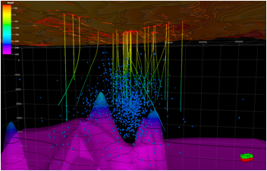
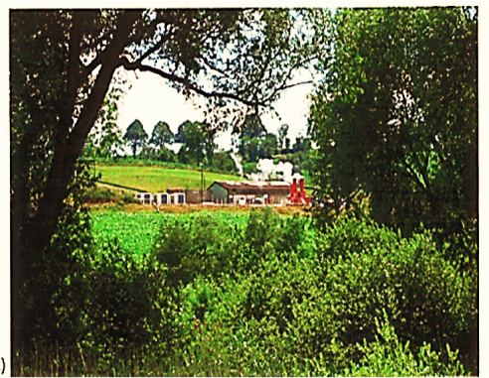
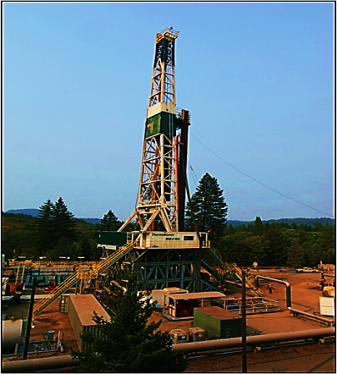
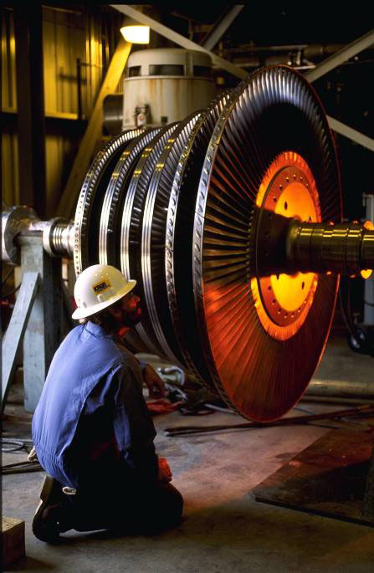
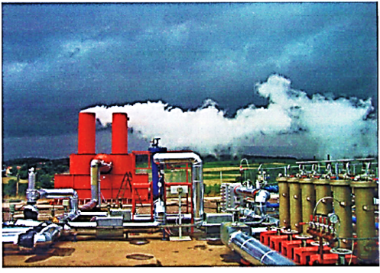
Joint Programme of Geothermal Energy
SP1
Resource Assessment
SP2
Accessing and engineering a reservoir
SP 3
Process engineering of power system
SP4
Operation and management of geothermal systems
SP5
Sustainability, enviroment and regulatory framework
_{Overall goal}
_{Development of new}
cost– effective technologies suitable for a sustainable growth of geothermal energy in Europe and worldwide
Notes:
As you can see here this joint program of geothermal energy has a very integrated nature.

Slide 13
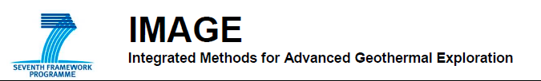
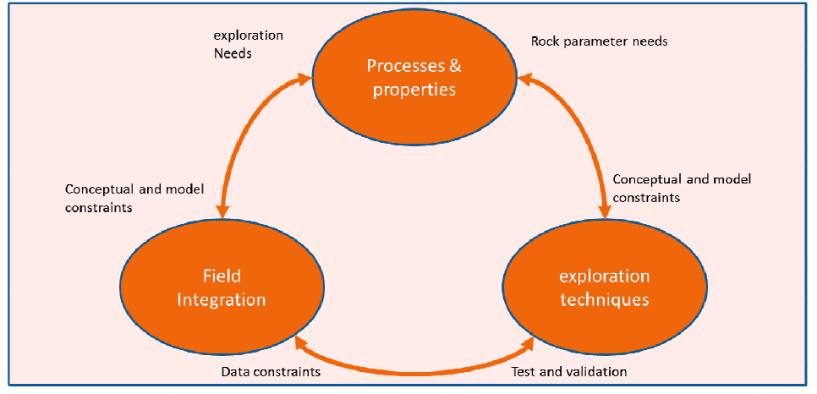
13.5 MLN
Notes:
The same is true for this IMAGE project on Integrated Methods for Advanced Geothermal Exploration, part of EU FP-7 program.

Slide 14
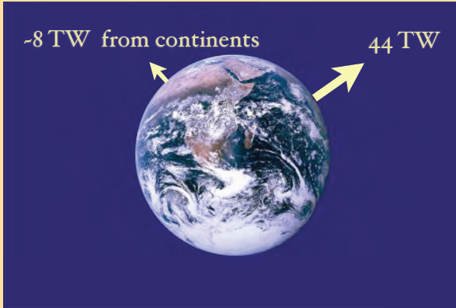

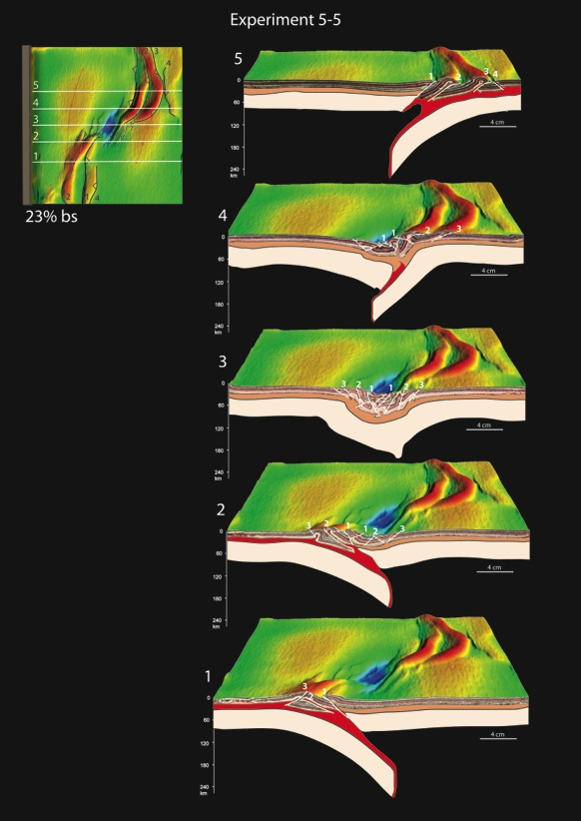
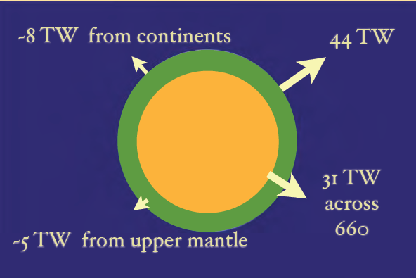
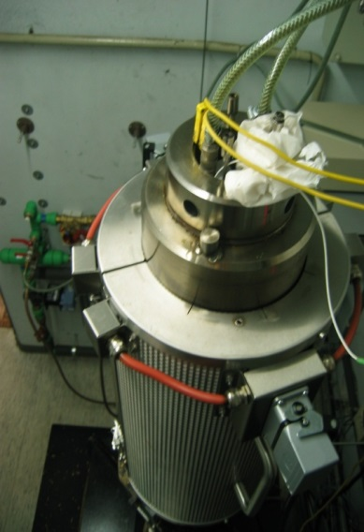
World class fundamental research to understand the heat engine ➔ Linking small to large scales
Tomography
Imaging/
validation
Triaxial cell
models
Rock deformation
characteristics
Multi-scale geodynamic
models
Notes:
World-class fundamental research is a must to unlock the great potential for geothermal energy. By nature this research should be multi-scale linking seismic imaging, monitoring earth processes, experimental modeling of tectonic processes, numerical modeling and rock physics experiments.

Slide 15
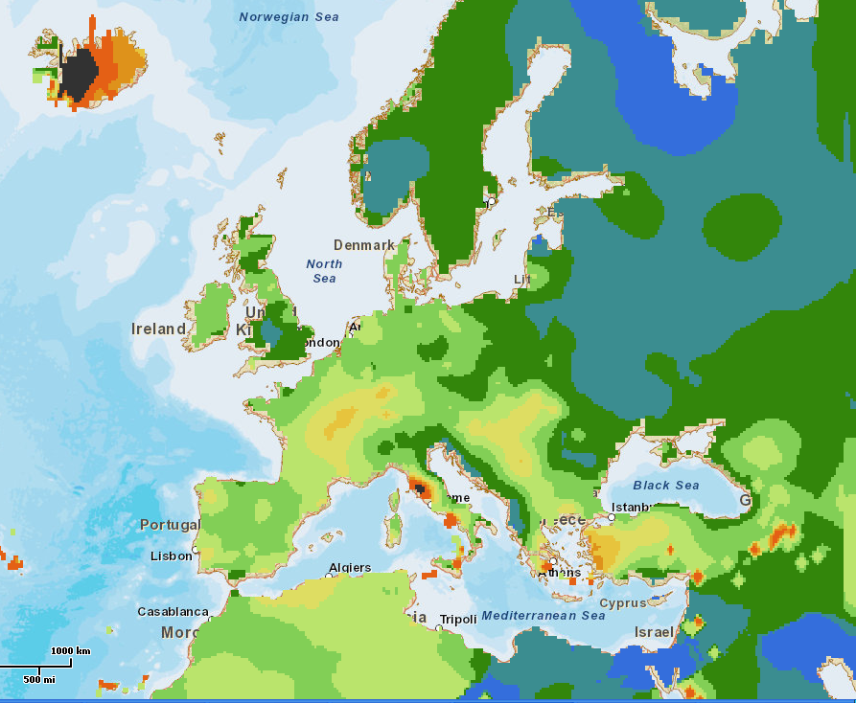
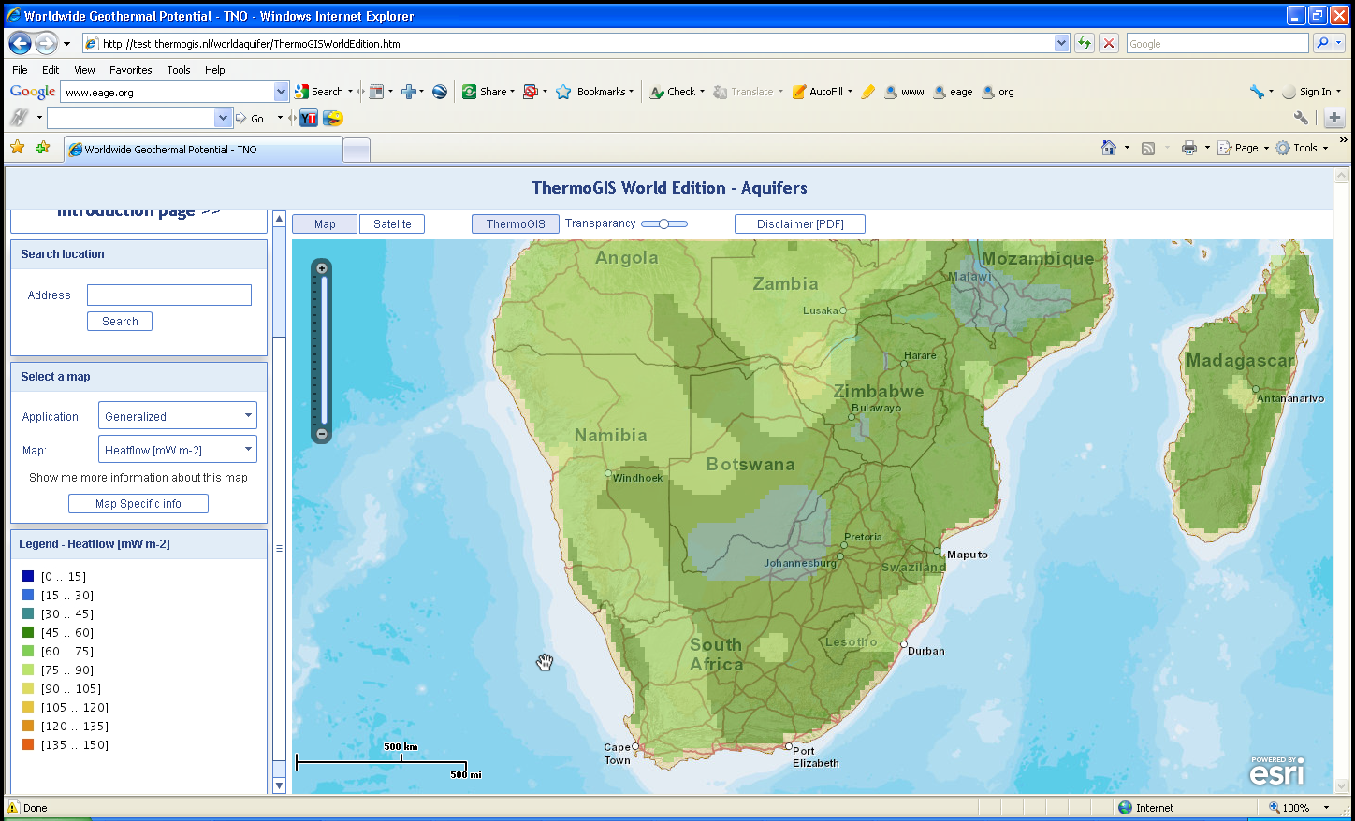
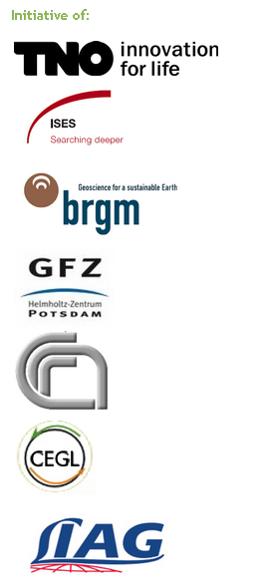


Surface heat flow as indicator for deep temperature
15C/km
30C/km
45C/km
60C/km
>75C/km
Notes:
This surface heat flow is a direct indicator for deep temperature. Note the sharp NW-SE trending boundary between relatively hot western and central Europe and the eastern European platform with low temperatures.

Slide 16
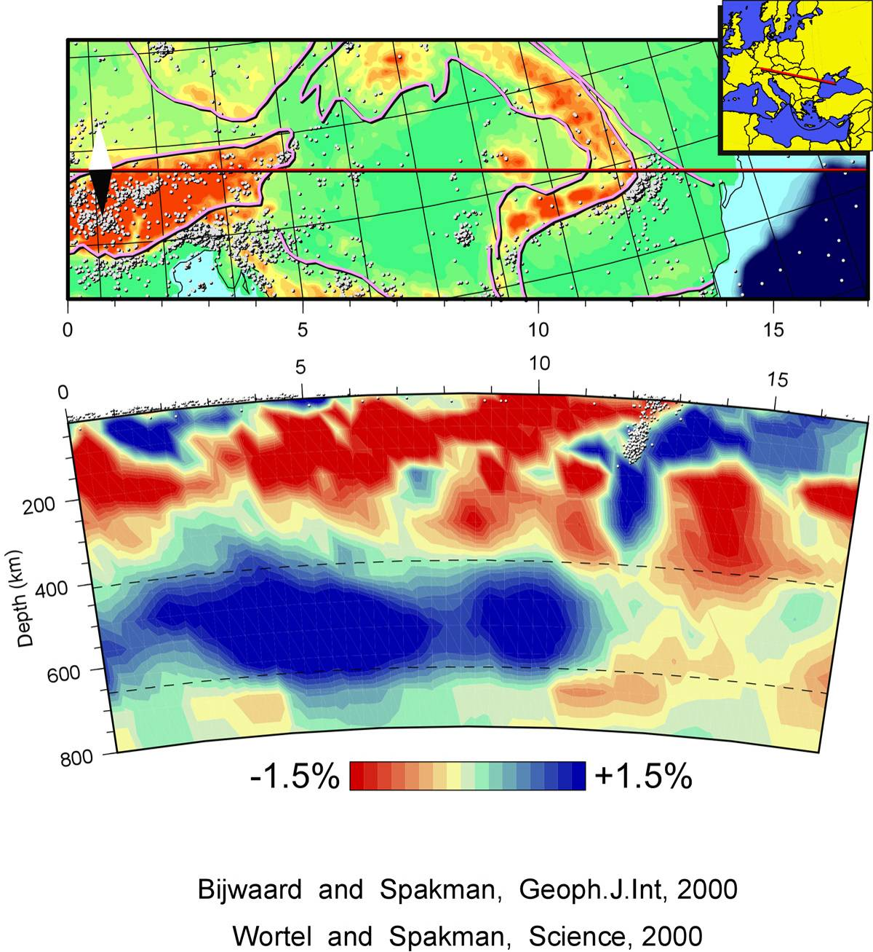
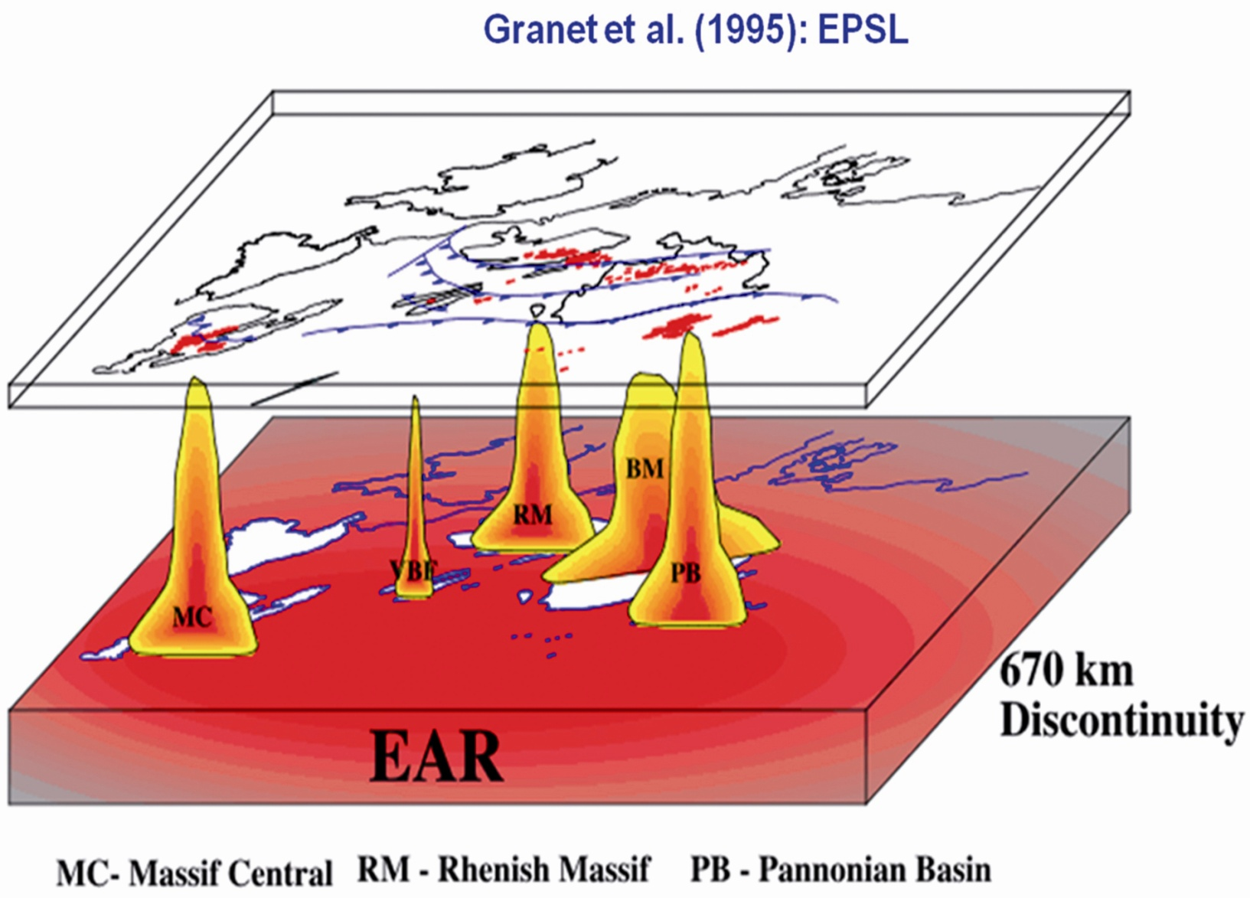
Notes:
Here we see that the areas with high temperatures at depth of a few kilometers are underlain by areas of mantle upwelling from depths up to 600-700 km. Like under the Massif Central of France, the volcanic areas of Tuscany, the Hungarian plain and the Aegean area.

Slide 17
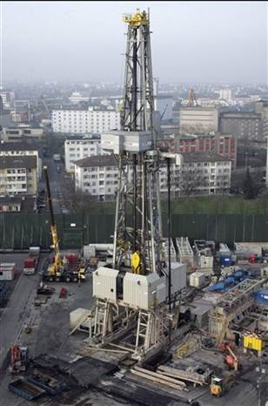
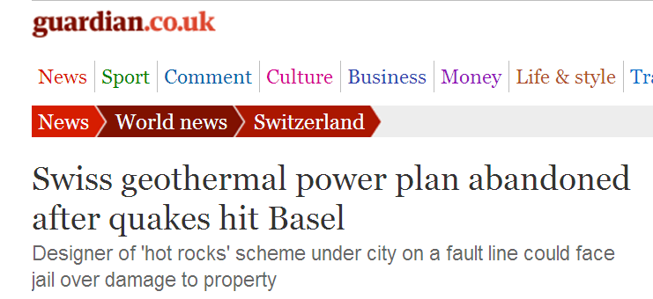
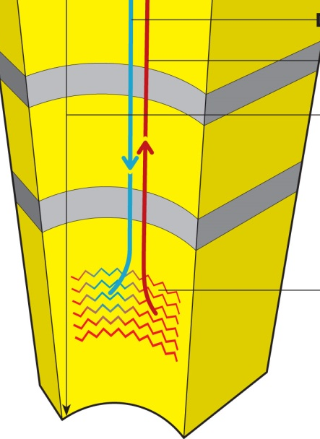
BASEL: Enhanced Geothermal System
Notes:
Like everything we do as humans in the subsurface, we operate in a system which has its own natural dynamics. In deep geothermal energy production, drilling can lead to induced seismicity and in the case of Basel it actually did, leading to abandonment of the geothermal power plan.

Slide 18
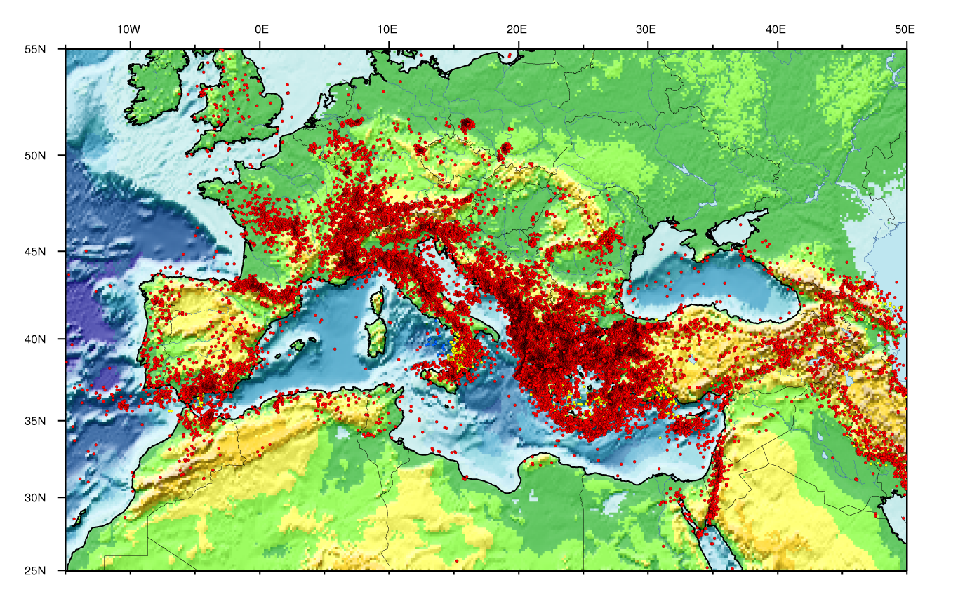
Cross-border nature of earth sciences
Natural hazards occur everywhere and do not respect national borders
Notes:
Natural hazards, including earthquakes (in red) occur everywhere and do not respect national borders. They are not limited to plate boundaries but also occur in the plate interiors.

Slide 19
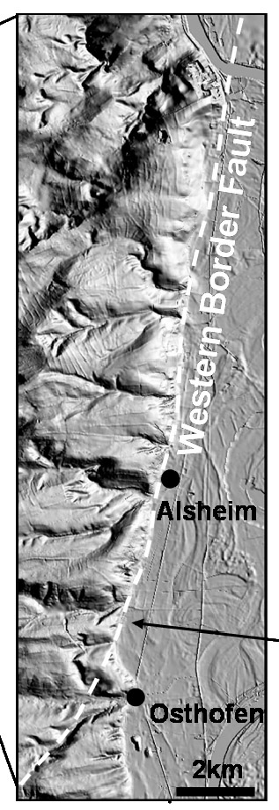
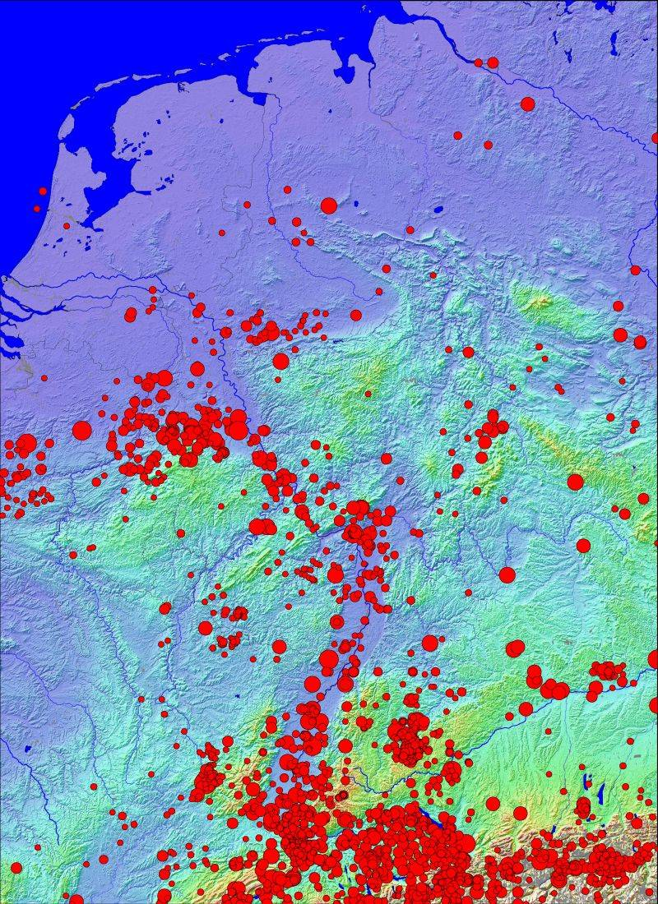
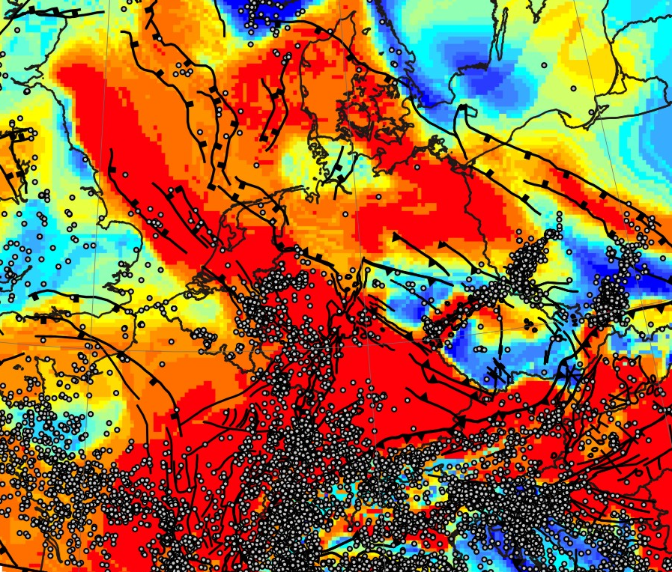
Neotectonics and crustal strength: The NW European foreland
trench site
Correlation between seismicity and crustal strength (Cloetingh et al., 2006, ESR)
Neotectonics and geomorphology (Peters et al., 2005)
Seismicity of the North-European Platform
Notes:
They do not occur random but are localized in weak areas (in red) or even more in areas where a contrast occurs in crustal strength between weak crust (in red) and strong crust (in blue) such as here in the NW European foreland of the Alps (left). The seismicity here is concentrated in the Rhine Rift, the major traffic corridor between the Netherlands and Switzerland (right). Deep-seated earthquakes (with depths up to 25km) occur primarily at the master faults bounding the Rhine rift with a steep geomorphic expression (center).

Slide 20
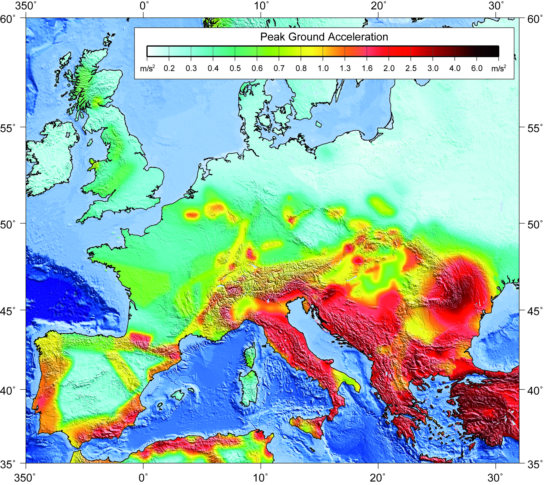

PGA hazard map
Return period
failure
Increase stress due to subsurface operation
Seismic Hazard Map of Europe as part of the Global Seismic Hazard Map (Giardini et al., 2003; Grünthal et al., 1999). The map depicts the seismic hazard as Peak Ground Acceleration (PGA, ms⁻²) with 10% probability of exceedence (or a 90% chance of non-exceedance) in 50 years, corresponding to a return period of 475 years (source GFZ, Oliver Heidbach)
Notes:
This seismic hazard map of Europe identifies the areas with enhanced seismic hazard in terms of peak ground acceleration. The return period for intraplate earthquakes is much longer than for earthquakes at the plate boundaries, with a much longer time for stress build up prior to release by an earthquake.
The weaker and thinner the lithosphere, the higher the stresses induced by tectonic forces will be. Subsurface operations due to engineered geothermal energy production will increase the natural stress field and can shorten the return period.

Slide 21
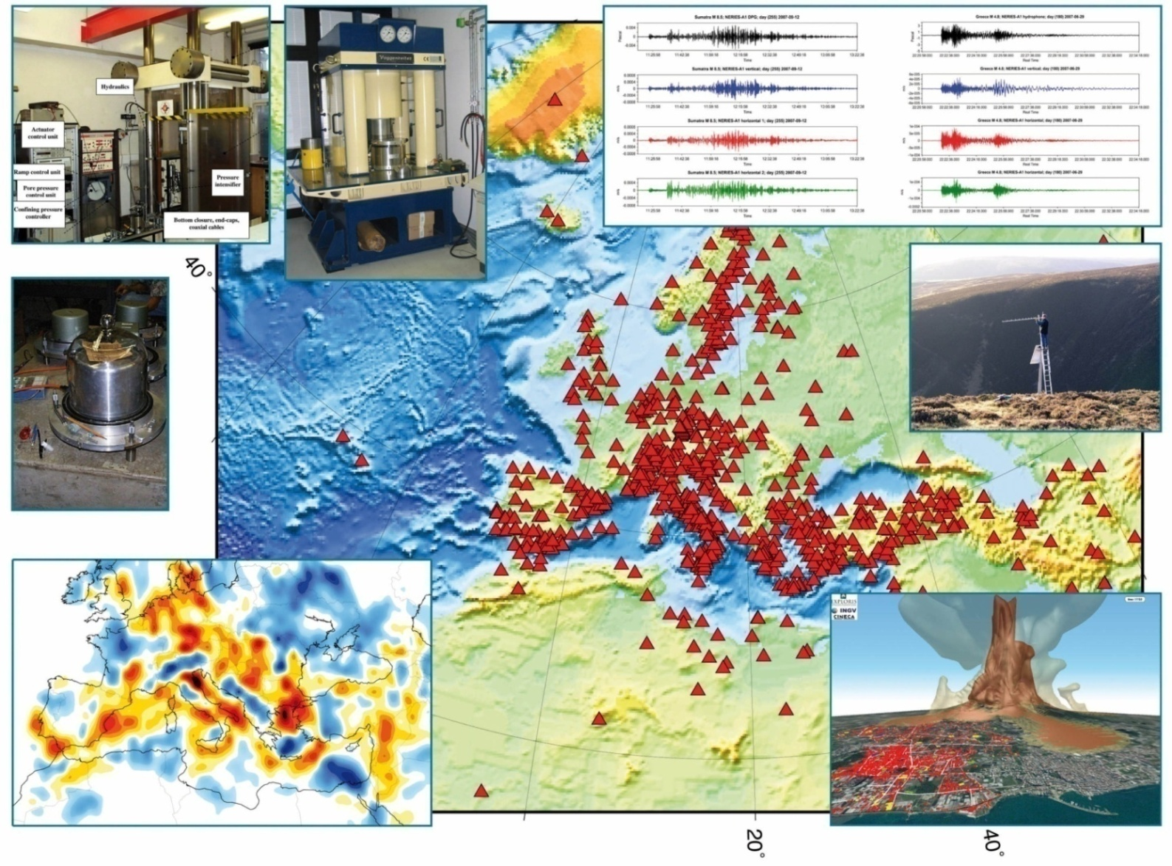


ESFRI
Notes:
The research community in sold earth sciences in Europe has set up a European Plate Observing System (EPOS) to monitor earthquakes, volcanoes, surface dynamics and tectonics for the whole of western and central Europe. EPOS is part of the European large-scale scientific infrastructure initiative (ESFRI), and its establishment is an important development for monitoring induced seismicity in the context of geothermal energy production.

Slide 22
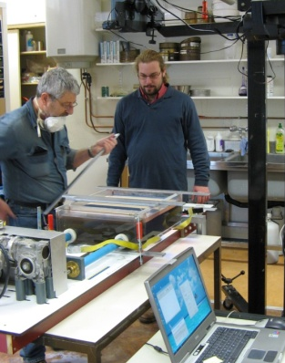
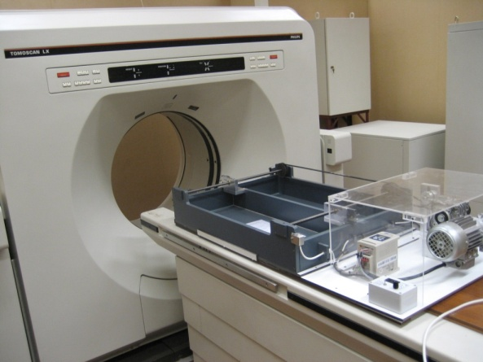
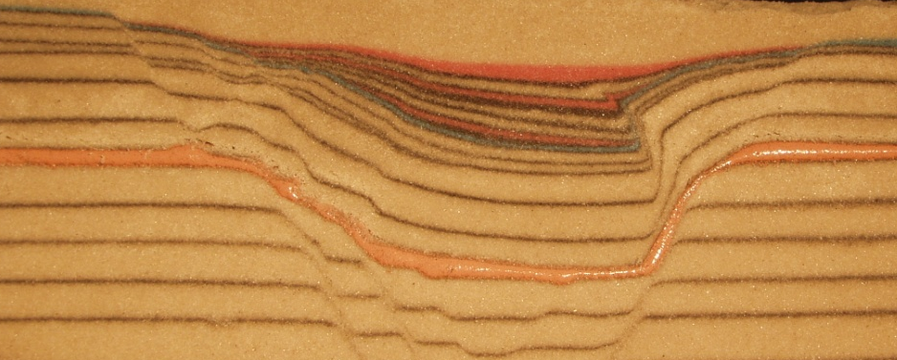
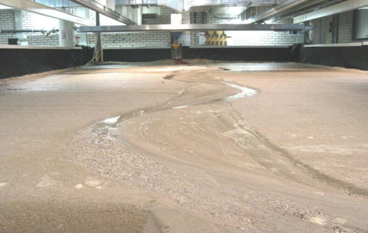
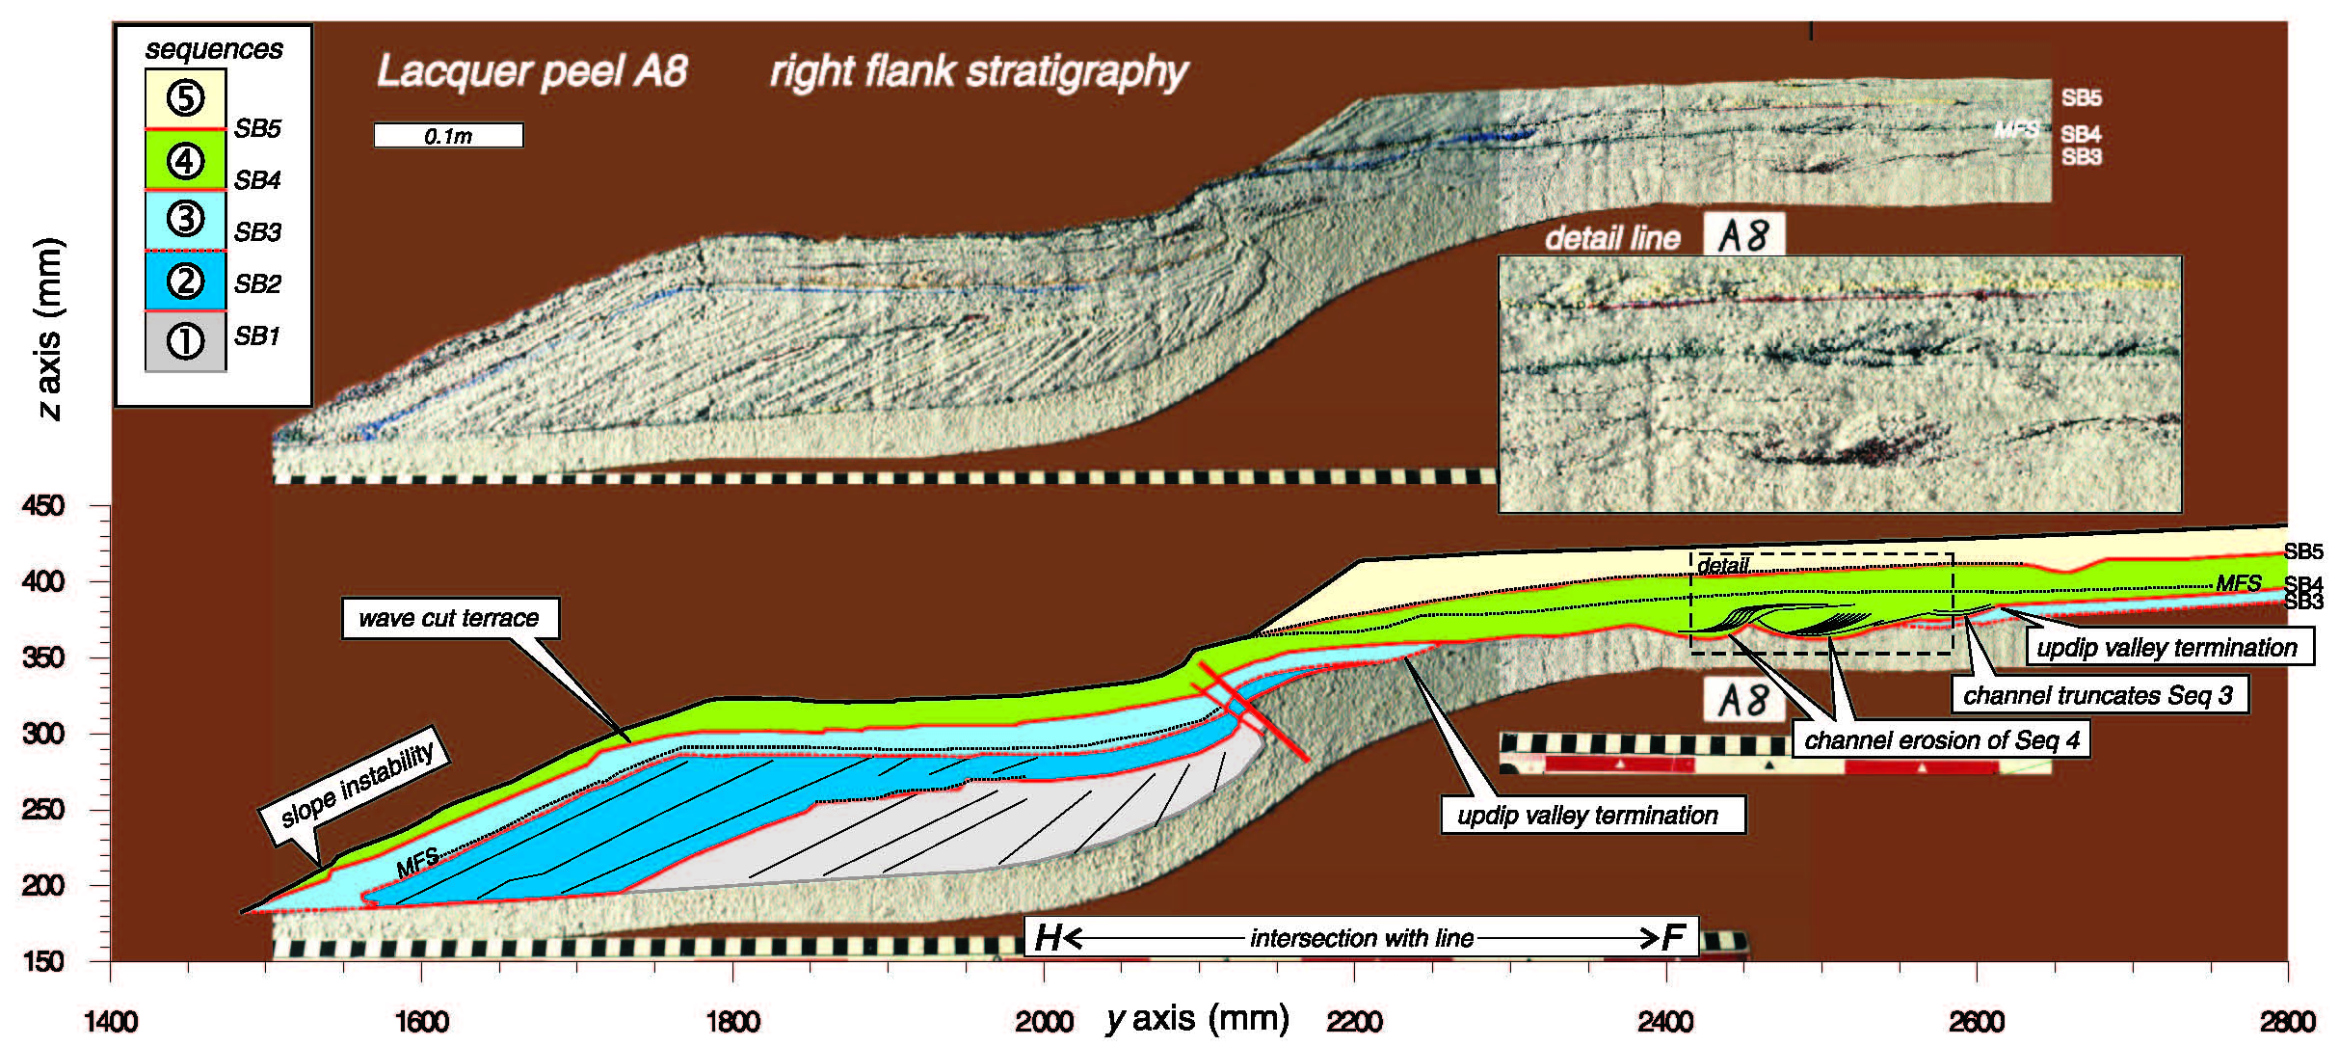

Integrated multiscale experimental facilities
tectonic processes
syn-tectonic sediments
3 cm
TecLab
vertical motions
EuroTank
surface mass transfer
depositional processes
Notes:
The multi-scale experimental facilities of the earth simulation lab (ESL) in Utrecht are part of EPOS. ESL includes the experimental tectonic modeling laboratory (TecLab) (top) where faulting and rift formation processes are modeled leading to vertical motion, affecting sedimentary processes in delta systems, modeled in the EuroTank (bottom).

Slide 23



PPP with strong participation of IND stakeholders
At the interface of academic and industry challenges
Embedding in academic curricula
Towards Subsurface databases
www.geocap.nl
Notes:
The results of these European research efforts now also relevant for countries outside Europe. An example is the Geothermal Capacity Building Program (GEOCAP) where Dutch institutions share their expertise in geothermal energy research and education with Indonesia for unlocking the great potential of geothermal energy in Indonesia.

Slide 24
Sierd Cloetingh, Sean Willett
& TOPO-EUROPE team
TOPO-EUROPE
Fundamental Premise
Continental topography is the product of the interaction between processes operating deep in the Earth, on its surface and in the atmosphere
It’s understanding requires a multidisciplinary approach
23 participating countries
14.5 M Euro funding
60 new positions for young researchers
INTERNATIONAL LITHOSPHERE PROGRAM
Notes:
Important is the further development of the science base for future applications, requiring a long-term perspective such as developed in the TOPO-EUROPE program. TOPO-EUROPE was initiated through a joint effort of Academia Europaea, the International Lithosphere Program and the European Science Foundation.

Slide 25


10th TOPO-EUROPE workshop 2014
Interplay between surface, lithospheric, and mantle processes
Barcelona, September 17-19, 2014
Venue: CosmoCaixa, Science Museum Barcelona
Notes:
Last year TOPO-EUROPE had its 10th annual workshop in Barcelona it continues to serve as a platform for integrated solid earth science with a strong involvement of members of Academia Europaea.

Slide 26

Origins & Mission
Formed in 1988 as an international not-for-profit charitable organisation headquartered in London, and now with new regional hubs (Wroclaw 2011, Barcelona 2012, Bergen 2014). The AE covers all disciplines and fields of the Applied and Natural Sciences; Social Sciences, Humanities and Letters.
Mission
Encourage interdisciplinary and international research in all areas of learning, particularly in relation to European issues.
Identify topics of trans-European importance to science and scholarship, and propose appropriate action to ensure that these issues are adequately studied.
Pro-active role as voice for science in Europe, in close partnership with e.g. EASAC, ALLEA, ERC, and national academies
Promoting synergy between Academia Europaea and the Young Academy of Europe
Notes:
Academia Europaea was formed in 1988 and with its broad mission covers all fields of science, including social sciences and humanities.

Slide 27



A pan-European initiative of young scientists and scholars with outspoken views about science and science policy
Notes:
A recent development has been the establishment of the Young Academy of Europe also formed in a bottom-up spirit.

Slide 28


Notes:
Academia Europaea and the Young Academy of Europe meet this year in Darmstadt (Germany). For their annual conference with the theme ‘Symbioses – synergy of humans & technology’, a theme multidisciplinary by its nature.

Slide 29
Conclusions
Geothermal power is cost effective, reliable, sustainable, and environmentally friendly, but historically has been limited to areas near tectonic plate boundaries.
The science base is now rapidly developing to bring geothermal energy into power in plate interiors.
The Future of Scientific drilling for geothermal energy holds the prospect for significantly enhancing its contribution to the global energy transition.
Europe through its excellent natural laboratories, its high level of integrated solid earth science and its links to other science fields fostered by Academia Europaea has a strong potential to be at the forefront of this endeavour.

